Slide 1
Partner Portal Overview Reciprocal Access

Slide 2
Agenda
Partner Portal Overview
Introduce new terminology
Access Management
Member Report Basics
Notes:
Welcome to our new system today we are going to introduce new terminology, discuss how to set up others to have access to our system via Access Management and review the Member Data Report you will access or download to get IMRF Data on our Reciprocal members.

Slide 3
Compatible Browsers
The chart below shows the supported browsers with the Horizon line of business:
IMRF encourages the use of Microsoft Edge and Google Chrome
Notes:
On this slide, we have a chart of supported browsers with IMRF’s new business solution. IMRF encourages the use of Google Chrome and/or Microsoft Edge. For those employers who use an Apple operating system, Safari and Mozilla Firefox are also supported. For your reference, N-2 indicates N as the current version and -2 includes the 2 prior releases. It is important to keep your browsers up-to-date in order to make the reporting process as seamless and efficient as possible.

Slide 4
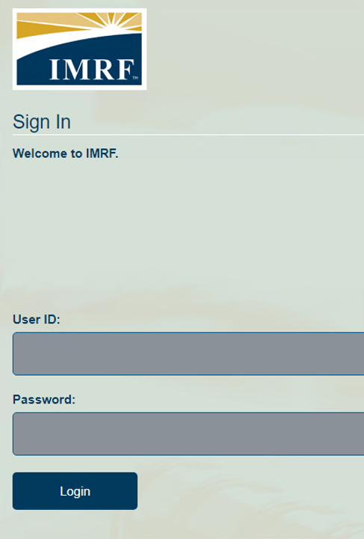
Signing into Partner Portal
Enter your User ID and Password to login to your account.
If you do not have an account, then you will need to register for one.
User ID’s will not be assigned.
If it is your first-time logging in, you need to register for Employer Access
Click the appropriate buttons for help recovering your password or for assistance
Notes:
In the new system, the login process has been streamlined. You will no longer be assigned a unique User ID. When you log in for the first time, you are required to register. The detailed registration process is available as a webinar in the Learning Center of the website. For basic troubleshooting assistance, click on “Need help?” To update or change a forgotten password, select “Forgot your password?”

Slide 5
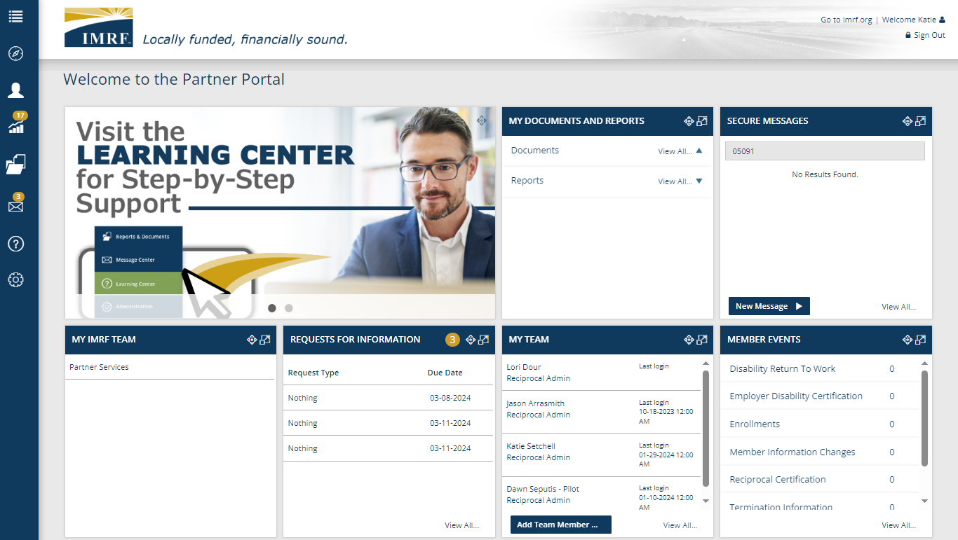
Notes:
Upon your first successful login, your dashboard will resemble the image displayed here. At the top right, you will see a link to go to our website and your name. Directly underneath that line, you have the option to sign out. All the way on the left in blue, you can see the toolbar with icons. The icons in the left-hand toolbar correspond to the tiles on the dashboard. These tiles are called widgets.

Slide 6
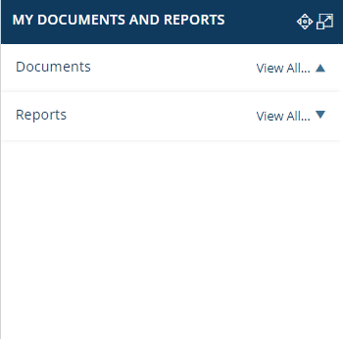
Widget Basics
Title Section, including buttons to move and resize widget
Most of the widgets on the landing page share 3 elements:
Title Section
Data Table
Action Area
Widgets are dynamic. They can be moved around the landing page and expanded as needed.
Data Table
Action Area
Notes:
We will take a closer look at each individual widget in the forthcoming slides, but there are a few elements most widgets have in common: a title section, data table, and an action area. All the widgets are dynamic, which means you can drag and drop the widgets you find most useful to the top of your dashboard by clicking on the directional arrows' icon. These widgets are also expandable with a click of your mouse. Simply click on the icon with two squares and an arrow and the widget will be adjusted to the expanded version.

Slide 7
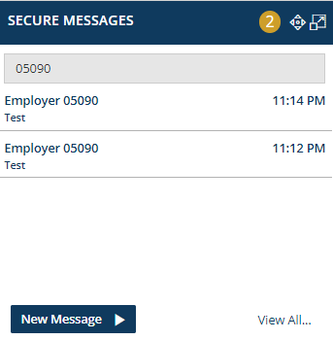
Secure Messages
Communicate with us electronically via the Secure Message Center!
Receive a response within 48 hours
Once a message is opened, it will no longer be new and the number in the gold badge will decrease
After you reply to a message, it is archived automatically
Notes:
This widget will allow you to securely correspond with IMRF electronically. The widget’s title bar will use a numbered gold badge to indicate whether there are new messages to view. The blue action button allows you to quickly start a new message, and View All… takes you to the Secure Message Center landing page. When you send us a message, you can expect a response within 48 hours. It is best practice to have one person on your team handle the secure messaging. This is because a new message that is opened is no longer considered new and will reduce the number in the gold badge, appearing as if there is nothing to read or respond to. After you hit the send button on a reply to a message, the system will automatically archive it.

Slide 8
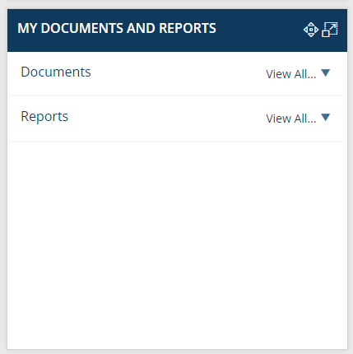
My Documents and Reports
Default widget view will display Documents first, followed by Reports (no documents will show for Reciprocal)
Reports is where you find Reciprocal information on members as you do today.
Click View All or Reports and select IMRF Member Data report
You may navigate via the tool bar by clicking on the folder and selecting Report Generator
Notes:
All icons in the left tool bar correspond with a widget in the main screen. The main widget you will use is the My Documents and Reports widget. Click on Reports and select the ‘IMRF Member Data’ report to view search for a member’s Reciprocal information with IMRF. Or from the left blue toolbar select the folder icon and select Report Generator and click on IMRF Member Data report to search for a member’s Reciprocal information with IMRF.

Slide 9
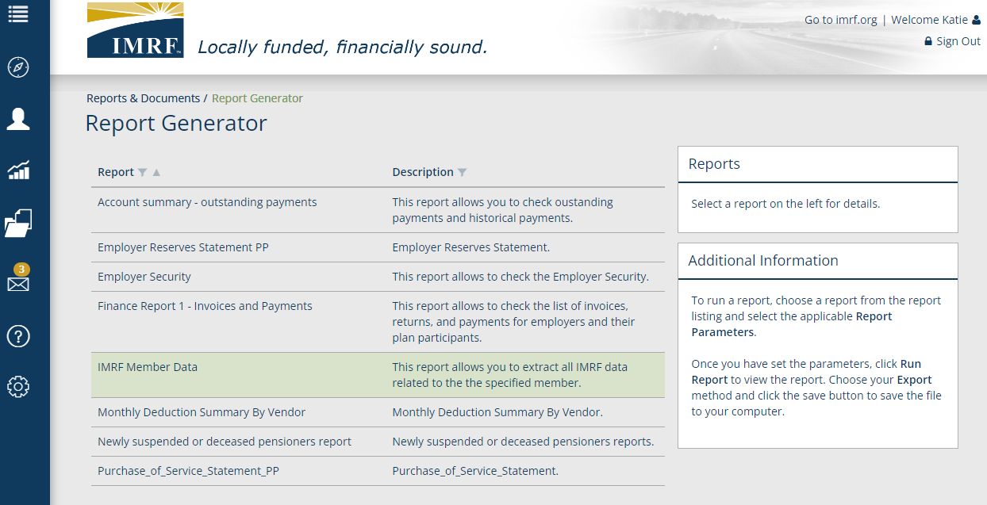
Report Generator
Double click on the IMRF Member Data Report
Notes:
Select the IMRF Member Data report to retrieve details on a reciprocal member.

Slide 10
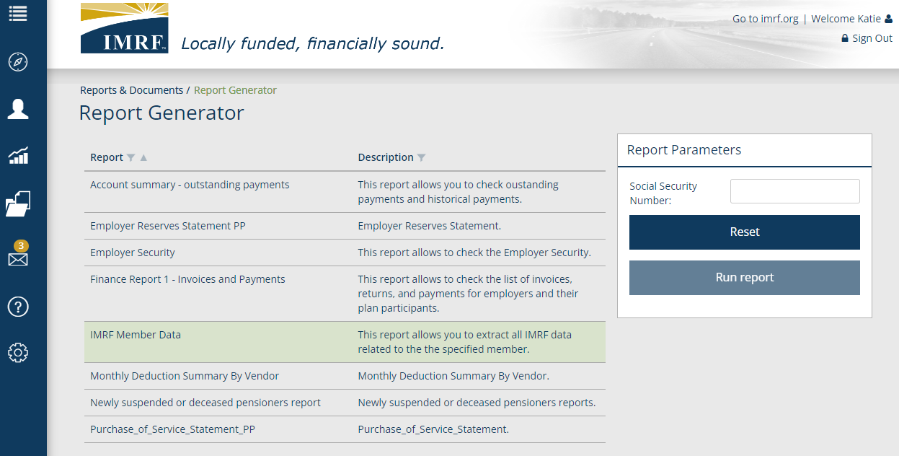
Report Generator
Enter the SSN for the Member you wish to view.
Notes:
Enter the Social Security number of the member you wish to search for and click Run Report.

Slide 11
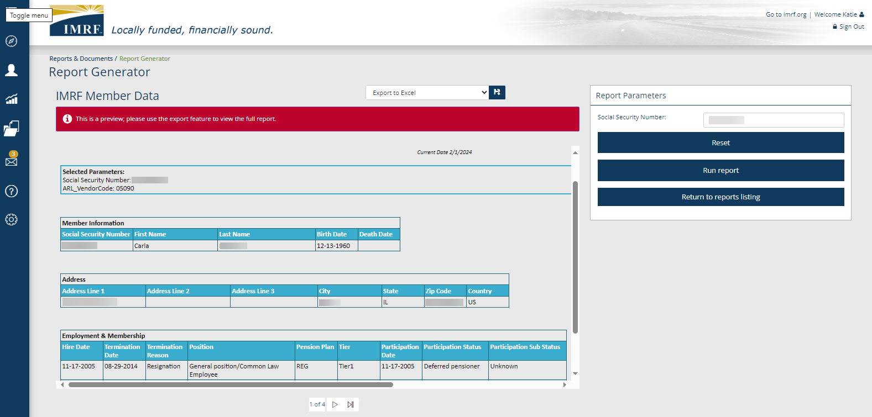
Member’s Personal, Employment & Membership information
Notes:
A report window will show with 4 pages of detail and provide identical data to our previous system. You may view them on screen using the toggle on the bottom to switch pages or you may download the report into an excel for cut and paste options. To view them on screen, use the slider to and scroll bar to view all information in the window. Toggle to page 2 to see their monthly and annual wage history.

Slide 12
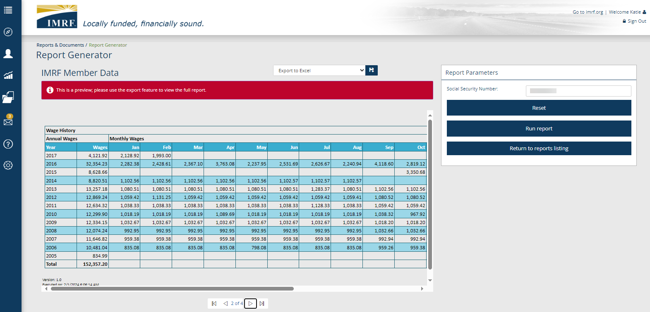
Member’s Monthly and Annual Wages
Annual Wages
Monthly Wages
Notes:
Annual Wages are totaled on the left by year and vertically down or may be viewed by month across.
Use the slider to view all monthly wages. Toggle at the bottom to page 3 to view their Service History.

Slide 13
Member’s Monthly and Annual Service
Annual Service
Monthly Service
Notes:
Annual Service is totaled on the left by year and vertically down or may be viewed across by month.
Use the slider to view all months. Toggle at the bottom to page 4 to view their FRE and Indicators.

Slide 14
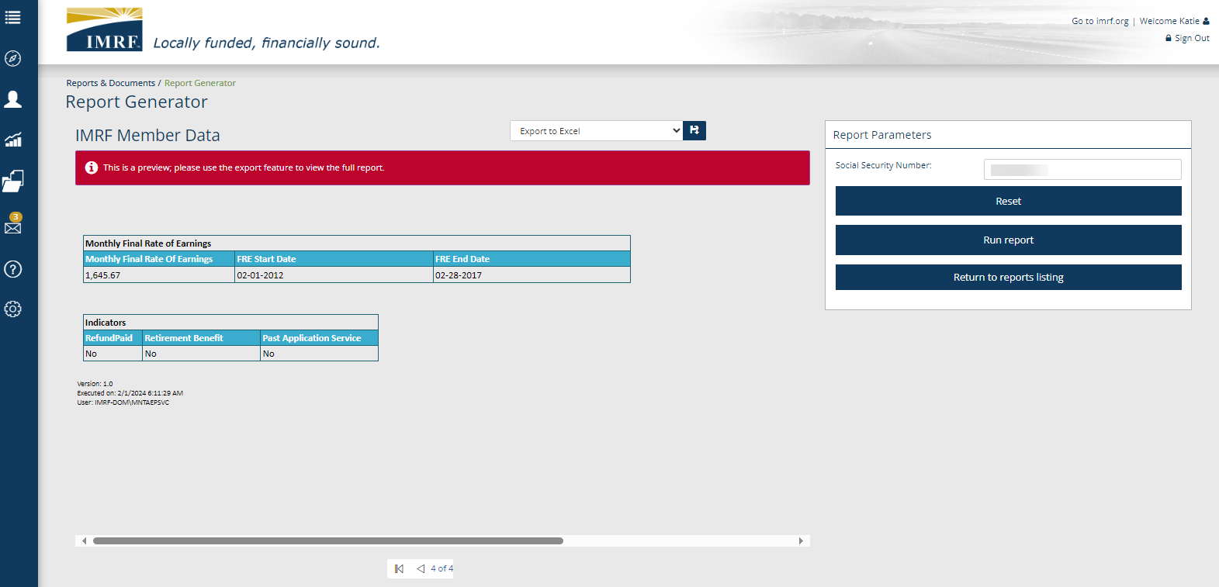
Member’s Monthly FRE and Indicators
Monthly FRE
FRE Start Date
FRE End Date
Indicators for Refund Paid, Retirement Benefit and Past Service Application on file
Notes:
Member’s FRE is at the top left and next to it is the FRE’s Start and End date.
Below are the member’s Indicators for Refund paid, Retirement Benefit and Past Service Application on file. The death indicator is on the first page of the report by their name, so you do not have toggle through the pages.
Click Reset on the right at any time to view another member.
Now let’s review the downloadable version of the report.

Slide 15
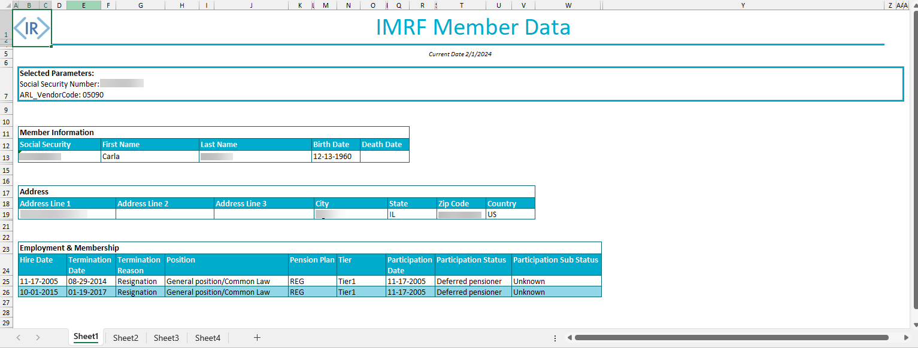
Excel Download of Member Data Report
Member’s Personal, Employment & Membership information
Notes:
If you export the report to your desktop from any of the online screens.
Use the Excel tabs at the bottom to view sheets 1-4.
Page one is the member’s personal detail and employment and & membership information.
Click sheet 2 for the member’s monthly and annual wages.

Slide 16
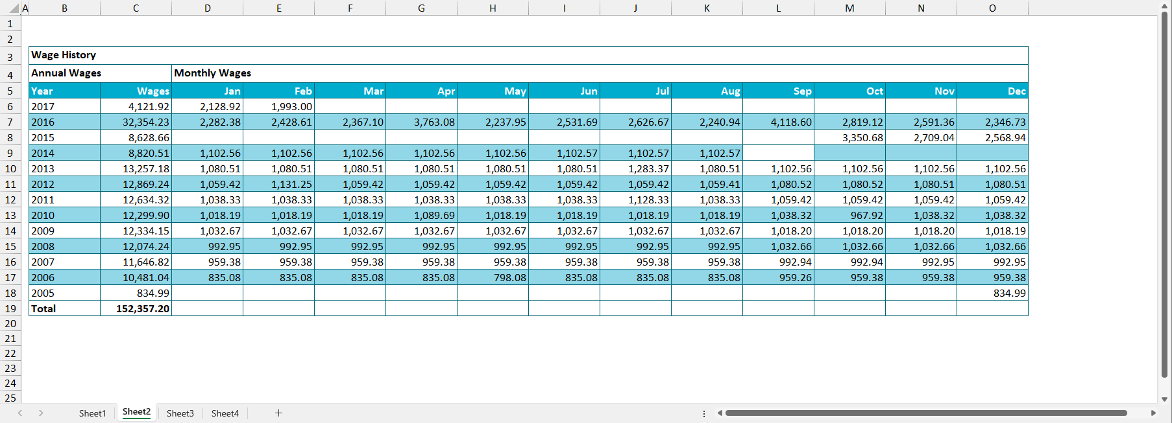
Member’s Monthly and Annual Wage History
Notes:
Sheet 2 is the member’s Wage History. Annual Wages are totaled on the left by year and vertically down or may be viewed by month across.
Click sheet 3 at the bottom to their Service History.

Slide 17
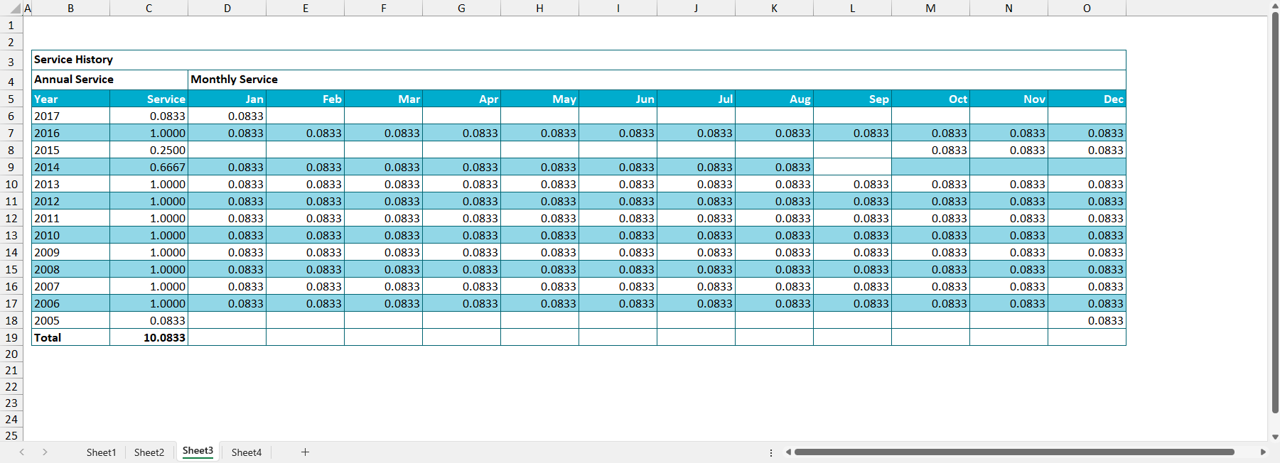
Member’s Monthly and Annual Service History
Notes:
Sheet 3 is the member’s Service History. Annual Service is totaled on the left by year and vertically down or may be viewed across by month.
Click sheet 4 at the bottom to view their FRE and Indicators for Refund paid, Retirement Benefit and Past Service Application on file.

Slide 18
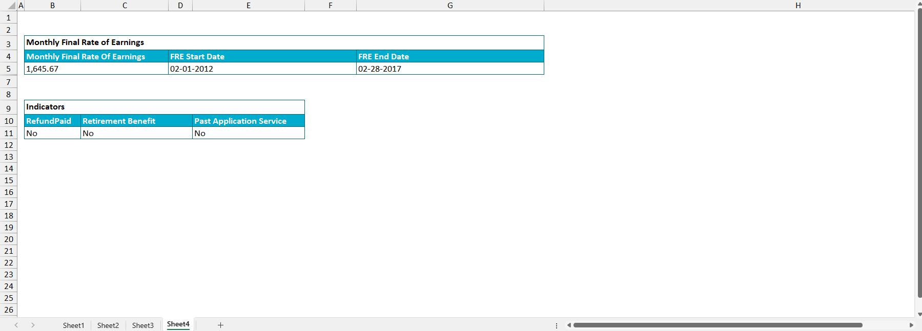
Excel Download of Member’s FRE and Indicators
Notes:
Member’s FRE is at the top left and next to it is the FRE’s Start and End date.
Below are the member’s Indicators for Refund paid, Retirement Benefit and Past Service Application on file.

Slide 19
Access Management
Access Management provides the ability to define user roles based on security within the Partner Access Portal.
Granting a specific user profile comes with the read-only or read-write ability. Furthermore, the same profile also determines which feature the user will have access to.
The security roles can also allow a specific user to take additional actions within the portal that other level of accesses wouldn’t allow.
Each functionality is configurable per profile.

Slide 20
Reciprocal Admin - has access to all Reciprocal member information and may create new users.
Reciprocal All Access - has access to all Reciprocal Member information but they cannot create new users.
Reciprocal View Only - user can view and read information only.
There are 3 different user roles for IMRF Partners.
Notes:
There are 3 different user roles for Third Party Providers in Employer Access.
Recip Admin - has access to Reciprocal Member information and may create new users.
Recip All Access – has access to all Reciprocal Member Information but they cannot create new users.
Recip View Only – user can view and read information only.

Slide 21
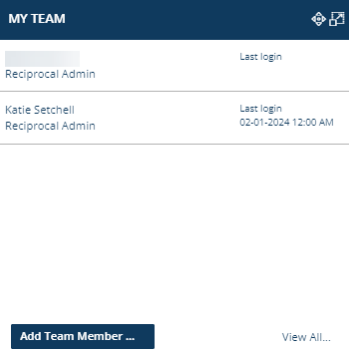
My Team
Partner Roles:
1 Admin per Reciprocal System required, may have multiple All Access and View Only
Each role provides different levels of access
If you are an Admin and want to add access, click the Add Team Member… action button
To edit a previous users access, click view all.
Notes:
The users who have access to the online account and their role will be listed in the data table in the My Team widget, along with their last login. To view a complete list or remove access to the website for a particular user, click the View All… action button and double click the appropriate user’s name to make the necessary adjustments. Alternatively, if you need to add a new user, simply click the Add Team Member … action button in the bottom section of the widget

Slide 22
Header and Footer
2
From the Header:
Visit the IMRF website
Click the person icon to manage your weekly update preferences
Click the lock icon to change password/update security questions
From the Footer:
Read about the site, terms of use, contact us, and legal information
Visit us on social media platforms to learn more about the information we share with the public
2
1
3
Notes:
The header section allows you to manage your own profile preferences and visit the IMRF website. Click on the IMRF logo or the words Go to IMRF.org to jump to the IMRF website. Clicking on the person icon next to your name allows you to access the Communication Preferences screen to select your delivery method for the weekly update. If you need to change your password or security questions, select the lock icon. The footer provides several links to IMRF social media sites and other information including About this site, Terms of Use, Contact us, and the Privacy Policy and Legal Disclaimer. Another link to www.imrf.org is provided in the footer as well.

Slide 23
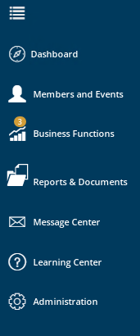
Resources
For additional information, refer to the question mark icon in the left-hand toolbar.
To view procedures for all IMRF Partner tasks and an archive of on-demand PowerPoint presentations or to sign up for a webinar, click on the Learning Center.

Slide 24
Thank you for your time!
Any other questions?
Send questions via Secure Messaging
Or
Employer Contact Center:
1-800-728-7971
Notes:
Thank you for viewing. If you still have questions, please reach out to IMRF via Secure Message. You may also reach us by phone at 800-728-7971. Thanks again.

