Slide 1
Partner Portal Overview
NCPERS

Slide 2

Agenda
Partner Portal Overview
Introduce new terminology
Get familiarized with the default layout and understand layout options
Widget Basics
Access Management

Slide 3
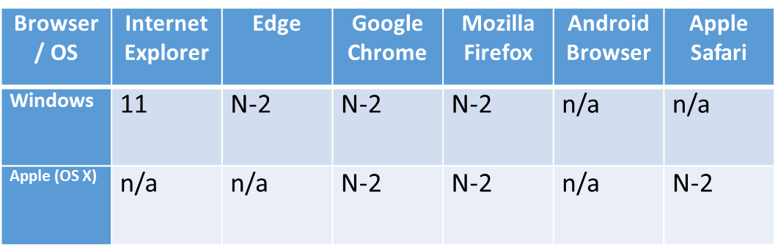
Compatible Browsers
The chart below shows the supported browsers with the Horizon line of business:
IMRF encourages the use of Microsoft Edge and Google Chrome
Notes:
On this slide, we have a chart of supported browsers with IMRF’s new business solution. IMRF encourages the use of Google Chrome and/or Microsoft Edge. For those employers who use an Apple operating system, Safari and Mozilla Firefox are also supported. For your reference, N-2 indicates N as the current version and -2 includes the 2 prior releases. It is important to keep your browsers up-to-date in order to make the reporting process as seamless and efficient as possible.

Slide 4
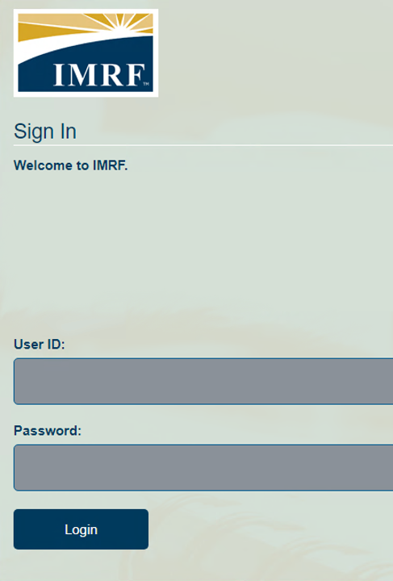
Signing into Partner Portal
Enter your User ID and Password to login to your account.
If you do not have an account, then you will need to register for one.
User ID’s will not be assigned.
If it is your first-time logging in, you need to register for Employer Access
Click the appropriate buttons for help recovering your password or for assistance
Notes:
In the new system, the login process has been streamlined. You will no longer be assigned a unique User ID. When you log in for the first time, you are required to register. The detailed registration process is available as a webinar in the Learning Center of the website. For basic troubleshooting assistance, click on “Need help?” To update or change a forgotten password, select “Forgot your password?”

Slide 5
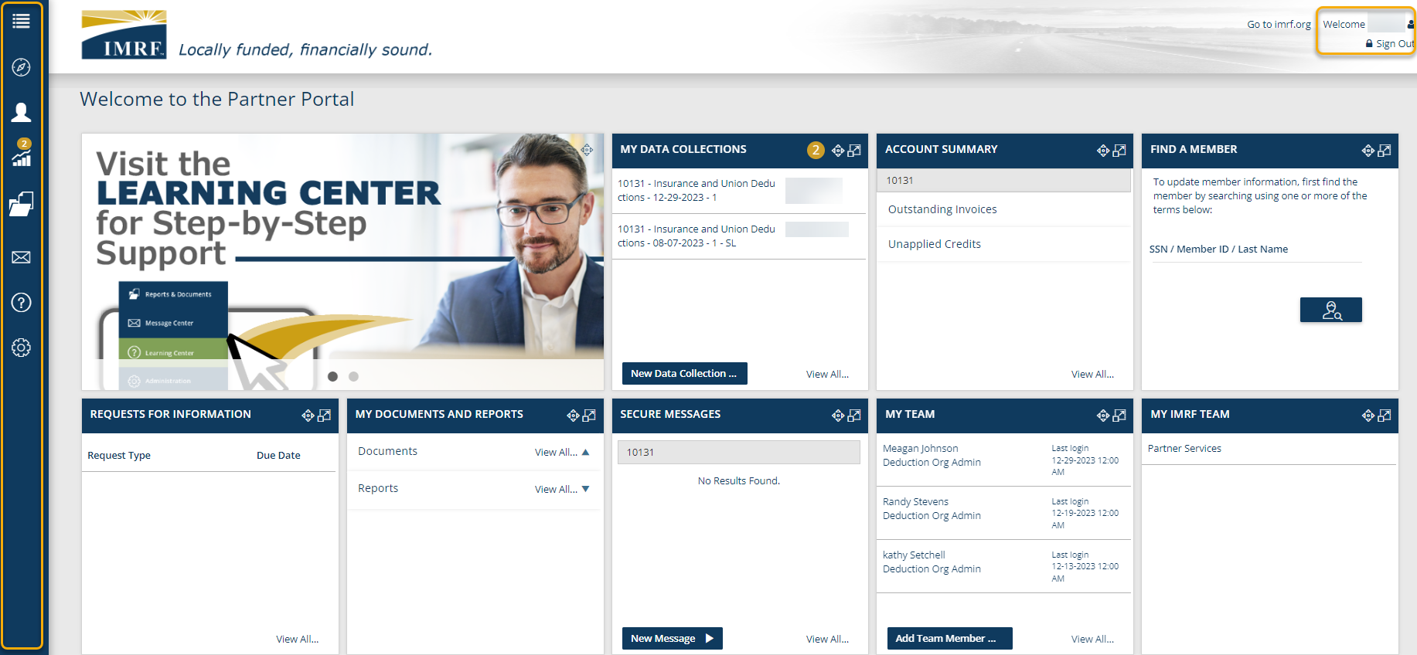
Notes:
Upon your first successful login, your dashboard will resemble the image displayed here. At the top right, you will see a link to go to our website and your name. Directly underneath that line, you have the option to sign out. All the way on the left in blue, you can see the toolbar with icons. The icons in the left-hand toolbar correspond to the tiles on the dashboard. These tiles are called widgets.

Slide 6
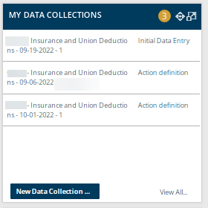
Widget Basics
Title Section, including buttons to move and resize widget
Most of the widgets on the landing page share 3 elements:
  Title Section
  Data Table
  Action Area
Widgets are dynamic. They can be moved around the landing page and expanded as needed.
Data Table
Action Area
Notes:
We will take a closer look at each individual widget in the forthcoming slides, but there are a few elements most widgets have in common: a title section, data table, and an action area. All the widgets are dynamic, which means you can drag and drop the widgets you find most useful to the top of your dashboard by clicking on the directional arrows' icon. These widgets are also expandable with a click of your mouse. Simply click on the icon with two squares and an arrow and the widget will be adjusted to the expanded version.

Slide 7
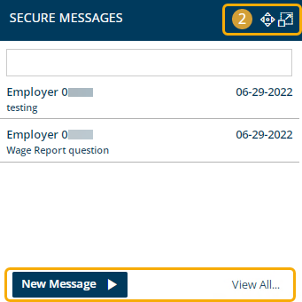

Secure Messages
Communicate with us electronically via the Secure Message Center!
Receive a response within 48 hours
Once a message is opened, it will no longer be new and the number in the gold badge will decrease
After you reply to a message, it is archived automatically
Notes:
This widget will allow you to securely correspond with IMRF electronically. The widget’s title bar will use a numbered gold badge to indicate whether there are new messages to view. The blue action button allows you to quickly start a new message and “View All…” takes you to the Secure Message Center landing page. When you send us a message, you can expect a response within 48 hours. It is best practice to have one person on your team handle the secure messaging. This is because a new message that is opened is no longer considered new and will reduce the number in the gold badge, appearing as if there is nothing to read or respond to. After you hit the send button on a reply to a message, the system will move it to your “Replied” folder.

Slide 8
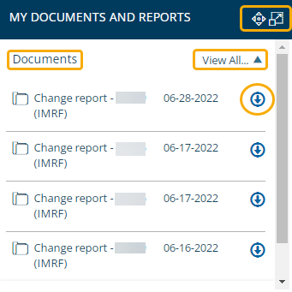
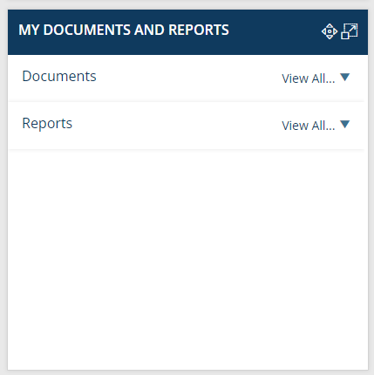

My Documents and Reports
Default widget view will display Documents first, followed by Reports
‘Reports’ are where you find the updated:
  Monthly Deduction Summary by Vendor report
  Newly Suspended or Deceased Pensioners report
Click ‘View All’ or ‘Reports’ to select the report
You may navigate via the tool bar by clicking on the folder and selecting ‘Report Generator’
Notes:
All icons in the left tool bar correspond with a widget in the main screen. You may click in the My Documents and Reports widget on Reports and select the report you would like to view. You can also use the left blue toolbar, select the folder icon, and select Report Generator and click on the different reports shown.

Slide 9
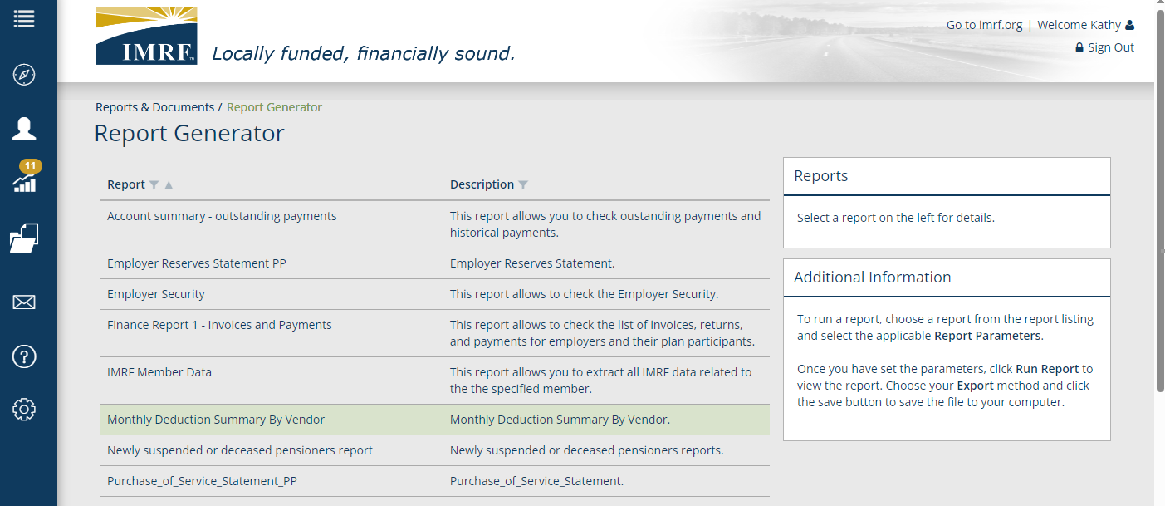
Report Generator
Double click on the Monthly Deduction Summary By Vendor report
Notes:
Select the Monthly Deduction Summary Report by Vendor to view the current or past monthly deductions.

Slide 10
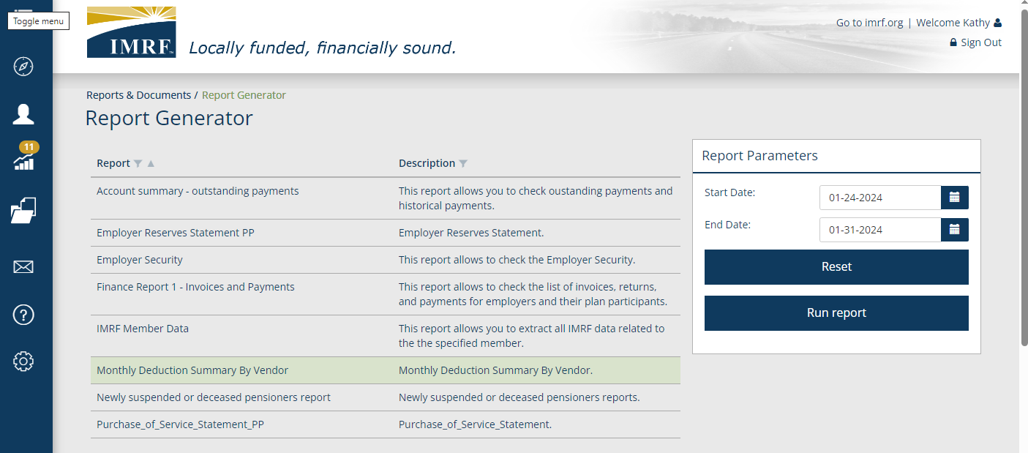
Report Generator
Enter the Dates of the time frame you wish to view.
Notes:
Enter the start date and end date of the time frame you wish to view and click Run Report.

Slide 11
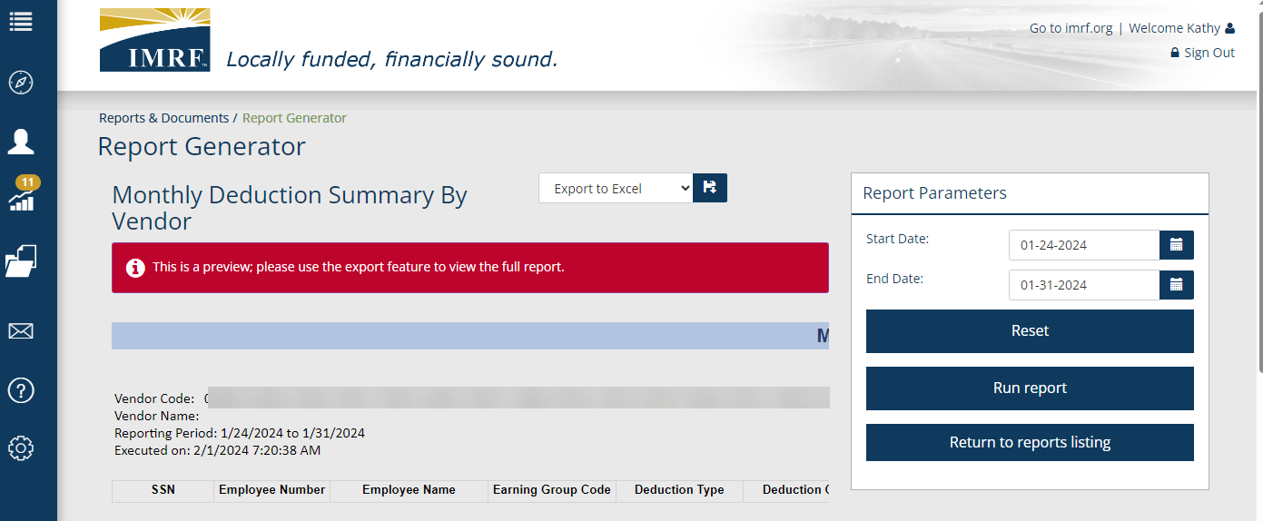
Report Generator
The report is too large to view on screen, click Export to Excel.
Notes:
Since the report is very large, the ability to view it in the window is hard to interpret. Instead, select ‘Export to Excel’ to download the report.

Slide 12
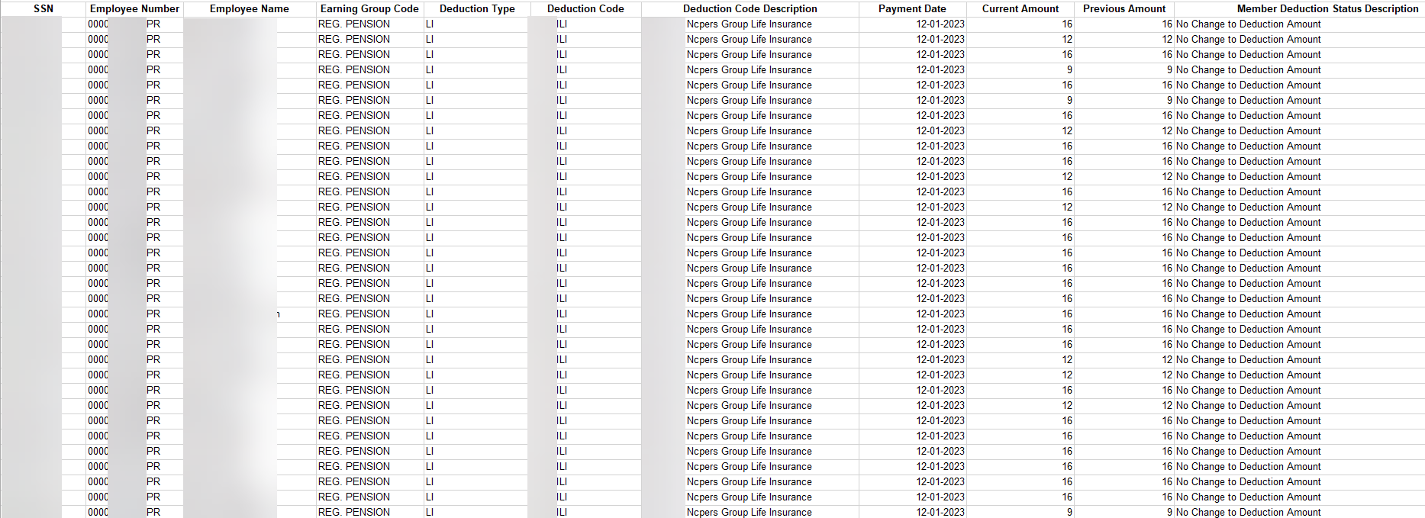
Monthly Deduction by Vendor Report
Sortable by column as needed: to view by plan, date, amount due, etc.
Notes:
Here is a view of the report. All columns are sortable using all Excel sort functions. We have blurred key member information for security purposes.

Slide 13
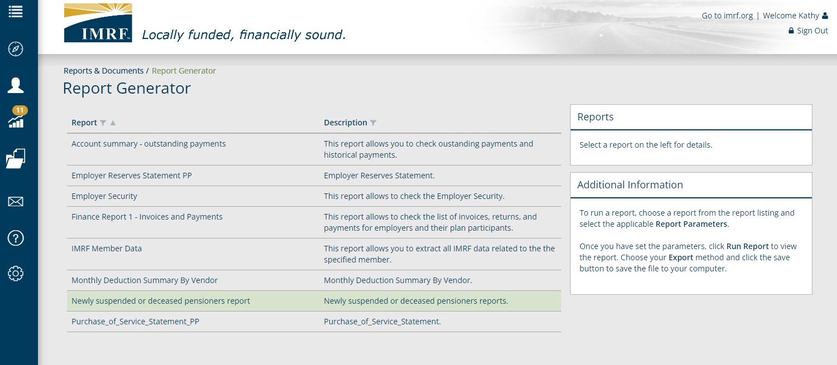
Report Generator
Double click on the Newly Suspended or Deceased Pensioners report
Notes:
Select the ‘Newly Suspended or Deceased Pensioners’ report to view the current or past monthly passings of members.

Slide 14
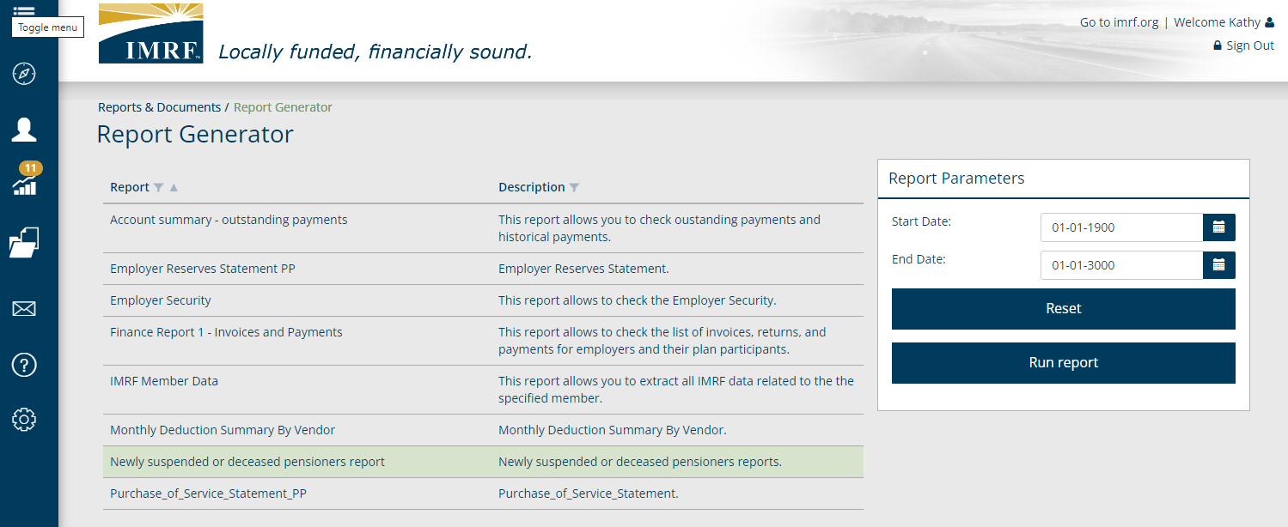
Report Generator
Enter the Dates of the time frame you wish to view.
Notes:
This report has some defects that will be fixed after go live. The first step you will need to take is to remove the prepopulated dates and Enter the start date and end date of the time frame you wish to view and click Run Report.

Slide 15
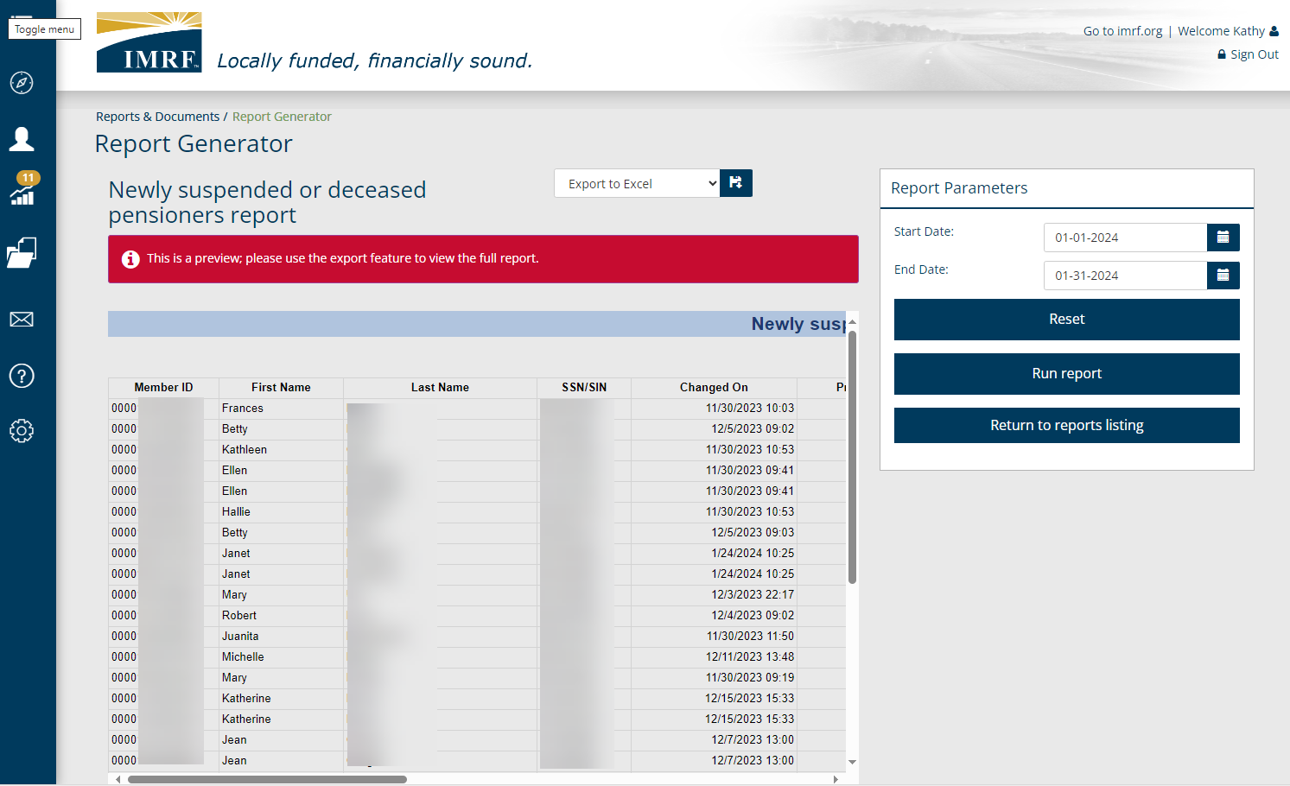
Report Generator
Click Export to Excel so all sort functions are available to you.
Notes:
Since the report is very large, the ability to view it in the window is hard to interpret. Instead, select ‘Export to Excel’ to download the report.

Slide 16
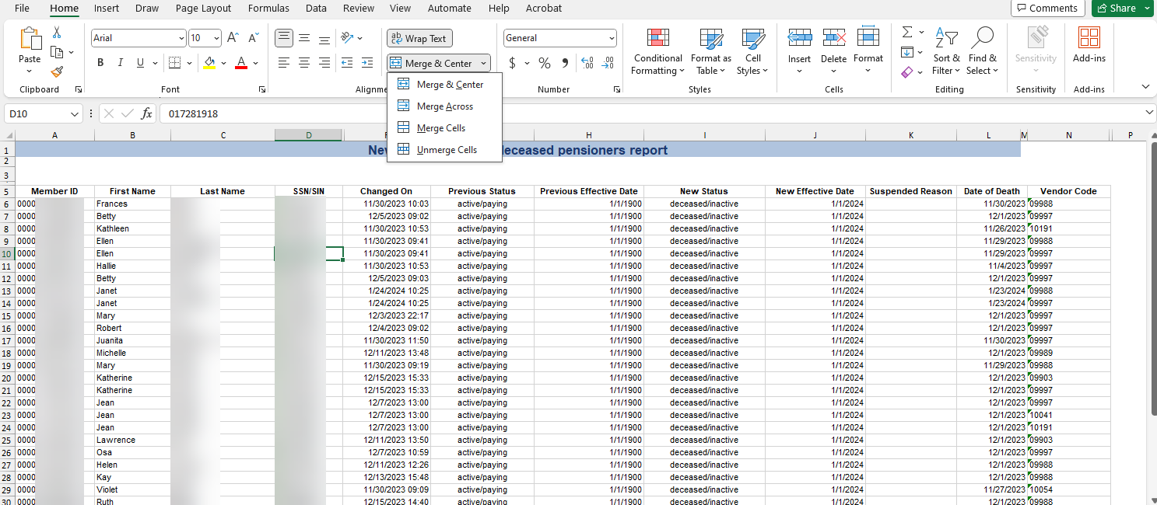
Newly Suspended or Deceased Pensioners report
Notes:
The banner at the top via merged cells makes the report unsortable. Click in the upper left corner of the Excel sheet to select the entire report. Then click on ‘Merge & Center’ and select ‘unmerge cells.’

Slide 17
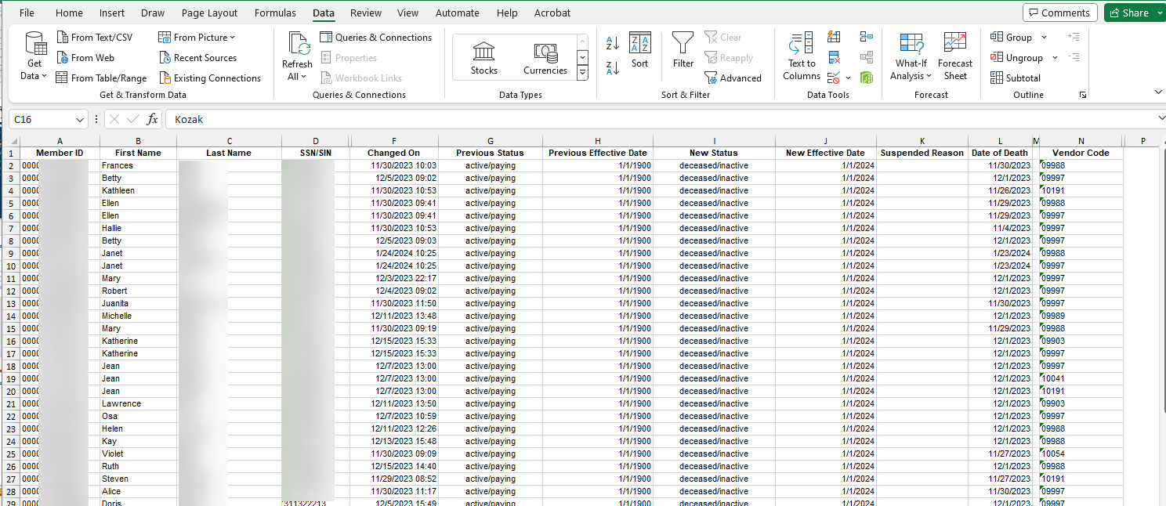
Newly Suspended or Deceased Pensioners report
Notes:
With the merged cells removed, click row 1 and select Data at the top and click on the filter icon. Now the report is viewable like the ‘Monthly Summary by Vendor’ Report. We are aware there are blank columns. These will also be fixed shortly after IMRF’s Go Live date. The columns will be altered to be like the ‘Monthly Summary by Vendor’ report and cleaned up for being left adjusted, right adjust and centered. The dates in column H are correct and let you know they came from our previous system.

Slide 18
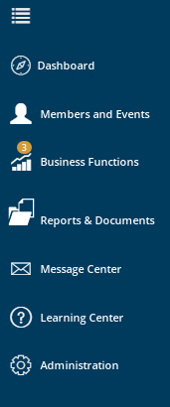
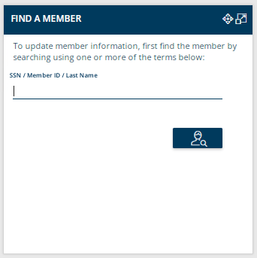

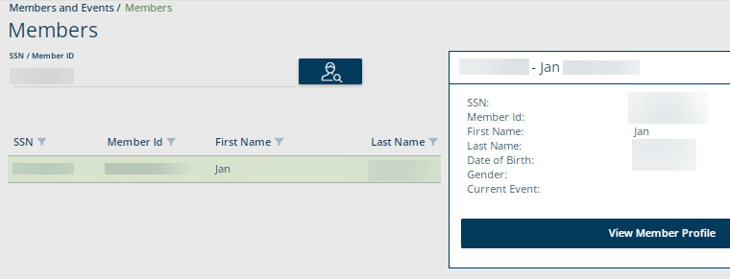
Find a Member
There are two methods to Find a Member- from the widget, or from the left-hand toolbar.
Entering the member info on the widget or clicking the Members submenu (toolbar) will bring you to the Members landing page.
Click the appropriate member and to the right there is an action button to view member profile.
Tabs are available to show additional information about the member.
Notes:
The Find a Member tool is used to view members current information. To access the information, you can use the find a member widget or the left-hand toolbar. Enter the members information and click search. It will take you to the landing page. When you click on the appropriate member there will be an action button to the right to click on. This will provide more detailed information regarding the member. Click on the individual tabs to view the desired information about the member.

Slide 19
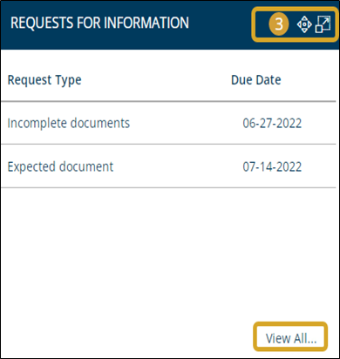

Requests For Information (RFIs)
The gold badge in the title bar indicates the number of items requiring input
Data table lists requests in order of due date
2 options for accessing the RFI landing page: Clicking View All… (widget) or Requests for Information submenu (toolbar)
Notes:
A partner would receive a Request for Information if one of their members has missing information or has passed away that would require updated information to move the process forward. The gold badge in the title bar shows the number of items requiring input. In the data table, requests will be listed by type and by due date, displayed in descending order of due date. Clicking the View All… action button redirects to the Requests for Information landing page. You can also reach the landing page by clicking the envelope icon in the toolbar, then selecting the Requests for Information submenu.

Slide 20

My Data Collections
Likely to be your most-used widget.
Online data collection process creates a hub for many of the necessary electronic forms
Clicking a collection in the data table redirects you to the stage of the collection where you left off
Click the blue action button to quickly begin a new data collection.
4 stages of a Data Collection: 1. Definition, 2. Add Member Data, 3. Validate Member Data, 4. Review & Submit
Examples of Data Types: Insurance and Union Deductions
Notes:
You will be referring to the My Data Collections widget quite frequently, because much of the information you will provide to IMRF will be submitted in the form of a Data Collection. The online submission process centralizes the most important electronic forms necessary to facilitate deductions for participant Insurance & Union Deductions. If you click on the collection in the data table, the system will redirect you to the stage of the collection where you left off. To quickly begin a new data collection, click the blue action button “New Data Collection…”.

Slide 21
21
What is a Data Collection?
Information is sent in via Employer Access as a Data Collection using a new file format, Comma-separated Value or .CSV.
Filing is Simple, Fast, Easy and Web-Centric replacing 90% of all previous forms.
For quick updates for a few participants the Add Record Manual Entry is quick, it prompts the user for information, responds interactively to prevent errors, and creates the new file format that is then submitted to IMRF.
For larger Updates the Upload File method, is quick, responds interactively to prevent errors and can be created offline and uploaded later.
Notes:
This slide gives more information on what a Data Collection is and the functions it provides.

Slide 22
Life Insurance Deductions
ADD RECORD
Data Collection Overview
Data Collection Creation
Add Member Data
Validation Process
Review and Submit
Notes:
Now, we are going to review doing quick updates for a few participants using the Add Record Manual Entry. It is quick, it prompts the user for information, responds interactively to prevent errors, and creates the new file format that is then submitted to IMRF.

Slide 23
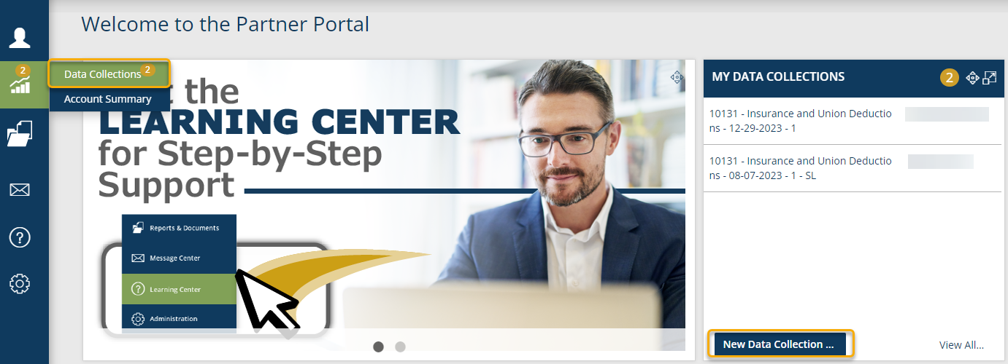
To begin the process of updating a participant's deductions, using the Add Record method a new Data Collection must be started (for smaller file updates).
Notes:
To process an Insurance and Union Deductions update, we need to create a Data Collection.
Start the Data Collection by clicking the Business Functions icon on the left-hand toolbar and select Data Collections.
This will now take you to a screen displaying all Data Collections previously created or on the Dashboard under the widget “My Data Collections”, click New Data Collection to go directly to Step 1.

Slide 24
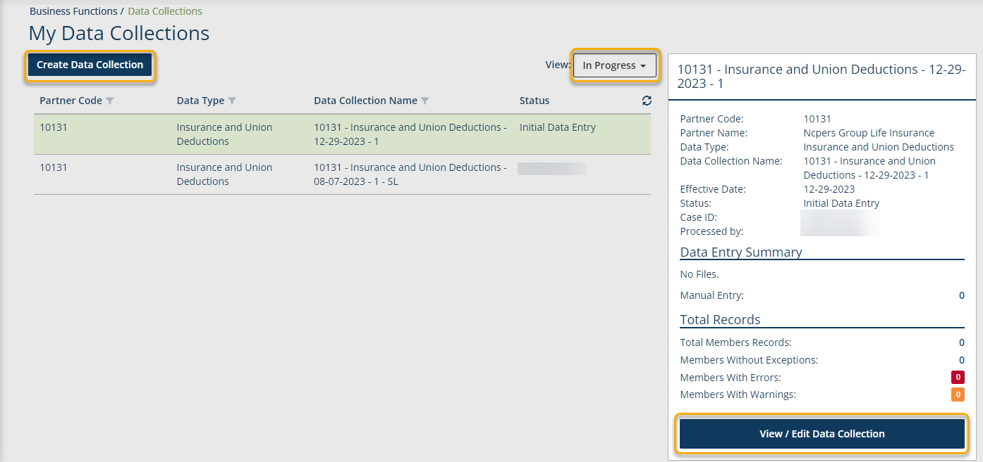
Click on Create Data Collection to start a Life Insurance Deduction data collection.
Notes:
Click on Create Data Collection to begin the update for Insurance and Union Deductions. This screen also lists data collections that have previously been created. You can see the status by clicking on the drop-down menu next to view and it will show- In Progress, Completed or All.
To View/Edit a data collection already created click on the row you want and to the right a brief summary window will open, click view/edit Data Collection.

Slide 25
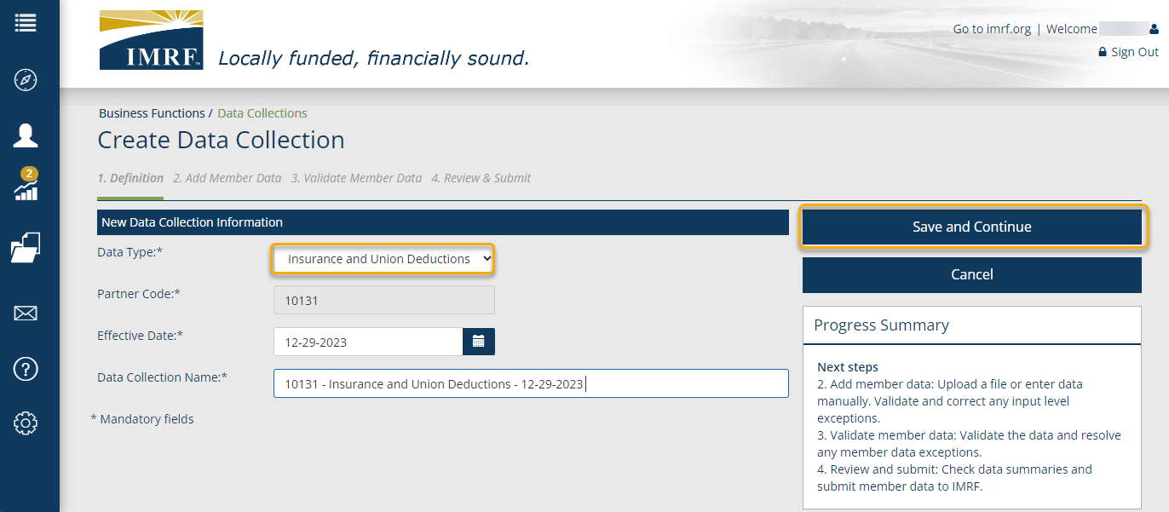
Select Insurance and Union Deductions as the Data Type from the drop-down menu and complete all mandatory fields. Click Save and Continue to move to the next step in the process.
Notes:
We are now at Step 1. Definition.
You will need to select Insurance & Union Deductions as the Data Type from the drop-down menu.
Your partner code will pre-populate, enter the effective date of the deduction and the Data Collection Name, which will be prepopulated for your convenience, and we strongly suggest that you add the member’s Last Name and First name to identify this collection.
Click Save and Continue to bring you to step 2. Add Member Data.

Slide 26
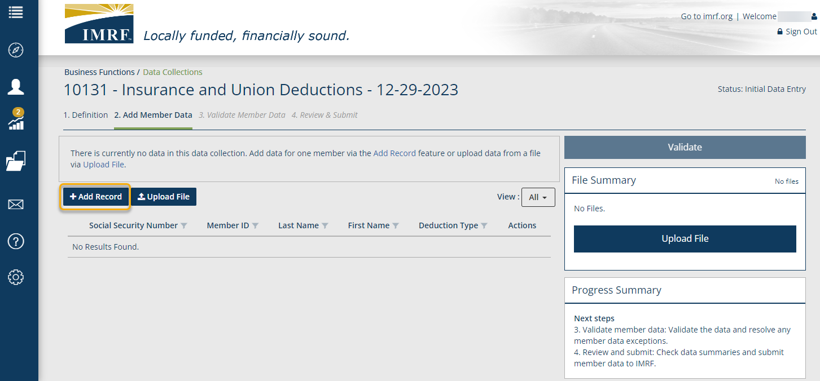
Click Add Record to enter the member data.
Notes:
Step 2 –
Click Add Record to enter the participant’s data.

Slide 27
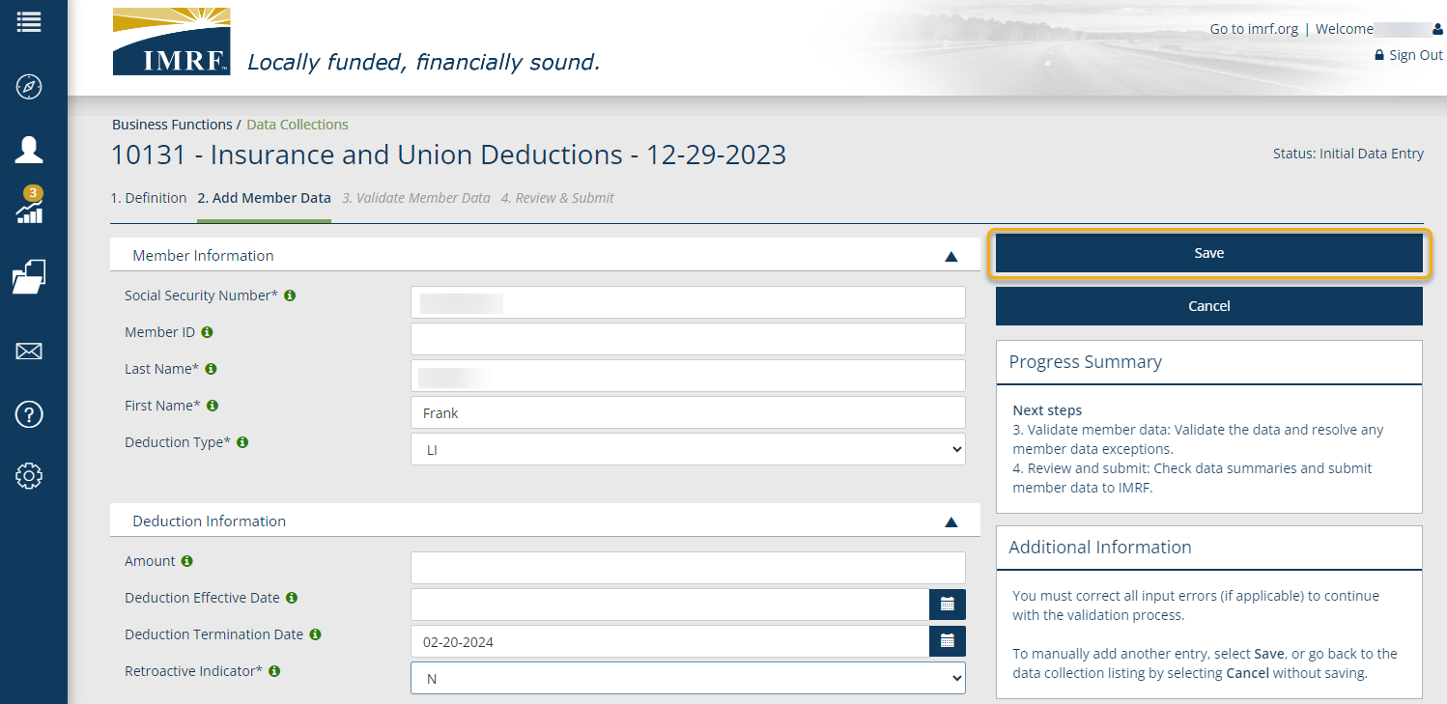
To terminate a Life Insurance Deduction, enter the Deduction Termination Date (must be last day of following month) and leave the “Amount” and “Deduction Effective Date” blank.
To revise a Life Insurance Deduction, enter the Deduction Effective Date (must be 1st day of following month) and leave the “Deduction Termination Date” blank.
See error that was generated on slide 29 due to the Termination date NOT being the last day of the following month.
Notes:
Enter the Insurance & Union Deductions information and click Save.
To Terminate a Deduction, enter the Deduction Termination Date (must be last day of the following month) and leave the “Amount and “Deduction Effective Date” blank.
To revise a Deduction, enter the Deduction Effective Date (must be the 1st day of the following month) and leave the “Deduction Termination Date” blank.
Please note: In this example, we used 02-20-2024 as the ‘Deduction Termination Date.’ This will generate an error since we did not use the last day of the month. Refer to slide 29 for the details of the error that will be generated by the system.
Asterisk by field is REQUIRED.
If you have multiple entries, after you click Save, select Add Record and repeat steps until all are entered.

Slide 28
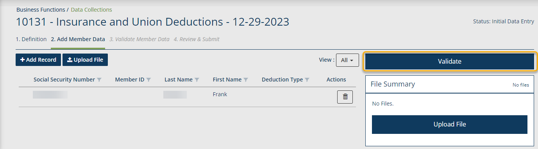
Once you have entered all the members for the data collection, they will display on the screen. Make sure that the view is set to All to see them listed. Click Validate and this step will validate the information entered against formatting and business requirements to show any errors or warnings, if applicable.
Notes:
Once you have all participant data entered, they will display on the screen.
Make sure that the view is set to All to see them listed. Click Validate and this step will validate the information entered against formatting and business requirements.
By doing this it will bring us to Step 3. Validate Member Data.

Slide 29
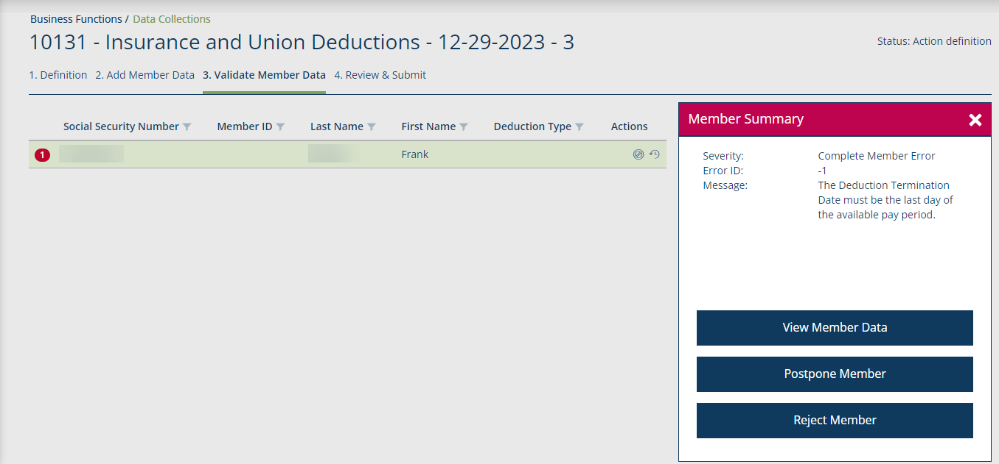
To address a member with errors or warnings, click on the row and a Member Summary box will open. From there you could act by selecting one of the options.
Click X to close
Click the row to highlight and open the Member Summary to the right.
Click on View Member Data to make any corrections.
“Postpone Member” will remove a member from the data collection. This will create a new data collection for the member and can be finished separate from this data collection.
Notes:
As mentioned in slide 27, an error was generated in this case since we did not use the last day of the month for the ‘Deduction Termination Date.’
To address a participant with errors or warnings, click on the row and a Member Summary box will open to the right.
Click on one of the options to make corrections to the member.
To close the Member Summary, click the X.

Slide 30
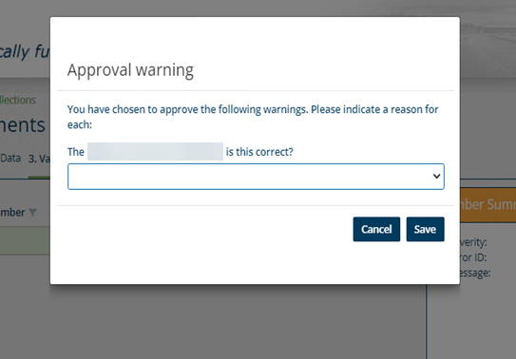
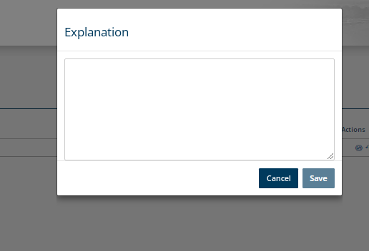
For Life Insurance Deduction warnings that were approved, a pop-up box will appear and ask for a reason. Answer the questions and click, Save. Once saved, click Validate.
For Life Insurance Deduction errors that were postponed or rejected, a pop-up box will require an explanation, provide and click Save. Once saved, click Validate.
Notes:
If there is a warning that was approved a pop-up box will appear and ask for the reason of approval.
Answer the question and click Save.
If an error was postponed or rejected, you will have a pop-up box that will require an explanation such as “need to do research and follow up”. Please provide one and select Save. After providing the information you will see a validate button.
Click validate to move on.

Slide 31
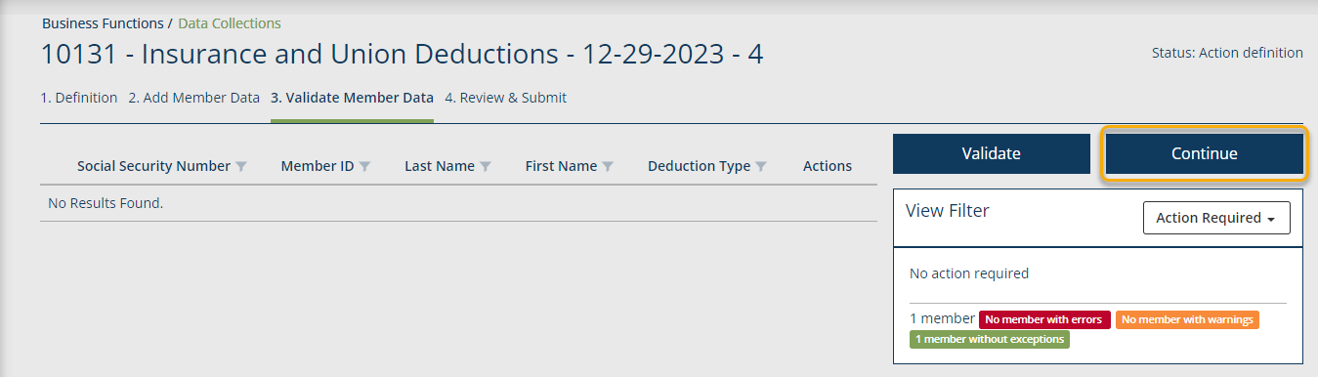
Once any warnings and errors have been resolved and validated, it will show no results found since all issues have been cleared in previous step. To the right it will show the number of members. Click Continue to move to Step 4. Review & Submit.
Notes:
We have reached the final phase of validation. The screen will show no results found once any warnings and/or errors have been resolved and validated.
The right side of the screen will state no action required and show the number of members in the Data Collection.
Click continue to go to Step 4. Review and Submit.

Slide 32
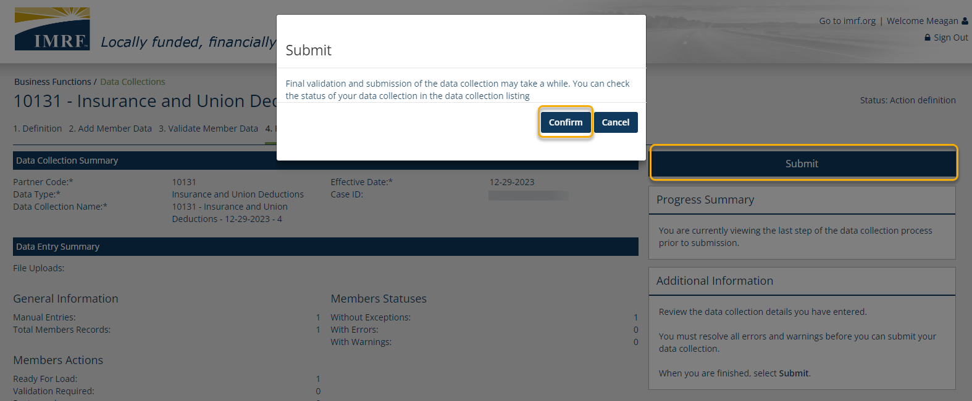
Review the listed Data Collection and Data Entry Summary and Reports. Once review is complete, click Submit. A pop-up box will appear to confirm. Click Confirm and that will complete your Data Collection.
Notes:
We have reached the final step in the Insurance & Union Deductions data collection process, Step 4. Review and Submit.
When you have reviewed the summaries and reports, click Submit, you will get a pop-up box to confirm.
Click confirm and that will complete your Insurance & Union Deductions data collection.

Slide 33
Life Insurance Deduction
UPLOAD FILE
Data Collection Overview
Data Collection Creation
Upload File Process
Validation Process
Review and Submit
Notes:
Our next example will be an Insurance & Union Deductions data collection for larger updates using the Upload File method.

Slide 34
To begin the process of updating participant deductions, using the Upload File method a new data collection must be started (for larger file updates).
Notes:
To process an Insurance and Union Deductions update, we need to create a Data Collection.
Start the Data Collection by clicking the Business Functions icon on the left-hand toolbar and select Data Collections.
This will now take you to a screen displaying all Data Collections previously created or on the Dashboard under the widget “My Data Collections”, click New Data Collection to go directly to Step 1.

Slide 35
Click on Create Data Collection to start a Life Insurance Deduction data collection.
Notes:
Click on Create Data Collection to begin the update for Insurance and Union Deductions. This screen also lists data collections that have previously been created. You can see the status by clicking on the drop-down menu next to view and it will show- In Progress, Completed or All.
To View/Edit a data collection already created click on the row you want and to the right a brief summary window will open, click view/edit Data Collection.

Slide 36
Select Insurance and Union Deductions as the Data Type from the drop-down menu and complete all mandatory fields. Click Save and Continue to move to the next step in the process.
Notes:
We are now at Step 1. Definition.
You will need to select Insurance & Union Deductions as the Data Type from the drop-down menu.
Your partner code will be pre-populated, enter the effective date of and the Data Collection Name, which will be prepopulated for your convenience, you may add to the title to make it easier to identify later.
Click Save and Continue to bring you to step 2. Add Member Data.

Slide 37
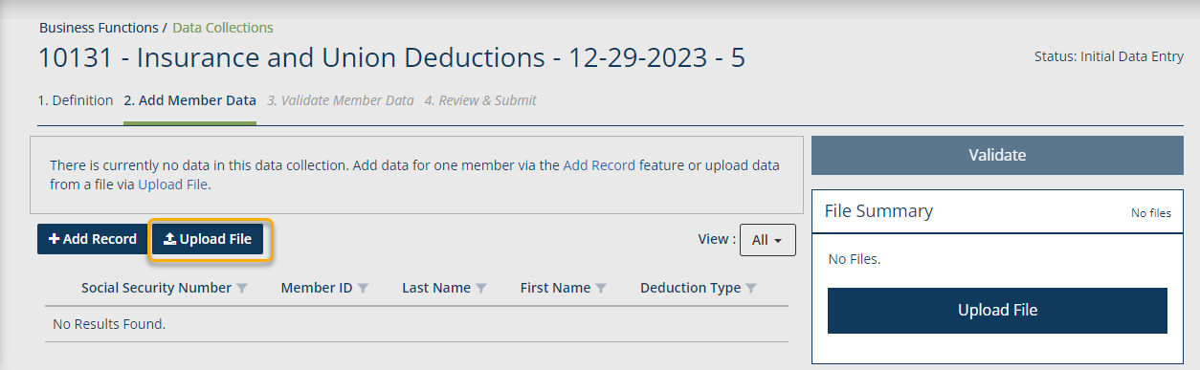
Click on Upload File to upload your Life Insurance Deduction file.
Notes:
The fields in the 1.Definition tab are pre-completed, allowing you to start at stage 2, which is Add Member Data,
Click on the Upload File Button to upload your Insurance & Union Deductions report file.

Slide 38
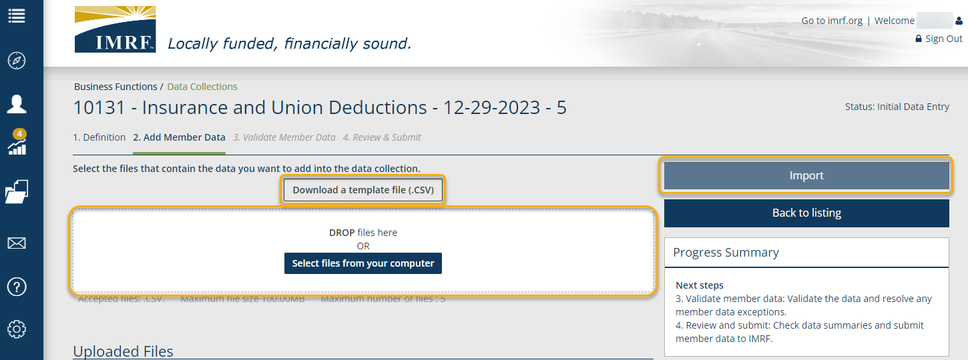
Drag and drop files from your desktop or click, Select files from computer to upload.
Select Import where data is reviewed against input formatting requirements.
If you need the format, select Download a template.
If needed, review the procedure with simple file specifications in the Learning Center.
Notes:
This is the screen is how a data file is uploaded.
The link [Download a template file (CSV)] is available to generate an empty import file in the format required.
If the file is saved as an icon on your desktop, you may drag and drop the file in the white box, or
You can Select files from your computer to choose which file to upload.
Once the file appears under the Upload Files section of the Add Member Data page, click Import. In this step, data is reviewed against formatting requirements.

Slide 39
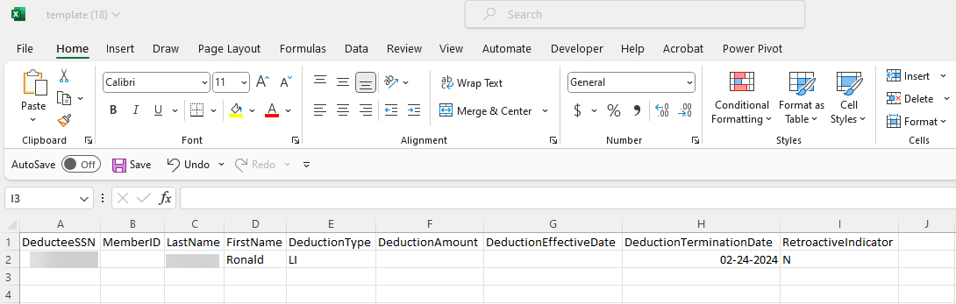
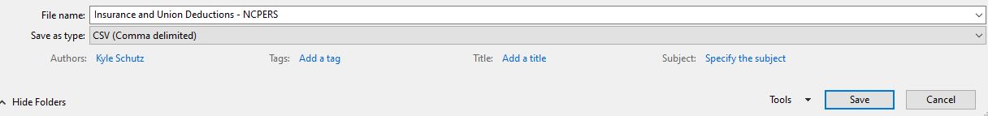


File Format Upload
See error that was generated on slide 41 due to the Termination date NOT being the last day of the following month.
Notes:
This is an example screenshot of how you will save your csv file (or a file you will be uploading.)
You will enter your information, as it applies to your situation, as the example shows.
The Retroactive Indicator is a yes or no answer to the question.
Please note: In this example, we used 02-24-2024 as the ‘Deduction Termination Date.’ This will generate an error since we did not use the last day of the month. Refer to slide 41 for the details of the error that will be generated by the system.

Slide 40
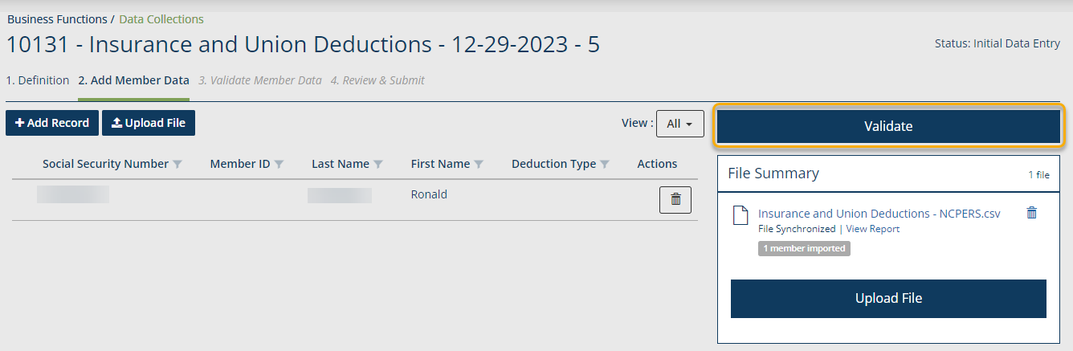
Once you have all member data entered, they will display on the screen. Make sure that the view is set to All to see them listed. Click Validate and this step will validate the information entered against formatting and business requirements to show any errors or warnings, if applicable.
Notes:
Once you have all participant data entered, they will display on the screen.
Make sure that the view is set to All to see them listed. Click Validate and this step will validate the information entered against formatting and business requirements.
By doing this it will bring us to Step 3. Validate Member Data.

Slide 41
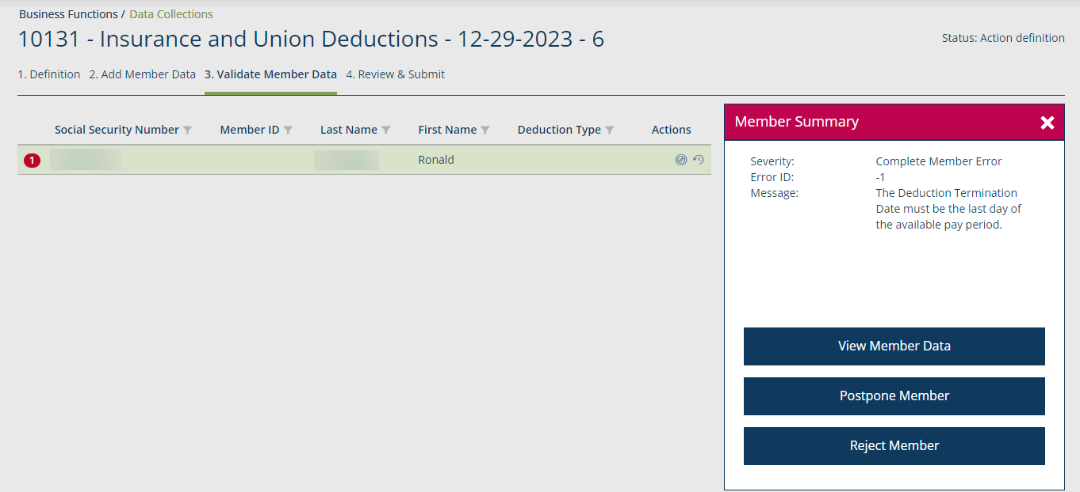
To address a member with errors or warnings, click on the row and a Member Summary box will open. From there you could act by selecting one of the options.
Click the row to highlight and open the Member Summary to the right.
Click on View Member Data to make any corrections.
“Postpone Member” will remove a member from the data collection. This will create a new data collection for the member and can be finished separate from this data collection.
Notes:
As mentioned in slide 39, an error was generated in this case since we did not use the last day of the month for the ‘Deduction Termination Date.’
To address a participant with errors or warnings, click on the row and a Member Summary box will open to the right.
Click on one of the options to make corrections to the participant.
To close the Member Summary, click the X.

Slide 42
For Life Insurance Deduction warnings that were approved, a pop-up box will appear and ask for a reason. Answer the questions and click, Save. Once saved, click Validate.
For Life Insurance Deduction errors that were postponed or rejected, a pop-up box will require an explanation, provide and click Save. Once saved, click Validate.
Notes:
If there is a warning that was approved a pop-up box will appear and ask for the reason of approval.
Answer the question and click Save.
If an error was postponed or rejected, you will have a pop-up box that will require an explanation such as “need to do research and follow up”. Please provide one and select Save. After providing the information you will see a validate button.
Click validate to move on.

Slide 43
Once any warnings and errors have been resolved and validated, it will show no results found since all issues have been cleared in previous step. To the right it will show the number of members. Click Continue to move to Step 4. Review & Submit.
Notes:
We have reached the final phase of validation. The screen will show no results found once any warnings and/or errors have been resolved and validated.
The right side of the screen will state no action required and show the number of members in the Data Collection.
Click continue to go to Step 4. Review and Submit.

Slide 44
Review the listed Data Collection and Data Entry Summary and Reports. Once review is complete, click Submit. A pop-up box will appear to confirm. Click Confirm and that will complete your Data Collection.
Notes:
We have reached the final step in the Insurance & Union Deductions data collection process, Step 4. Review and Submit.
When you have reviewed the summaries and reports, click Submit, you will get a pop-up box to confirm.
Click confirm and that will complete your Insurance & Union Deductions data collection.

Slide 45
Banking information & Account summary
Processes and Terminology
Notes:
In the next section of this presentation, we will go over banking information and how to access the Account Summary screen.

Slide 46
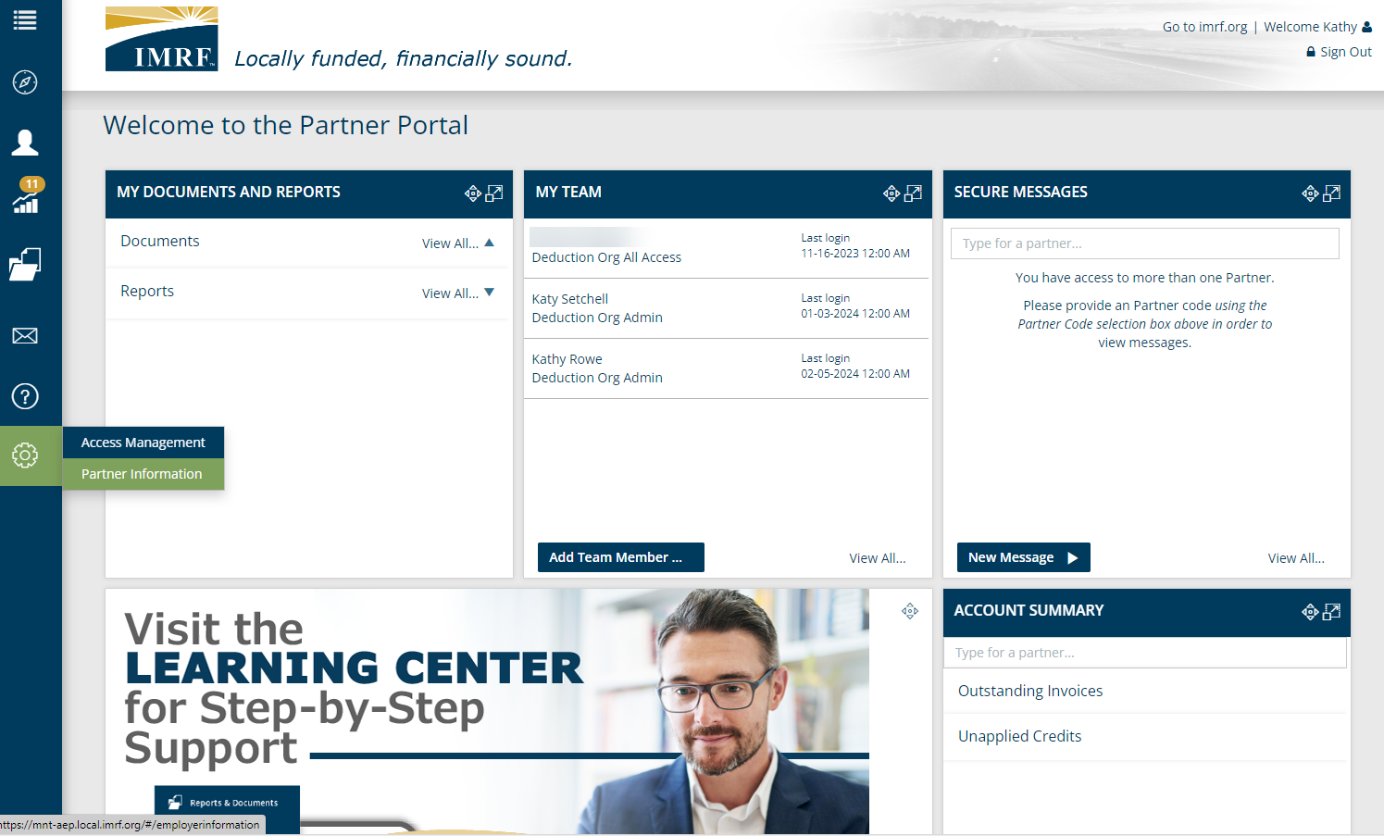
Entering Banking Information
Notes:
Select the gear icon from the left tool bar and click on Partner Information to enter your banking information.

Slide 47
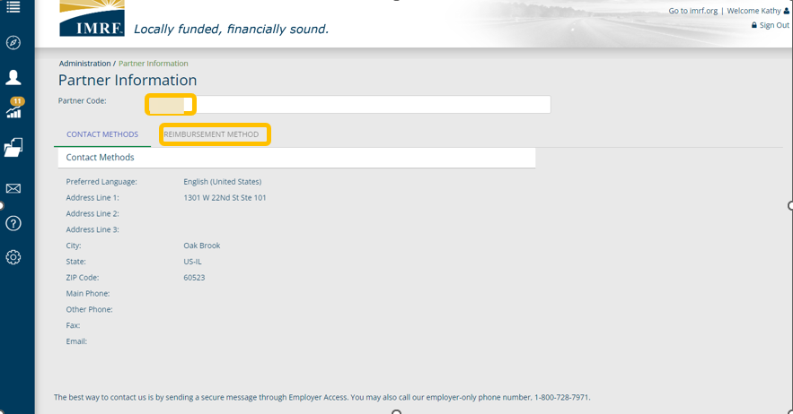
Entering Banking Information
Notes:
Enter your Partner Code and select ‘Reimbursement Method.’

Slide 48
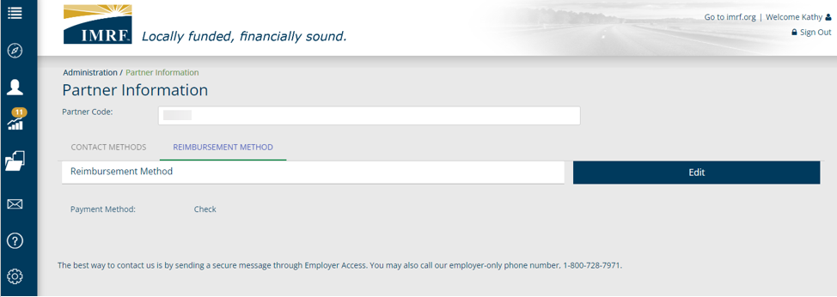
Entering Banking Information
Notes:
Click on edit

Slide 49
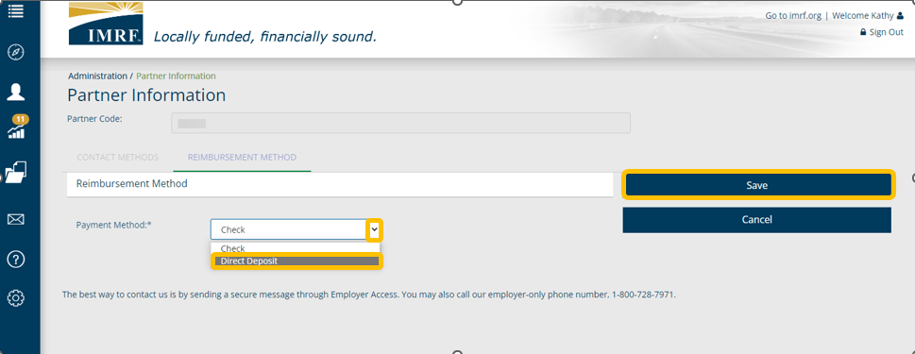
Entering Banking Information
Notes:
Click on the down caret and select direct deposit.

Slide 50
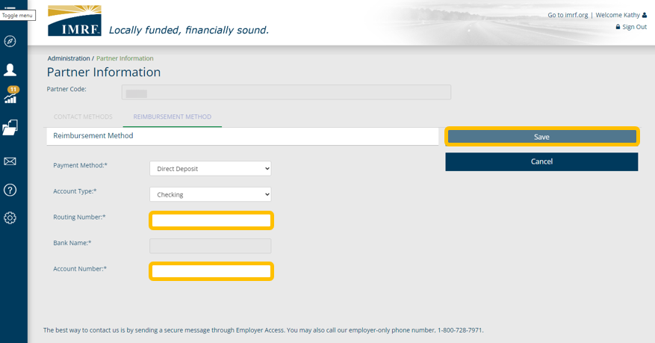
Entering Banking Information
Notes:
Select whether the account is checking or savings and enter the routing number and account number and click ‘Save.’
You can update these at any time but only need to enter them once.

Slide 51
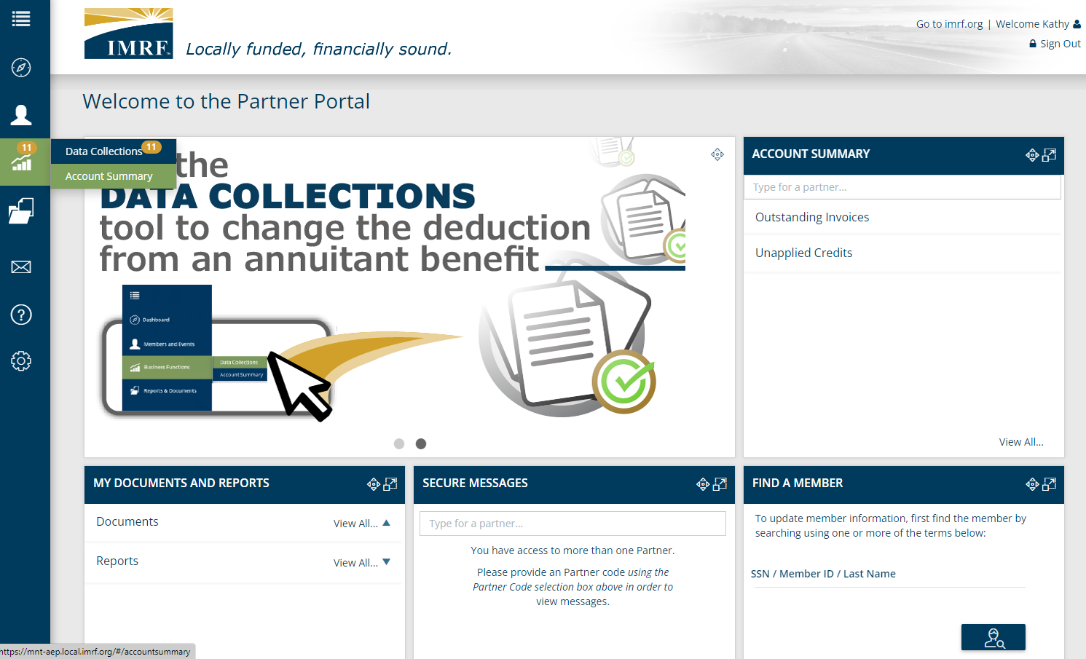
Account Summary
Notes:
In the left tool bar click on the gear icon and select Account Summary or in the Account Summary widget click on View All.

Slide 52
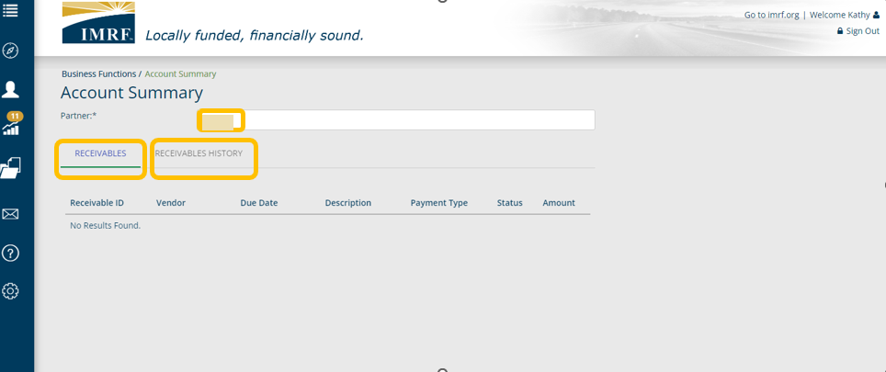
Account Summary
Notes:
Type in your Partner number to view the Receivables or click on Receivables History.

Slide 53
Access Management
Access Management provides the ability to define user roles based on security within the Partner Access Portal.
Granting a specific user profile comes with the read-only or read-write ability. Furthermore, the same profile also determines which feature the user will have access to.
The security roles can also allow a specific user to take additional actions within the portal that other level of accesses wouldn’t allow.
Each functionality is configurable per profile.

Slide 54
Deduction Org Admin - has access to basic member information, to all financial functions and may create new users.
Deduction Org All Access – has access to all financial functions but they cannot create new users.
Deduction Org View Only – user can view and read information only.
There are 3 different user roles for IMRF Partners.
Notes:
There are 3 different user roles for Third Party Providers in Employer Access.
Deduction Org Admin - has access to basic member information, to all financial functions and may create new users.
Deduction Org All Access – has access to all financial functions but they cannot create new users.
Deduction Org View Only – user can view and read information only.

Slide 55
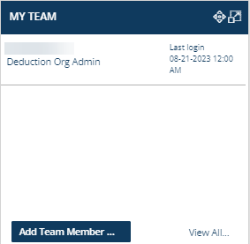
My Team
Partner Roles: 1 Admin per partner, can have multiple All Access and View Only
Each role provides different levels of access
If you are an Admin and want to add access, click the Add Team Member… action button
Notes:
The users who have access to the online account and their role will be listed in the data table in the My Team widget, along with their last login. To view a complete list or remove access to the website for a particular user, click the View All… action button and double click the appropriate user’s name to make the necessary adjustments. Alternatively, if you need to add a new user, simply click the Add Team Member … action button in the bottom section of the widget

Slide 56
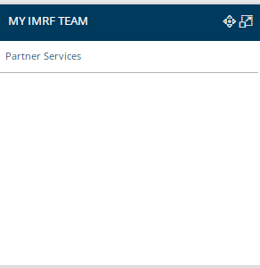
My IMRF Team
Find your IMRF Employer Representative in this widget
Basic IMRF contact information will also be provided: employer-only phone number (1-800-728-7971) and our business address.
Notes:
The My IMRF Team widget is where you will find your Employer Representative and their contact information. Your Employer Representative will be your main point of contact for questions or concerns that cannot be addressed via Secure Message or over the phone. This person is a subject matter expert and will be able to assist with more complex transactions, as well as act as the liaison between you and IMRF staff.

Slide 57

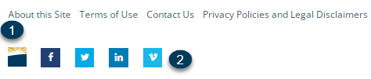
Header and Footer
From the Header:
Visit the IMRF website
Click the person icon to manage your weekly update preferences
Click the lock icon to change password/update security questions
From the Footer:
Read about the site, terms of use, contact us, and legal information
Visit us on social media platforms to learn more about the information we share with the public
Notes:
The header section allows you to manage your own profile preferences and visit the IMRF website. Click on the IMRF logo or the words Go to IMRF.org to jump to the IMRF website. Clicking on the person icon next to your name allows you to access the Communication Preferences screen to select your delivery method for the weekly update. If you need to change your password or security questions, select the lock icon. The footer provides several links to IMRF social media sites and other information including: About this site, Terms of Use, Contact us, and the Privacy Policy and Legal Disclaimer. Another link to www.imrf.org is provided in the footer as well.

Slide 58
Resources
For additional information, refer to the question mark icon in the left-hand toolbar.
To view procedures for all IMRF Partner tasks and an archive of pre-recorded on-demand PowerPoint presentations or to sign up for a webinar, click Learning Center.

Slide 59

Thank you for your time!
Any other questions?
Send questions via Secure Messaging
Or
Employer Contact Center:
1-800-728-7971
Notes:
Thank you for viewing. If you still have questions, please reach out to IMRF via Secure Message. You may also reach us by phone at 800-728-7971. Thanks again.

