Slide 1


Wage Adjustment Data Collection
Upload File

Slide 2

Agenda
Wage Adjustments
Data Collection Overview
Data Collection Creation
Upload File Process
Validation Process
Review and Submit
Wage Adjustment Overview

Slide 3
Data Collection Overview
What is a Data Collection?
Information is sent in via Employer Access as a Data Collection using a new file format, Comma-separated Value or .CSV.
Filing is Simple, Fast, Easy and Web-Centric replacing 90% of all previous forms.
For smaller employers the Upload File method is quick, it prompts the user for information, responds interactively to prevent errors, and creates the new file format that is then submitted to IMRF.
IMRF is asking for the information you supplied to us before and some new information. This allows the employer more control over the entire life cycle of their members from enrollment through retirement.
3
Notes:
What is a Data Collection ?
Information is sent in via employer Access as a Data Collection using a new file format, Comma-separated Value or .CSV.
Filing is Simple, Fast, Easy and Web-Centric replacing 90% of all previous forms. i.e., monthly wage report, wage adjustments, enrollments, terminations, disability, etc.
For smaller employers the upload file method is quick, it prompts the user for information, responds interactively to prevent errors, and creates the new file format that is then submitted to IMRF.
IMRF is asking for the information you supplied to us before and some new information. The new functionality allows the employer more control over the entire life cycle of their members from enrollment through retirement.

Slide 4
Wage Adjustment Overview
Things that will stay the same… | Things that are new…
Single member wage adjustment, one wage period Single member wage adjustments, more than one wage period Multiple member wage adjustments, one or more wage periods | File format for import: must be a comma-separated value .csv
Wage reports must be fully complete before an adjustment for the same period can be performed | Fields have simplified with the new .csv format Plans are defined as REG SLEP or ECO, without a Tier 1 or 2 Voluntary Additional is no longer a separate line Overtime is reported separate of Regular Wages A final wages prompt is added to speed claim processing Its interactive with the User to help prevent errors
Interest charges begin on adjustment(s) 30 days after the date of the invoice and continue until the payment is received -Interest is charged at a rate of 1% per month | Employers may Postpone a member on the record who is not enrolled, more detail is needed, quicker claims processing (file a claim). A new Data Collection will automatically create to file separately later.
 | When adjusting wages and contributions, the user will enter the difference of what was initially reported vs. the correct amounts. For example, if previous wages were reported at $2,000.00 but should have been $1,500.00 the user would make an adjustment of -$500.00.

Slide 5
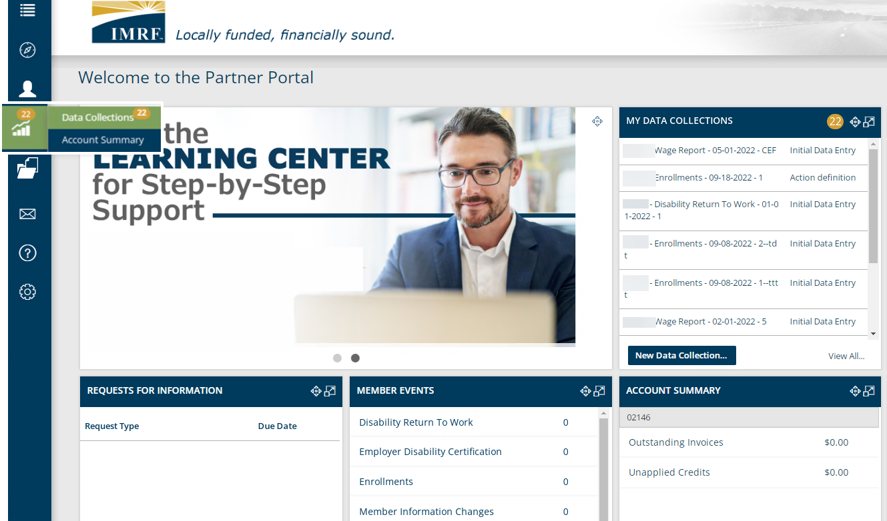
Create a new Data Collection to do a wage adjustment.
Start the Data Collection by clicking the Business Functions icon on the left-hand toolbar and select Data Collections.
You may also us the widget “My Data Collections” and click New Data Collection to get started.
Notes:
To process a wage adjustment a data collection must be created. Use the left-hand toolbar and select the business functions icon and then Data collections. You may also create a data collection from the My Data Collections widget but clicking on, New data Collection.

Slide 6
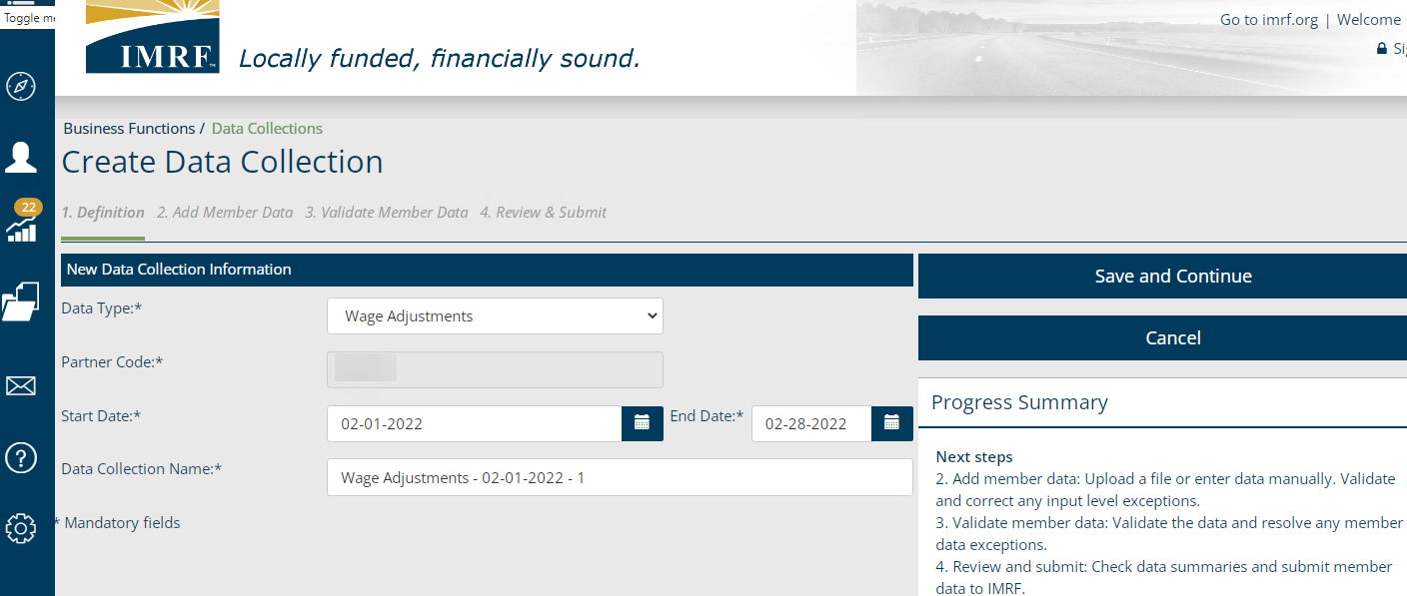
Data Collection Step 1: Definition
Select Wage Adjustment as Data Type
The Partner Code is your Employer Number
Enter the time period for the adjustment.
The Data Collection Name is prepopulated; however, you may edit this field.
Click Save and Continue to go to the next step.
Notes:
We are now at Step 1 Definition. You will need to select Wage Adjustments as the Data Type from the drop-down menu. Enter Partner code, also known as, employer number. Enter the start date and end date of the month or months you need to do a wage adjustment. The Data Collection Name is prepopulated for convenience; however, you may edit this field.
Click Save and Continue to bring you to step 2. Add Member Data.

Slide 7
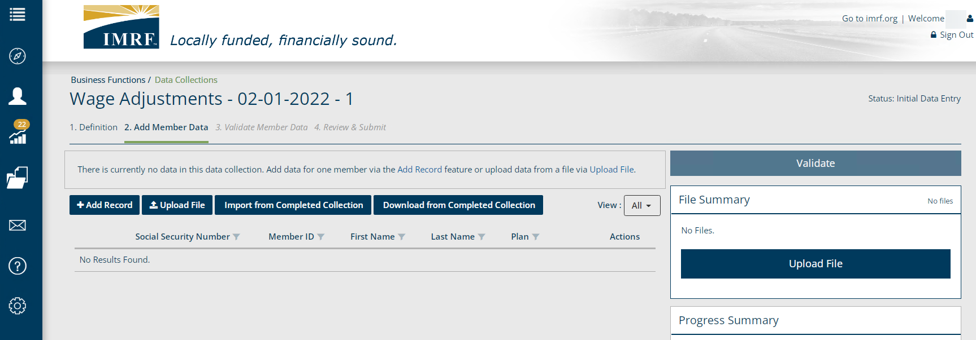
Data Collection Step 2: Add Member Data
Click on the Upload File button to enter the member data.
Notes:
To file with the Upload File method Click on the Upload File button to enter the member data.

Slide 8
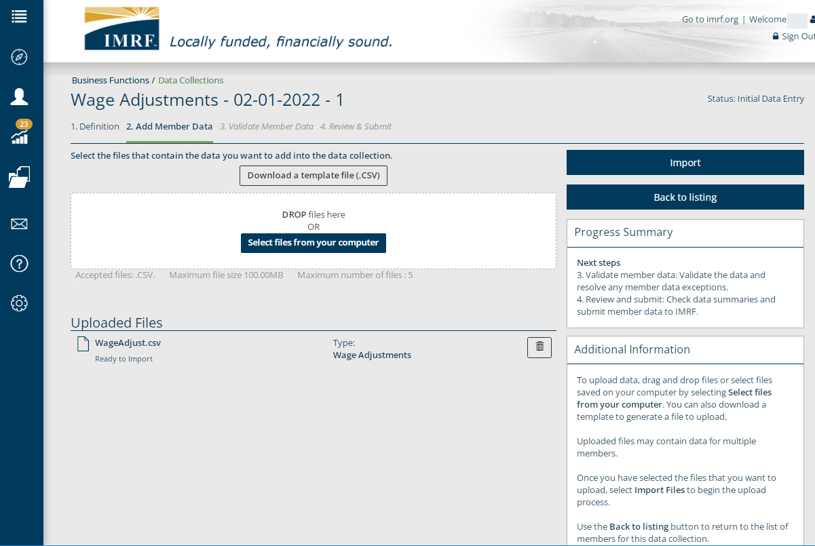
Data Collection Step 2. Add Member Data
Drag and drop files from your desktop or click, Select files from computer to upload.
Select Import where data is reviewed against input formatting requirements.
If you need the format, select Download a template.
If needed, review the procedure with simple file specifications in the Learning Center.
Notes:
This is the screen where data file is uploaded.
The link [Download a template file (CSV)] is available to generate an empty import file in the format required. If the file is saved as an icon on your desktop, you may drag and drop the file in the white box or click Select files from your computer to choose which file to upload.
Once the file appears under the Upload Files section of the Add Member Data page, click Import. In this step, data is reviewed against formatting requirements.

Slide 9
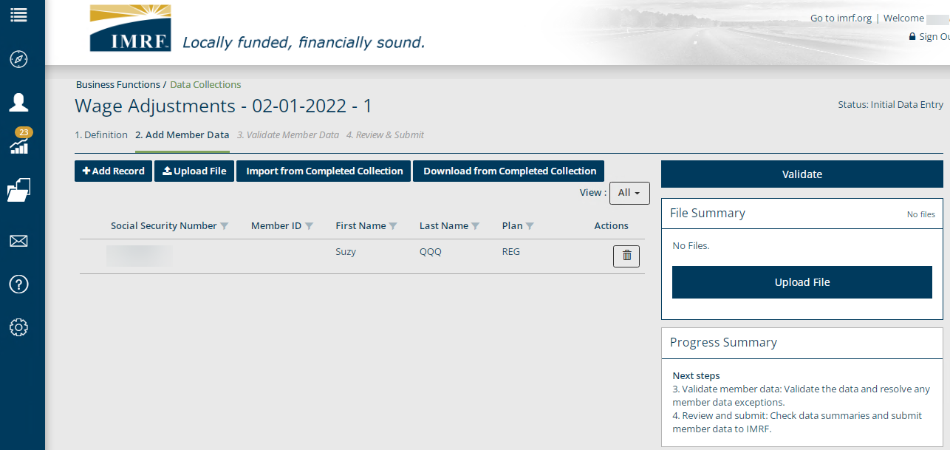
Data Collection Step 2: Add Member Data
Click Validate to move to Step 3. Validate Member Data tab. In this step data is validated against formatting and business requirements.
All members entered will display in this area.
Notes:
Once all members are entered, they will be displayed. Click Validate and this step will validate the information entered against formatting and business requirements to show any errors or warnings, if applicable.

Slide 10
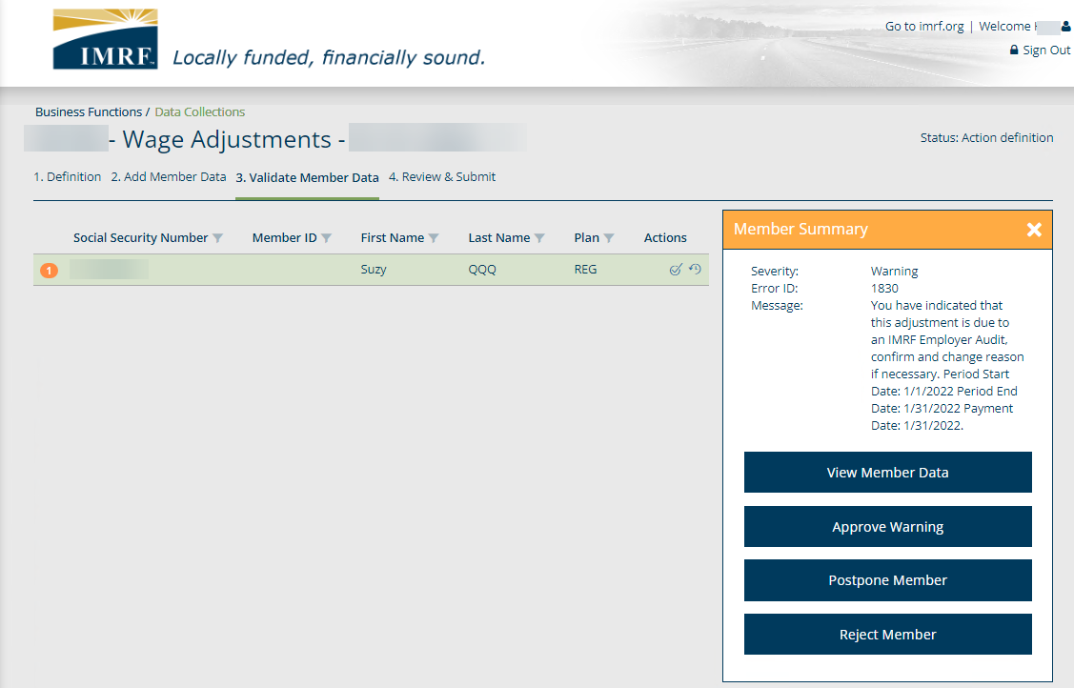
Data Collection Step 3: Validate Member Data
Upon Validation all records with warnings or errors must be addressed. Errors will show in red and warnings in orange, with the total number of issues for the member.
Click on the member and then View Member Data to make corrections.
Click Postpone to save them in a new Data Collection to submit later.
Click Reject to delete them from the Data Collection.
Click the X to close the Member Summary.
Upon resolving any warnings or errors click Validate again.
Click the row to highlight and open the Member Summary to the right.
Notes:
All records with warnings or errors must be addressed. Errors will be Red are a hard stop, with a number representing how many with a detailed explanation. Errors must be corrected prior to submission. Warnings will be in orange are a soft stop and will ask questions to approve them before submission.
You may:
Click View Member Data to make corrections.
Click Postpone to save them in a new Data Collection to submit later.
Click Reject to delete them from the Data Collection.
Click the X to close the Member Summary.
Upon resolving any warnings or errors click Validate again.

Slide 11
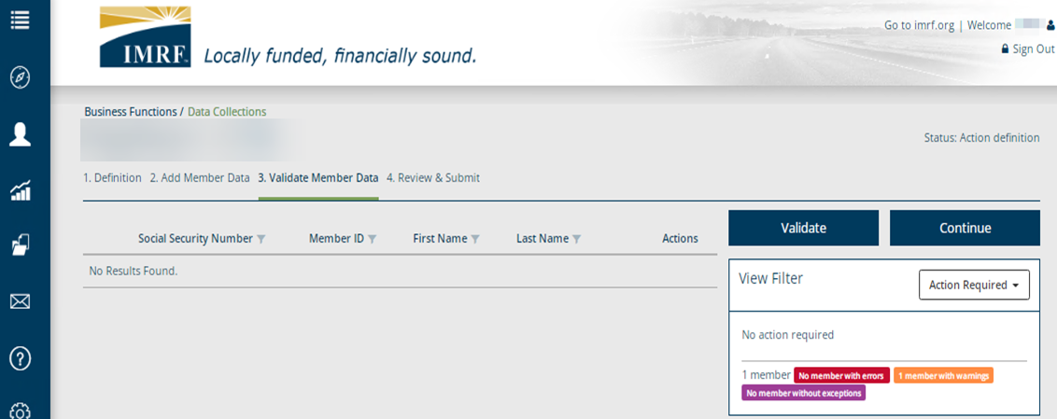
Data Collection Step 3: Validate Member Data
Once any warnings and errors have been resolved and validated, it will show no results found. Click Continue to move to Step 4. Review & Submit.
Notes:
Once any warnings and errors have been resolved and validated, it will show no results found. Click Continue to move to Step 4. Review & Submit.

Slide 12
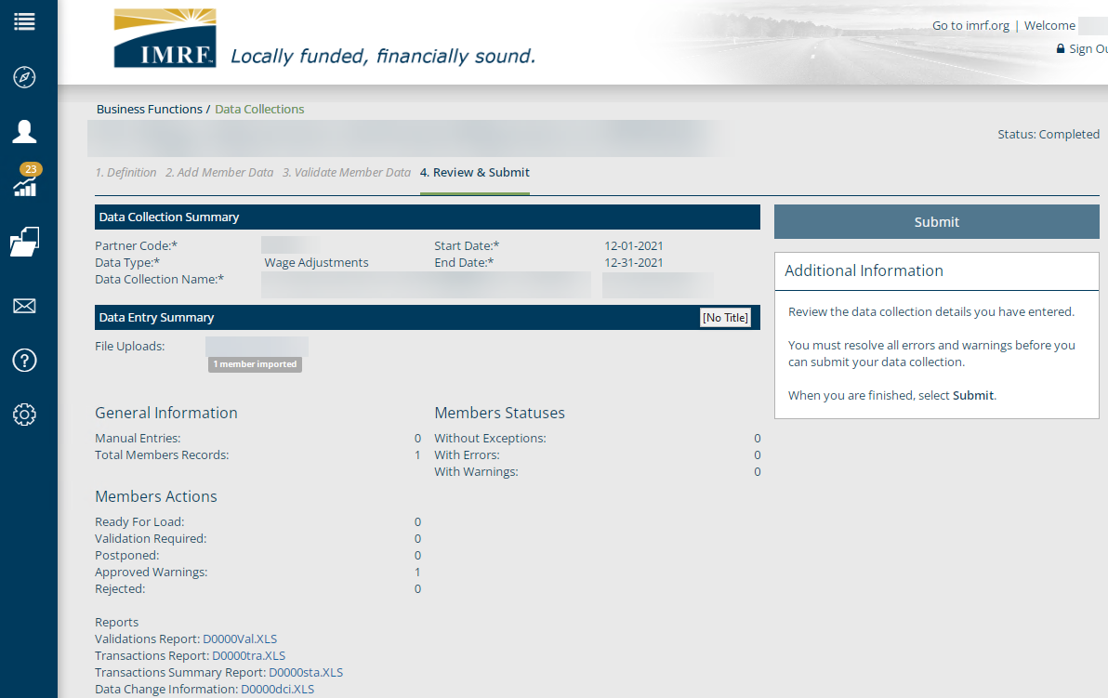
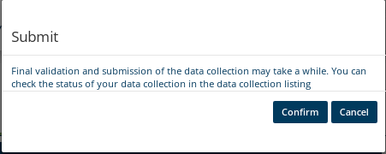
Data Collection Step 4: Review and Submit
Review the listed Data Collection Summary, Entry Summary and Reports. Upon review, click Submit then in the pop-up box click Confirm.
Notes:
Review the sections:
Data Collection Summary, Data Entry Summary and Reports.
Once review is complete, click Submit, you will get a pop-up box to confirm. Click confirm to file your wage adjustment via Add Record Manual Entry method.

Slide 13
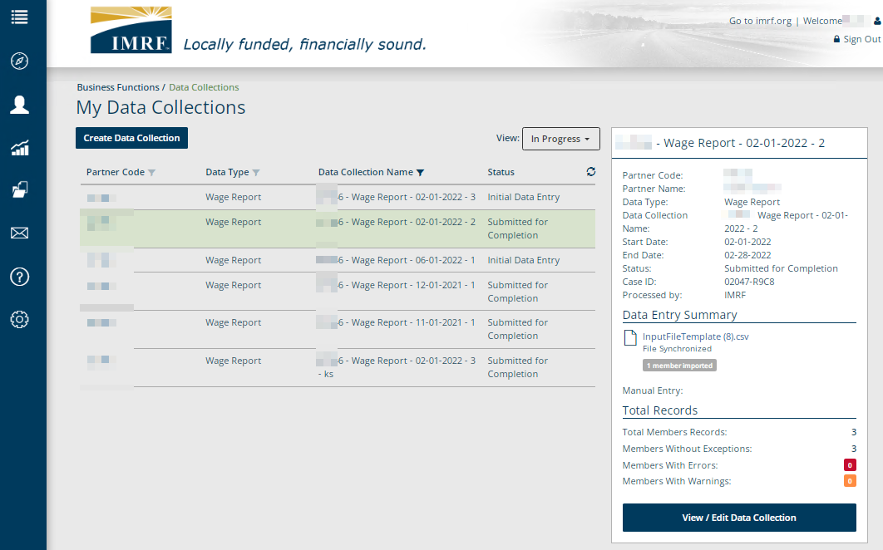
Data Collection: Check Status
Refresh Button
To check the status of a submitted data collections,
click on the collection to highlight it in green and click the Refresh button to see the updated status. You may also return later to check the status has changed to Completed.
To return later click View All in the My Data Collections widget.
Notes:
To check the status of a submitted data collection, click on the collection to highlight it in green and click the Refresh button to see the updated status or return later to check the status has changed to Completed.

Slide 14

14
Thank you for your time!
Any other questions?
Send questions via your
Employer Access Secure Messaging
Or
Employer Hotline: 1-800-728-7971
Notes:
Thank you for viewing. If you still have questions, please reach out to IMRF via Secure Message.
You may also reach us by phone at 800-728-7971. Thanks again.

