Slide 1
Viewing Employer Rates

Slide 2
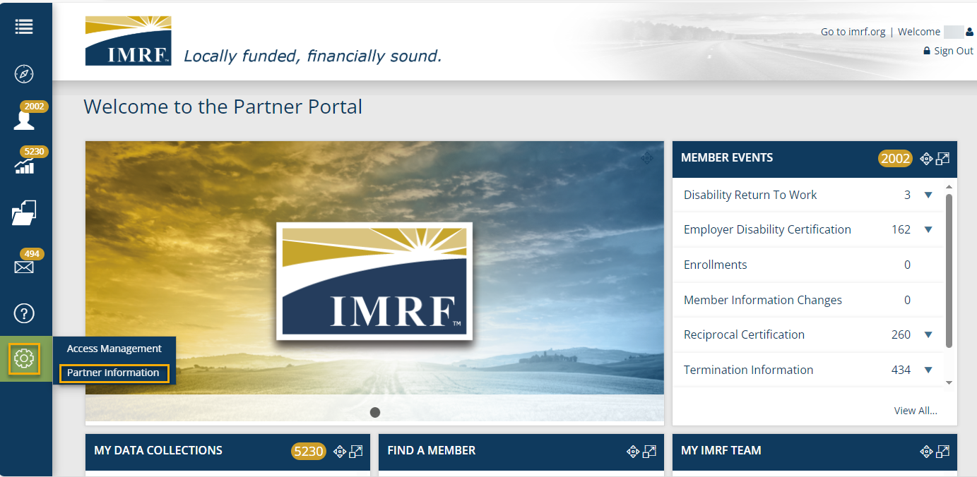
To view your employer rates, start by clicking on the “Gear” icon and then click “Partner Information.”

Slide 3
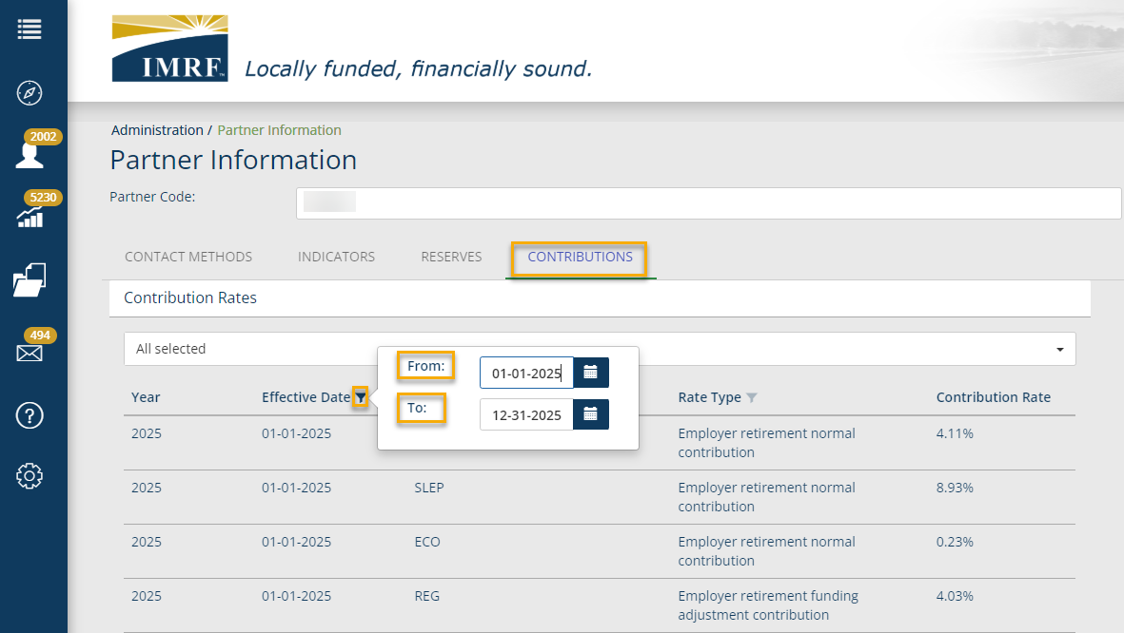
In the “Effective Date” column, click the funnel to filter for the year you would like to view. In the “From” and “To” fields, type the 1st and last day of the given year.

Slide 4
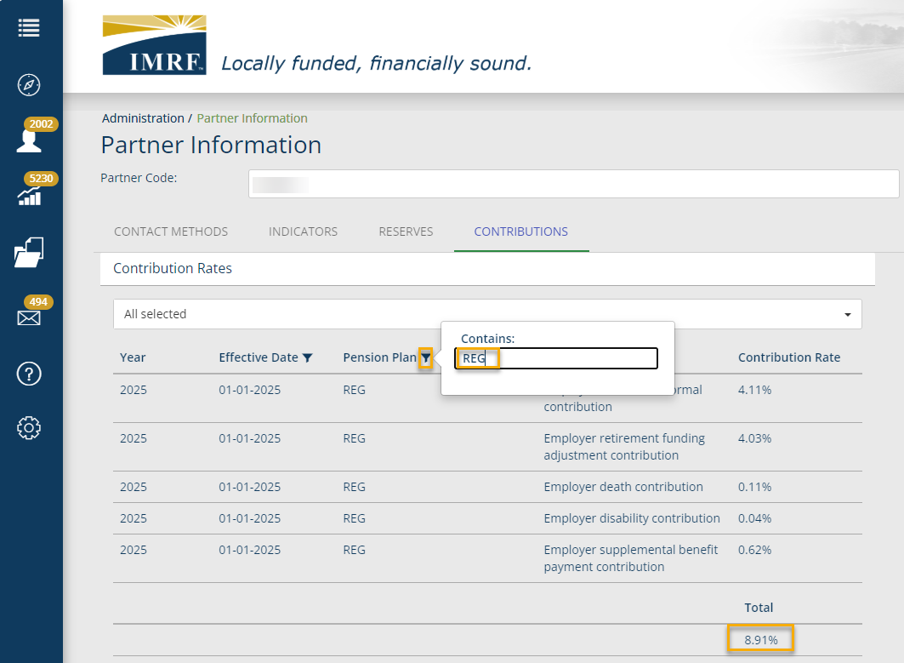
In the “Pension Plan” column, click the funnel to filter for the total rate per the Plan you wish to view.
Type REG, ECO, or SLEP. You will then see the total rate for that Plan at the bottom of your screen.
NOTE: If your employer only has the “REG” plan, you still need to type “REG” to see the contribution rate.
Also, we recommend clicking out and back into this screen if you plan on reviewing different years. There are times the data does not update properly.

Slide 5
Thank you for your time!
Any other questions?
Send questions via Secure Messaging
Or
Employer Contact Center:
1-800-728-7971

