Slide 1
Entering Bank Information and Making Payments to IMRF

Slide 2
2
Things that are new…
Employers will pay IMRF using a Pre-Authorized Debit Account.
Contributions may be paid no later than the 20th of the month.
All payments are invoice driven. A wage report or adjustment must occur to create an invoice to be paid.
Partial payments are allowed; however, interest accrues after the 20th of the month.
For employers that file wage report contributions and still have a minimum contribution due, in the new system employers will file the report and pay its invoice by the 20th. After the 21st, an invoice will generate for the outstanding minimum contributions, which is due by the last day of the month.
Notes:
Job titles will mostly relegate to General Position/Common Law, however, elected positions/city hospital workers will remain an option. Employers can now process enrollment for multiple employees as opposed to one at a time. Also, the new system is more interactive

Slide 3
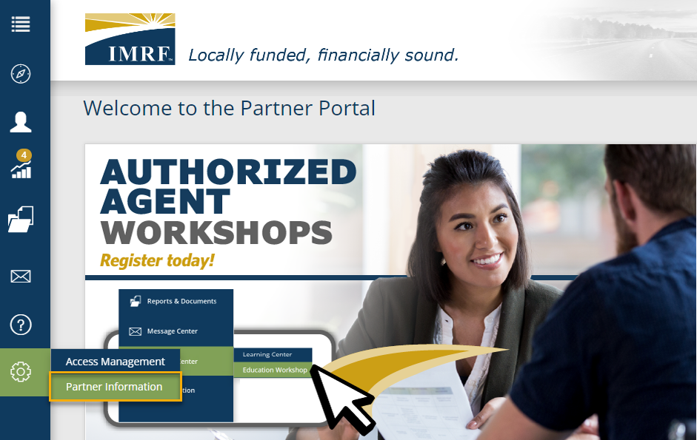
To begin the process of making a payment, banking information must be added.
First, click the gear icon on the left-hand side of the screen and then select Partner Information.
Notes:
To process an enrollment, we need to create a Data Collection. Start the Data Collection by clicking the Business Functions icon on the left-hand toolbar and select Data Collections, that will take you to a screen displaying all Data Collections previously created or on the Dashboard under the widget “My Data Collections”, click New Data Collection to go directly to Step 1.

Slide 4
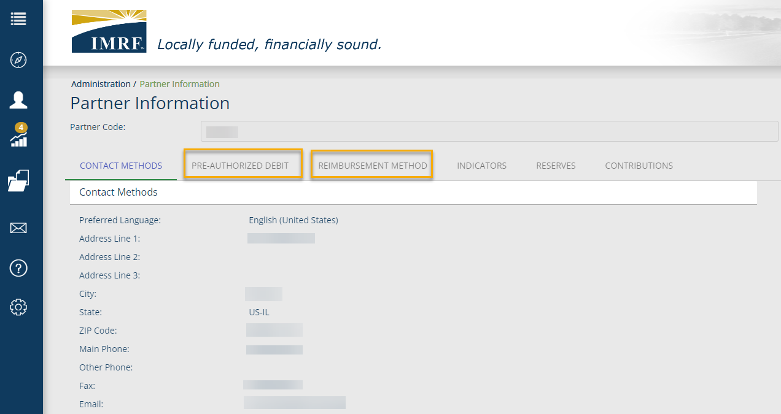
In the Pre-Authorized Debit window, you can view your bank account information. This will need to be added prior to making any payments to IMRF.
In the Reimbursement Method window, this banking detail will need to be added for your Health Insurance Continuation deductions.
Notes:
To process an enrollment, we need to create a Data Collection. Start the Data Collection by clicking the Business Functions icon on the left-hand toolbar and select Data Collections, that will take you to a screen displaying all Data Collections previously created or on the Dashboard under the widget “My Data Collections”, click New Data Collection to go directly to Step 1.

Slide 5
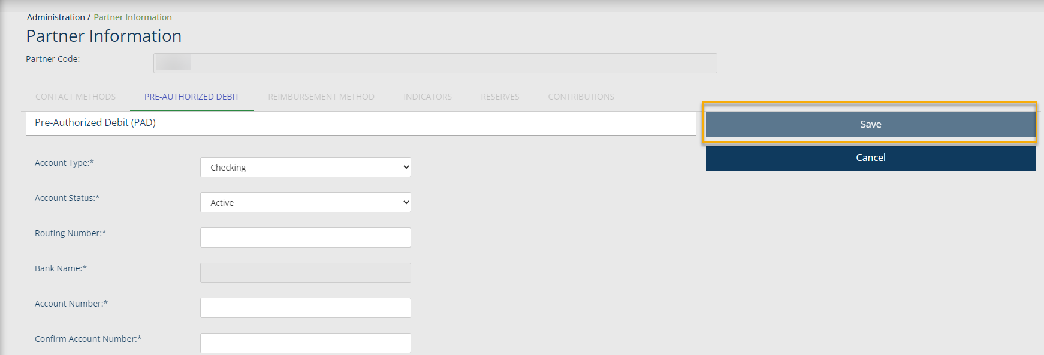
In the Pre-Authorized Debit window, click Add to input your banking information.
Complete all the fields and when done, click Save. After you add your banking information, this can be edited at any time.
Notes:
To process an enrollment, we need to create a Data Collection. Start the Data Collection by clicking the Business Functions icon on the left-hand toolbar and select Data Collections, that will take you to a screen displaying all Data Collections previously created or on the Dashboard under the widget “My Data Collections”, click New Data Collection to go directly to Step 1.

Slide 6
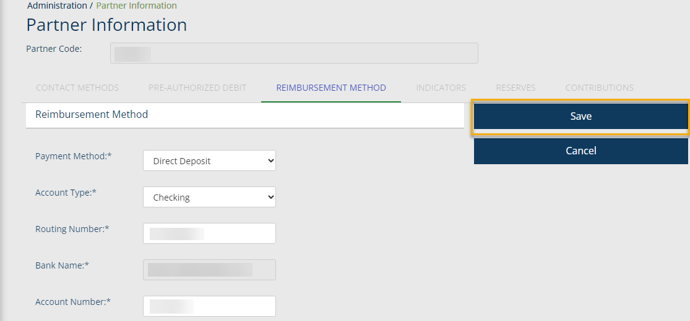
In the Reimbursement Method window, click Add to input your banking information. This does not need to be the same account you entered in the Pre-Authorized Debit window.
In this example, the banking information has already been entered. Click Edit to update/change the information. After editing, click Save.
Notes:
To process an enrollment, we need to create a Data Collection. Start the Data Collection by clicking the Business Functions icon on the left-hand toolbar and select Data Collections, that will take you to a screen displaying all Data Collections previously created or on the Dashboard under the widget “My Data Collections”, click New Data Collection to go directly to Step 1.

Slide 7
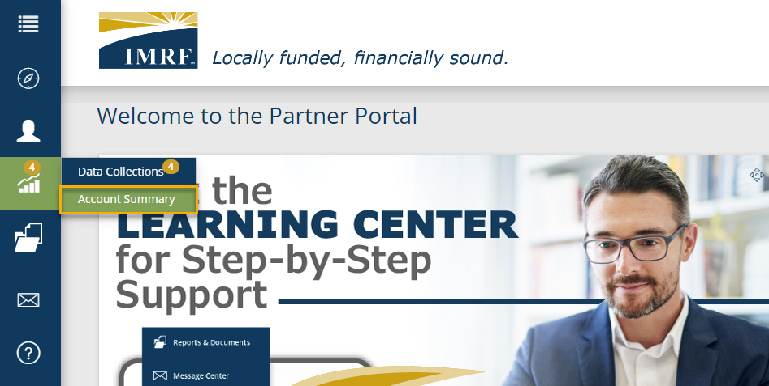
After your banking information is entered, you are now set up to make payments to IMRF.
Click the Graph icon on the left-hand side of the screen and then select Account Summary.
Notes:
To process an enrollment, we need to create a Data Collection. Start the Data Collection by clicking the Business Functions icon on the left-hand toolbar and select Data Collections, that will take you to a screen displaying all Data Collections previously created or on the Dashboard under the widget “My Data Collections”, click New Data Collection to go directly to Step 1.

Slide 8
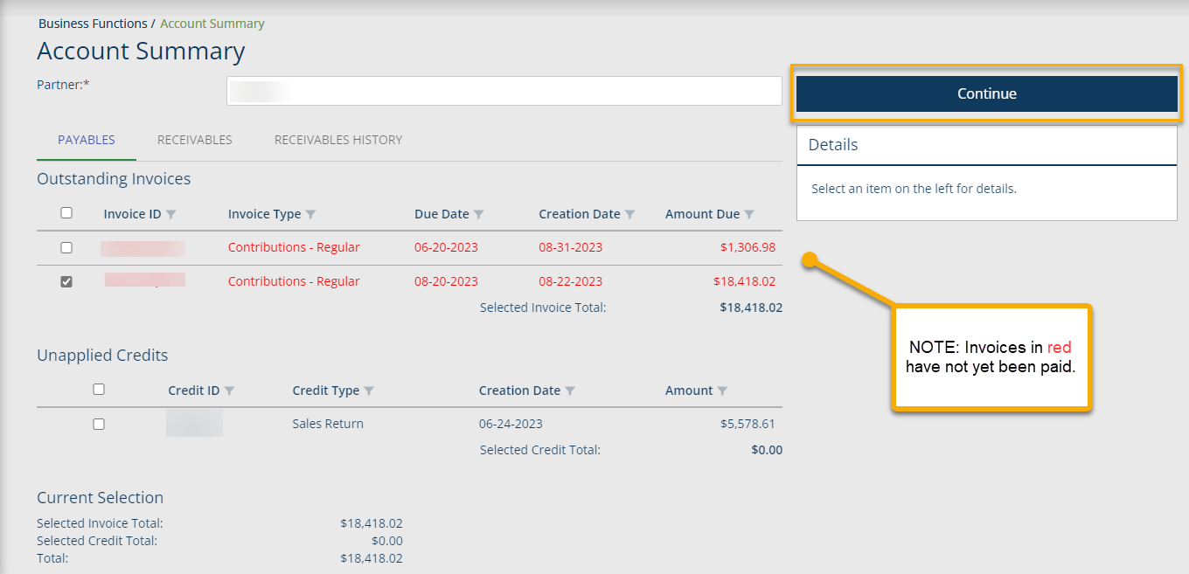
In the Payables window, select the box for the appropriate invoice in the Outstanding Invoices section you wish to pay. This can be a partial amount of the total balance that is due, however, interest accrues after the 20th of the month.
OR
To apply an Unapplied Credit toward the invoice, select the box for the appropriate credit in the Unapplied Credits section you wish to pay. Click Continue to proceed to payment finalization.
The Account Summary page is where the following actions can be performed:
Payables section:
Pay an Invoice payment to IMRF
Apply Unapplied Credits toward an outstanding invoice.
Review Account Balance.
Receivables section:
Review payments from IMRF
Receivables History
Notes:
To process an enrollment, we need to create a Data Collection. Start the Data Collection by clicking the Business Functions icon on the left-hand toolbar and select Data Collections, that will take you to a screen displaying all Data Collections previously created or on the Dashboard under the widget “My Data Collections”, click New Data Collection to go directly to Step 1.

Slide 9
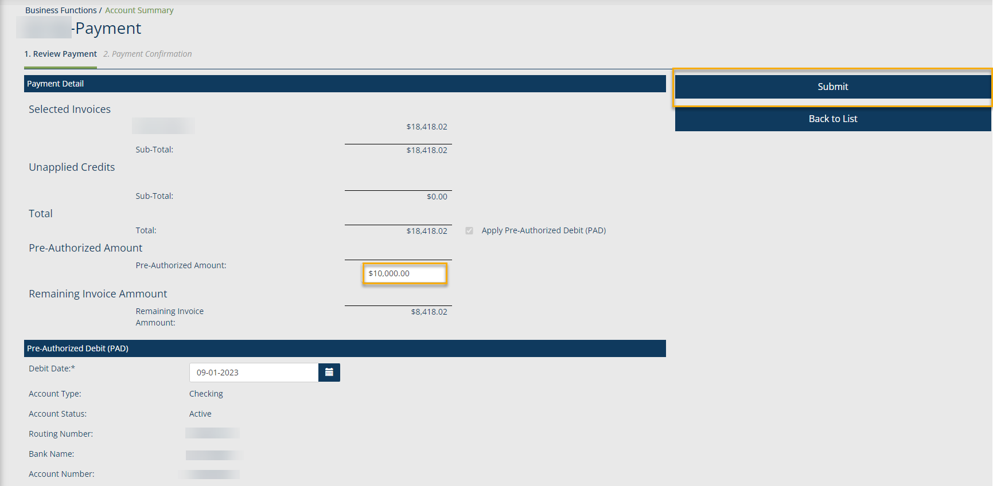
Review and Submit your payment.
REVIEW PAYMENT
You will see two sections on this screen:
Payment Detail: Review the transaction details and enter the amount you plan on paying for the selected invoice in the Pre-Authorized Amount box.
Pre-Authorized Debit (PAD): Review the banking information that will be used for the payment.
Select the Debit Date that the transaction will be debited from the account.
Click the Submit button. The payment process starts, and the Payment ID is displayed.
Notes:
To process an enrollment, we need to create a Data Collection. Start the Data Collection by clicking the Business Functions icon on the left-hand toolbar and select Data Collections, that will take you to a screen displaying all Data Collections previously created or on the Dashboard under the widget “My Data Collections”, click New Data Collection to go directly to Step 1.

