Slide 1
Insurance and Union Deductions Data Collection Add Record Manual Entry

Slide 2
Agenda
Insurance and Union Deductions
Data Collection Overview
Data Collection Creation
Add Member Data
Validation Process
Review and Submit

Slide 3
Data Collection Overview
What is a Data Collection?
Information is sent in via Employer Access as a Data Collection using a new file format, Comma-separated Value or .CSV.
Filing is Simple, Fast, Easy and Web-Centric replacing 90% of all previous forms.
For smaller employers the Add Record Manual Entry is quick, it prompts the user for information, responds interactively to prevent errors, and creates the new file format that is then submitted to IMRF.
IMRF is asking for the information you supplied to us before and some new information. This allows the employer more control over the entire life cycle of their members from enrollment through retirement.
3
Notes:
What is a Data Collection ?
Information is sent in via employer Access as a Data Collection using a new file format, Comma-separated Value or .CSV.
Filing is Simple, Fast, Easy and Web-Centric replacing 90% of all previous forms. i.e., monthly wage report, wage adjustments, enrollments, terminations, disability, etc.
For smaller employers the Add Record Manual Entry is quick, it prompts the user for information, responds interactively to prevent errors, and creates the new file format that is then submitted to IMRF.
IMRF is asking for the information you supplied to us before and some new information. The new functionality allows the employer more control over the entire life cycle of their members from enrollment through retirement.

Slide 4
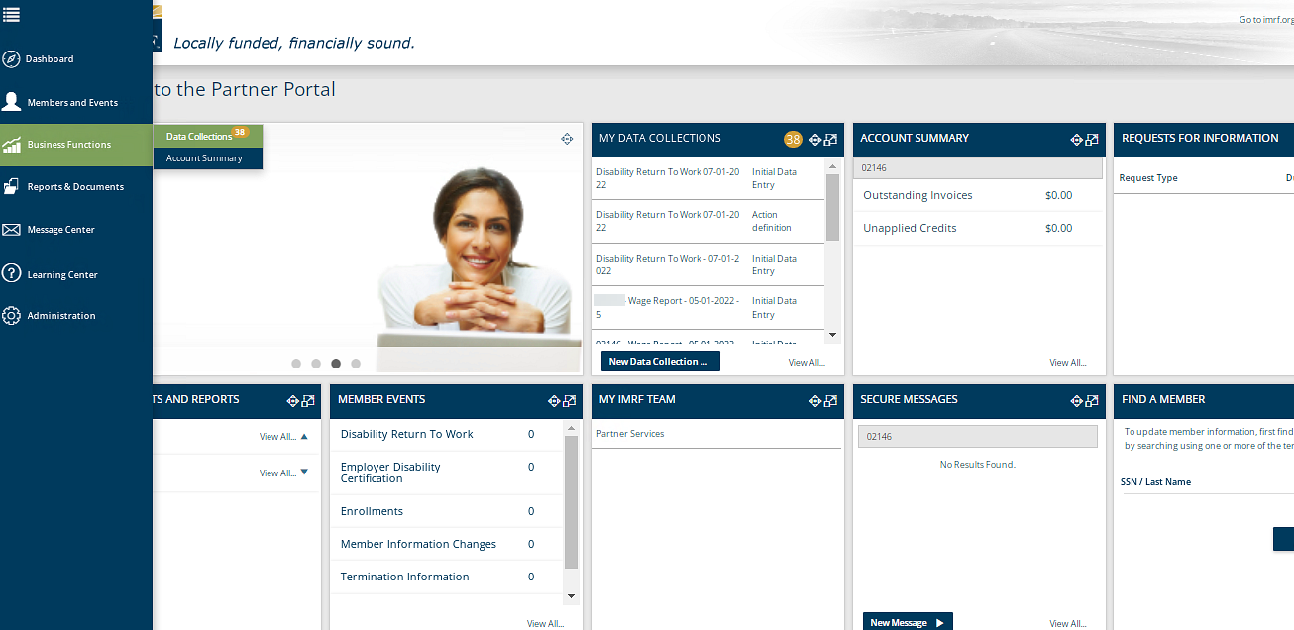
To begin the process of an Insurance or Union Deduction, a new Data Collection must be started.
Notes:
To process an Insurance or Union Deduction, we need to create a Data Collection. Start the Data Collection by clicking the Business Functions icon on the left-hand toolbar and select Data Collections, that will take you to a screen displaying all Data Collections previously created or on the Dashboard under the widget “My Data Collections”, click New Data Collection to go directly to Step 1.

Slide 5
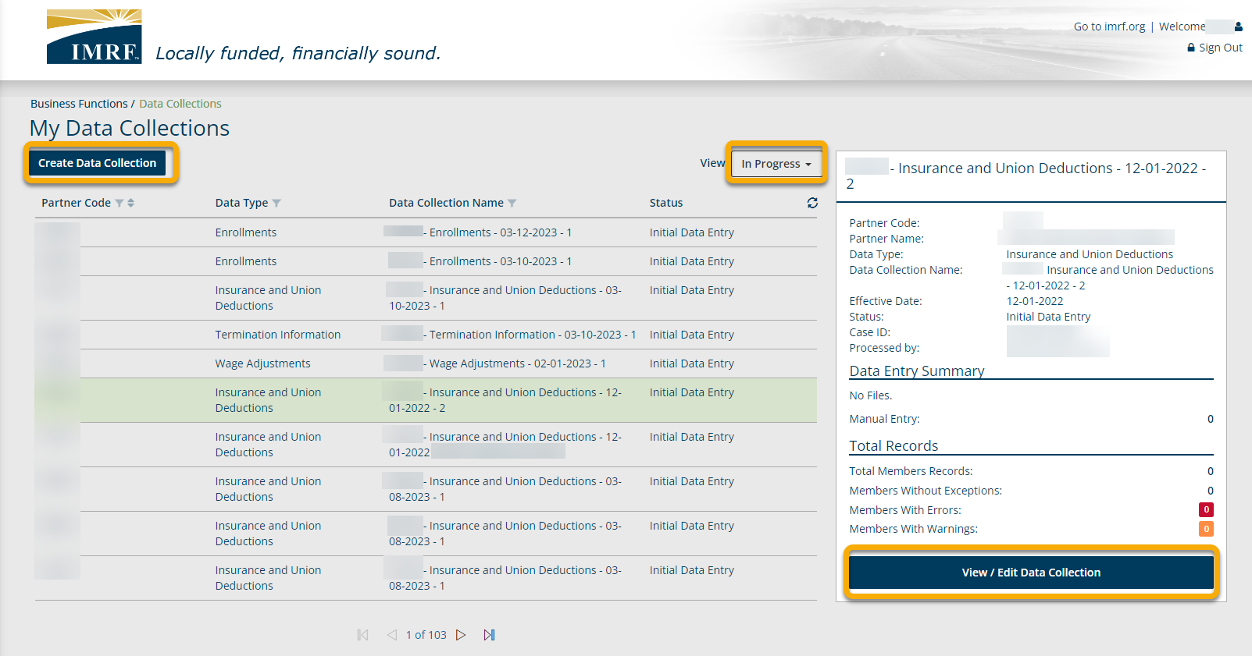
Click on Create Data Collection to start an Insurance or Union Deduction.
Data Collections previously created will be listed below with their status.
Click on row to highlight. View/edit already created Data Collections
Notes:
Click on Create Data Collection to begin the process. This screen also lists data collections that have previously been created. You can see the status by clicking on the drop-down menu next to view and it will show- In Progress, Completed or All. To View/Edit a data collection already created click on the row you want and to the right a brief summary window will open, click view/edit Data Collection.

Slide 6
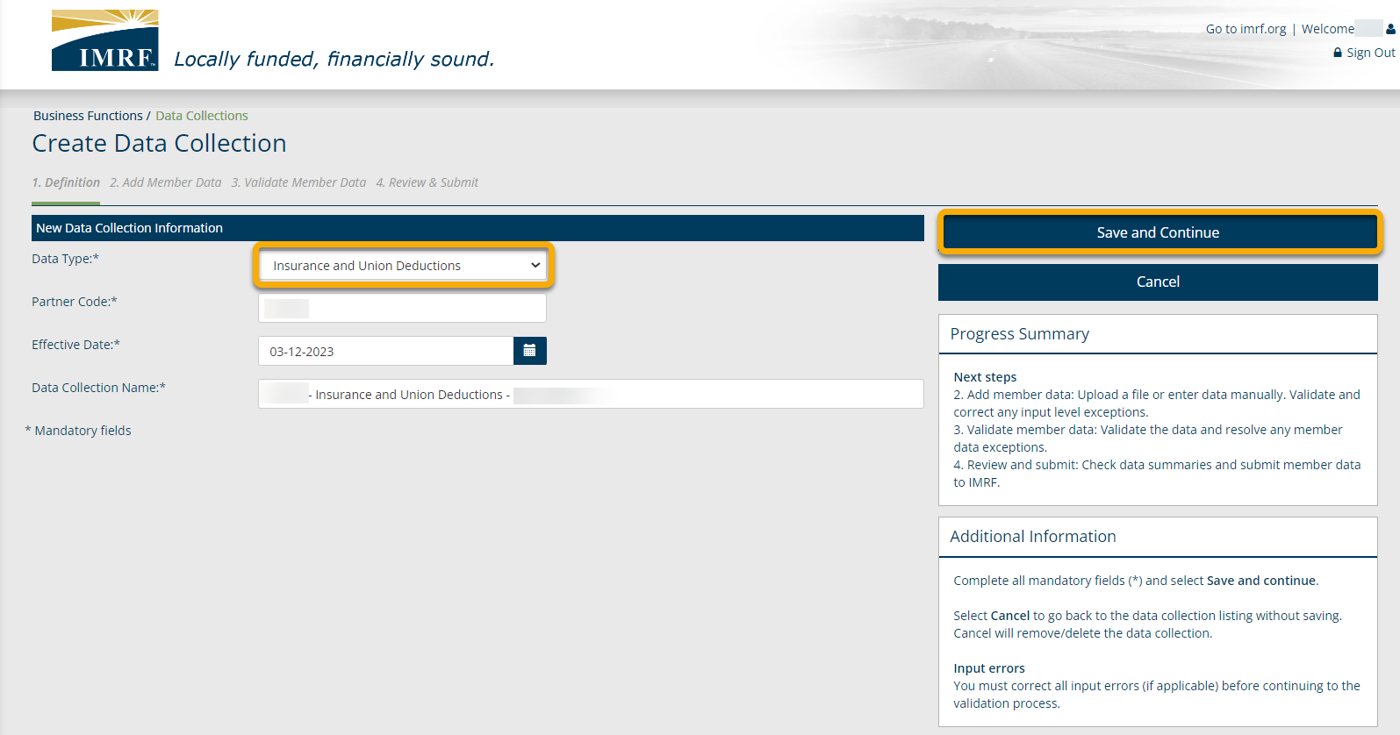
Data Collection Step 1. Definition
Select Insurance and Union Deductions as the Data Type from the drop-down menu and complete all mandatory fields. Click Save and Continue to move to the next step in the process.
Notes:
We are now at Step 1 Definition. You will need to select Insurance and Union Deductions as the Data Type from the drop-down menu. Enter Partner code; also known as employer number, enter the effective date of the insurance or union deduction change, and the Data Collection Name, which will be prepopulated for your convenience.
Click Save and Continue to bring you to step 2. Add Member Data.

Slide 7
Data Collection Step 1. Definition
Click Add Record to enter the member data.
Notes:
Click Add Record to enter the member data.

Slide 8
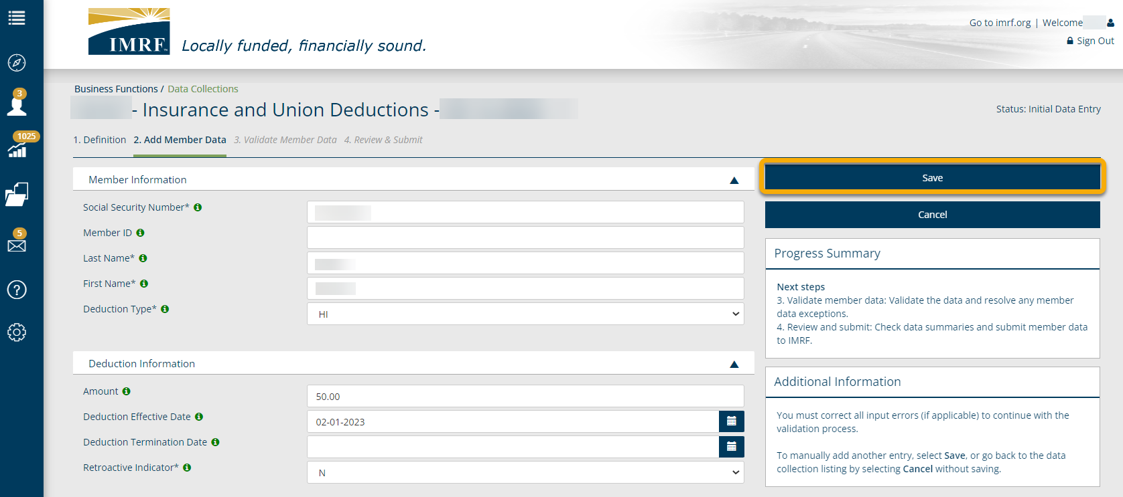
Data Collection Step 1. Definition
Enter the Member Information and Deduction Information fields and click Save.
Notes:
Enter the Insurance or Union Deduction information and click Save. If you have multiple members that need updating, after you click Save, select Add Record and repeat steps until all are entered.

Slide 9
Data Collection Step 2: Add Member Data
Once you have all member data entered, they will display on the screen. Make sure that the view is set to All to see them listed. Click Validate and this step will validate the information entered against formatting and business requirements to show any errors or warnings, if applicable.
All new members entered will display here.
Notes:
Once you have all member data entered, they will display on the screen. Make sure that the view is set to All to see them listed. Click Validate and this step will validate the information entered against formatting and business requirements. By doing this it will bring us to Step 3. Validate Member Data.

Slide 10
Data Collection Step 3. Validate Member Data
If any warnings or errors were resolved and validated, it will show no results found. In this example, there were no errors or warnings in the Data Collection. Click Continue to move to Step 4. Review & Submit.
Notes:
We have reached the final phase of validation. The screen will show no results found once any warnings and/or errors have been resolved and validated, if applicable. The right side of the screen will state no action required and show the number of members in the Data Collection. Click continue to go to Step 4. Review and Submit.

Slide 11
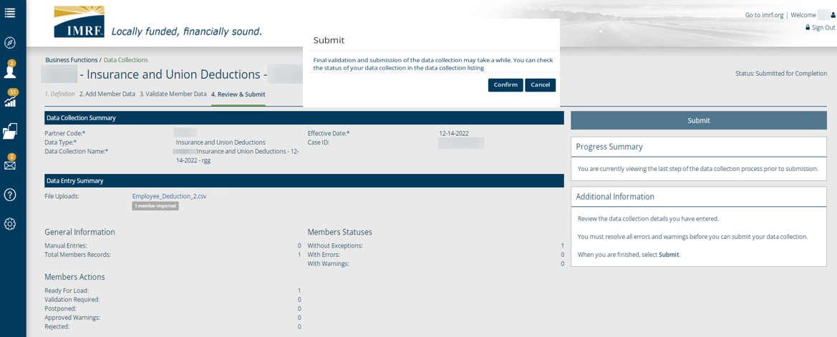
Data Collection Step 4: Review and Submit
Review the listed Data Collection and Data Entry Summary and Reports. Once review is complete, click Submit. A pop-up box will appear to confirm. Click Confirm and that will complete your Enrollment Data Collection.
Notes:
We have reached the final step in the Insurance and Union Data Collection process, Step 4. Review and Submit. When you have reviewed the summaries and reports, click Submit, you will get a pop-up box to confirm. Click confirm and that will complete your Enrollment Data Collection.

Slide 12
Thank you for your time!
Any other questions?
Send questions via Secure Messaging
Or
Employer Contact Center:
1-800-728-7971
Notes:
Thank you for viewing. If you still have questions, please reach out to IMRF via Secure Message. You may also reach us by phone at 800-728-7971. Thanks again.

