Slide 1
Enrollments Data Collection Add Record Manual Entry

Slide 2
Agenda
Enrollments
Data Collection Overview
Data Collection Creation
Add Member Data
Validation Process
Review and Submit

Slide 3
Data Collection Overview
What is a Data Collection?
Information is sent in via Employer Access as a Data Collection using a new file format, Comma-separated Value or .CSV.
Filing is Simple, Fast, Easy and Web-Centric replacing 90% of all previous forms.
For smaller employers the Add Record Manual Entry is quick, it prompts the user for information, responds interactively to prevent errors, and creates the new file format that is then submitted to IMRF.
IMRF is asking for the information you supplied to us before and some new information. This allows the employer more control over the entire life cycle of their members from enrollment through retirement.
3
Notes:
What is a Data Collection ?
Information is sent in via employer Access as a Data Collection using a new file format, Comma-separated Value or .CSV.
Filing is Simple, Fast, Easy and Web-Centric replacing 90% of all previous forms. i.e., monthly wage report, wage adjustments, enrollments, terminations, disability, etc.
For smaller employers the Add Record Manual Entry is quick, it prompts the user for information, responds interactively to prevent errors, and creates the new file format that is then submitted to IMRF.
IMRF is asking for the information you supplied to us before and some new information. The new functionality allows the employer more control over the entire life cycle of their members from enrollment through retirement.

Slide 4
4
Enrollment Overview
Things that will stay the same… | Things that are new…
Titles for elected positions/city hospital workers | Most position titles will be General Position/Common Law
 | Multiple employees can be enrolled in same data collection Plans are defined as REG SLEP or ECO, without a Tier 1 or 2 Its interactive with the User to help prevent errors
Notes:
Job titles will mostly relegate to General Position/Common Law, however, elected positions/city hospital workers will remain an option. Employers can now process enrollment for multiple employees as opposed to one at a time. Also, the new system is more interactive

Slide 5
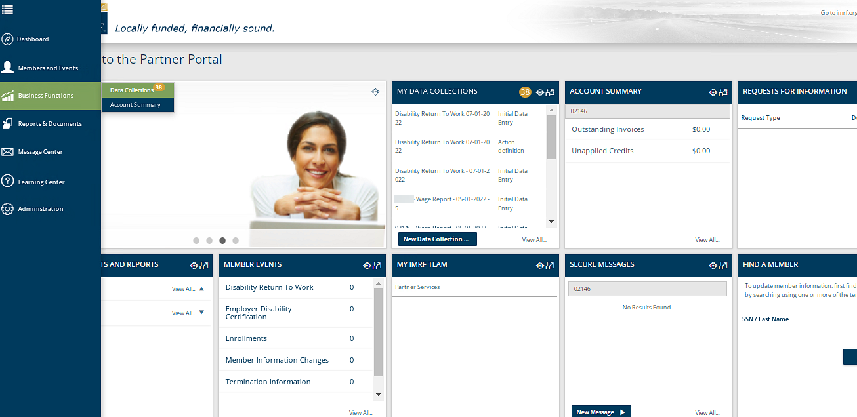
To begin the process of an Enrollment, a new Data Collection must be started.
Notes:
To process an enrollment, we need to create a Data Collection. Start the Data Collection by clicking the Business Functions icon on the left-hand toolbar and select Data Collections, that will take you to a screen displaying all Data Collections previously created or on the Dashboard under the widget “My Data Collections”, click New Data Collection to go directly to Step 1.

Slide 6
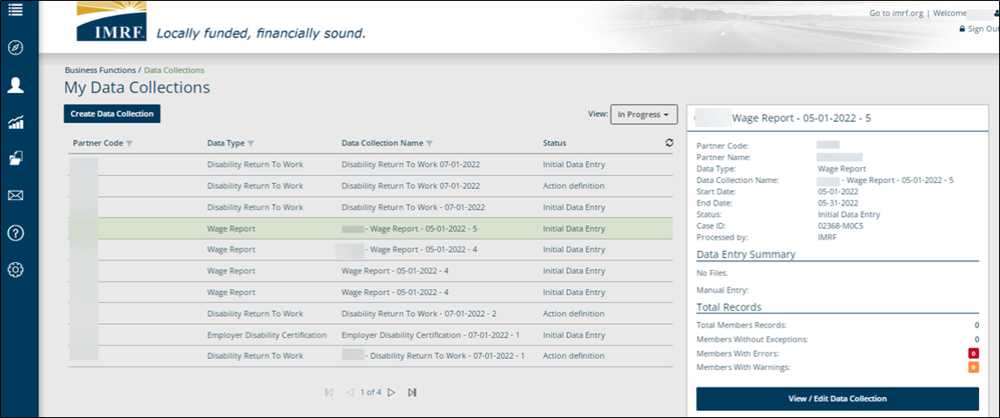
Click on Create Data Collection to start an enrollment.
Data Collections previously created will be listed below with their status.
Click on row to highlight. View/edit already created Data Collections
Notes:
Click on Create Data Collection to begin the enrollment process. This screen also lists data collections that have previously been created. You can see the status by clicking on the drop-down menu next to view and it will show- In Progress, Completed or All. To View/Edit a data collection already created click on the row you want and to the right a brief summary window will open, click view/edit Data Collection.

Slide 7
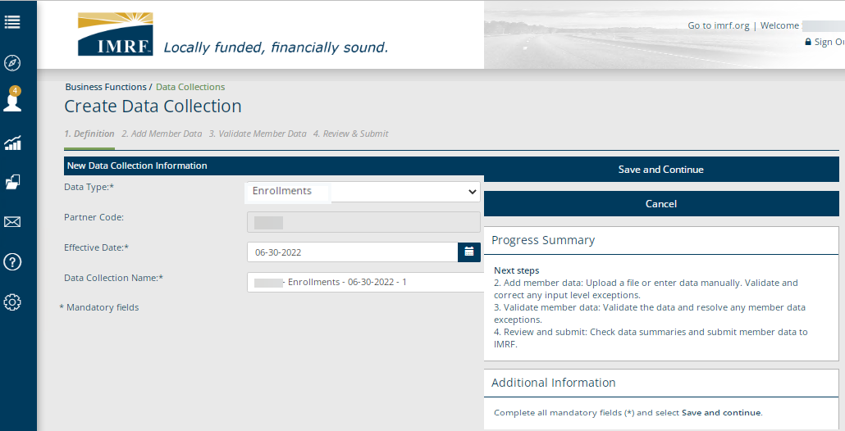
Data Collection Step 1. Definition
Select Enrollments as the Data Type from the drop-down menu and complete all mandatory fields. Click Save and Continue to move to the next step in the process.
Notes:
We are now at Step 1 Definition. You will need to select Enrollments as the Data Type from the drop-down menu. Enter Partner code, also known as, employer number, enter the effective date of enrollment and the Data Collection Name, which will be prepopulated for your convenience.
Click Save and Continue to bring you to step 2. Add Member Data.

Slide 8
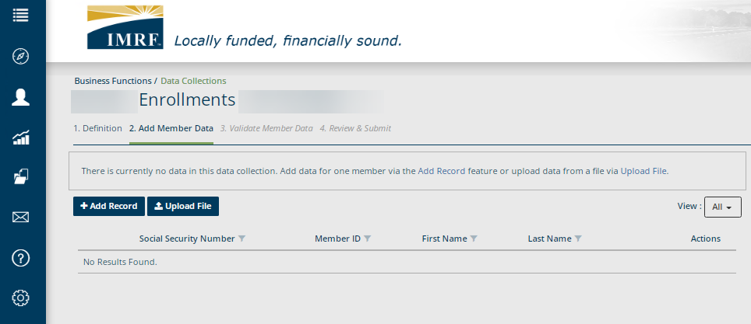
Data Collection Step 1. Definition
Click Add Record to enter the member data.
Notes:
Click Add Record to enter the member data.

Slide 9
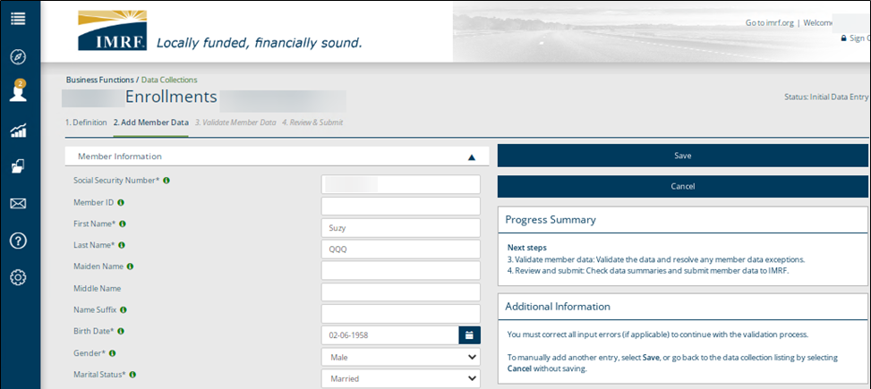
Data Collection Step 1. Definition
Enter Enrollment information and click Save.
If you have multiple Enrollments, after you click Save, select Add Record and repeat steps until all are entered.
Notes:
Enter the Enrollment information and click Save. If you have multiple enrollments, after you click Save, select Add Record and repeat steps until all are entered.

Slide 10
Data Collection Step 2: Add Member Data
Once you have all member data entered, they will display on the screen. Make sure that the view is set to All to see them listed. Click Validate and this step will validate the information entered against formatting and business requirements to show any errors or warnings, if applicable.
All new members entered will display here.
Notes:
Once you have all member data entered, they will display on the screen. Make sure that the view is set to All to see them listed. Click Validate and this step will validate the information entered against formatting and business requirements. By doing this it will bring us to Step 3. Validate Member Data.

Slide 11
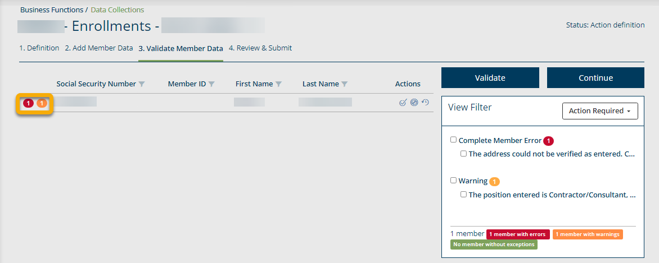
Data Collection Step 3. Validate Member Data
If the system shows any errors or warnings, action is required before submission. Errors will show in red and warnings in orange, with the total number of issues for the member.
Notes:
At the completion of Step 2, validate would alert the system of any errors or warnings, if applicable. This information would now be for step 3. Validate member Data. If the system shows any errors or warnings, there is action required before submission.

Slide 12
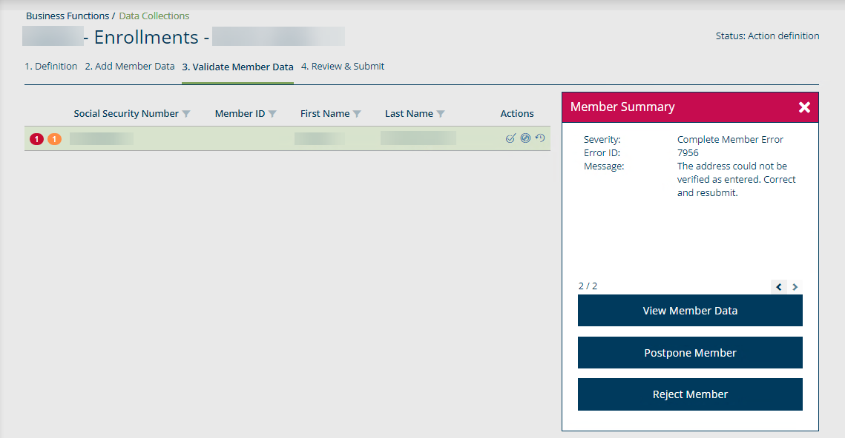
Data Collection Step 3: Validate Member Data
To address a member with errors or warnings, click on the row and a Member Summary box will open. From there you could act by selecting one of the options.
Click X to close
Click the row to highlight and open the Member Summary to the right.
Click on any option below to make corrections to member.
Notes:
To address a member with errors or warnings, click on the row and a Member Summary box will open to the right. Click on one of the options to make corrections to the member. To close the Member Summary, click the X.

Slide 13
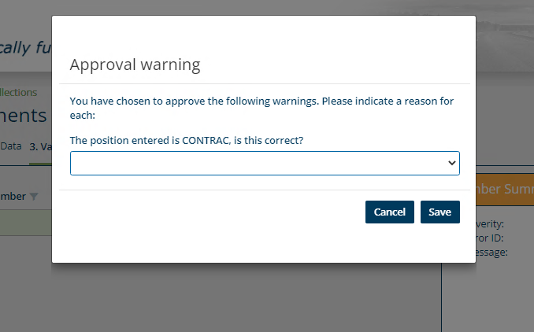
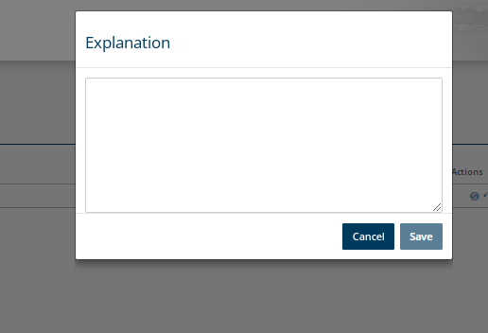
Data Collection Step 3: Validate Member Data
For enrollment warnings that were approved, a pop-up box will appear and ask for a reason. Answer the questions and click, Save. Once saved, click Validate.
For enrollment errors that were postponed or rejected, a pop-up box will require an explanation, provide and click Save. Once saved, click Validate.
Notes:
If there is a warning that was approved a pop-up box will appear and ask for the reason of approval. Answer the questions and click Save. If an error was postponed or rejected, you will have a pop-up box that will require an explanation. Please provide one and select Save. After providing the information you will see a validate button. Click validate to move on.

Slide 14
Data Collection Step 3: Validate Member Data
Once any warnings and errors have been resolved and validated, it will show no results found since all issues have been cleared in previous step. To the right it will show the number of members. Click Continue to move to Step 4. Review & Submit.
Notes:
We have reached the final phase of validation. The screen will show no results found once any warnings and/or errors have been resolved and validated, if applicable. The right side of the screen will state no action required and show the number of members in the Data Collection. Click continue to go to Step 4. Review and Submit.

Slide 15
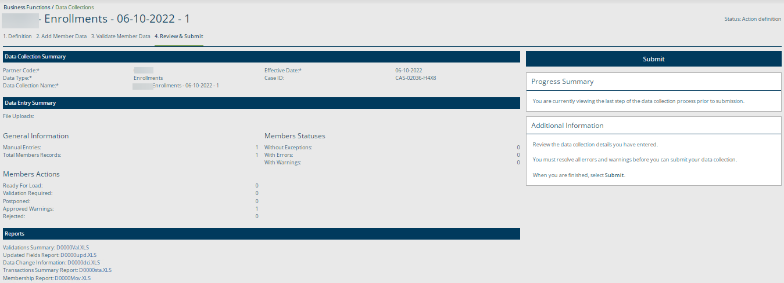
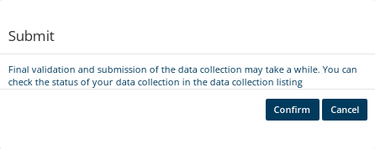
Data Collection Step 4: Review and Submit
Review the listed Data Collection and Data Entry Summary and Reports. Once review is complete, click Submit. A pop-up box will appear to confirm. Click Confirm and that will complete your Enrollment Data Collection.
Notes:
We have reached the final step in the Enrollment Data Collection process, Step 4. Review and Submit. When you have reviewed the summaries and reports, click Submit, you will get a pop-up box to confirm. Click confirm and that will complete your Enrollment Data Collection.

Slide 16
Thank you for your time!
Any other questions?
Send questions via Secure Messaging
Or
Employer Contact Center:
1-800-728-7971
Notes:
Thank you for viewing. If you still have questions, please reach out to IMRF via Secure Message. You may also reach us by phone at 800-728-7971. Thanks again.

