Slide 1


Employer Access: Employer Disability Certification

Slide 2

Agenda
Employer Disability Certification
          Data Collection Creation
          How to submit an Employer Disability Certification
          How to Upload the employee’s Job Description
Notes:
In this webinar, we will touch on: (read list)

Slide 3
Data Collection Overview
What is a Data Collection?
Information is sent through Employer Access as a Data Collection using a new file format, Comma-separated Value or .CSV.
Filing is Simple, Fast, Easy and Web-Centric replacing 90% of all previous forms.
For smaller employers the Add Record Manual Entry is quick, it prompts the user for information, responds interactively to prevent errors, and creates the new file format that is then submitted to IMRF.
IMRF is asking for the information you supplied to us before and some new information. This allows the employer more control over the entire life cycle of their members from enrollment through retirement.
3
Notes:
What is a Data Collection ?
Information is sent in via employer Access as a Data Collection using a new file format, Comma-separated Value or .CSV.
Filing is Simple, Fast, Easy and Web-Centric replacing 90% of all previous forms. i.e., monthly wage report, wage adjustments, enrollments, terminations, disability, etc.
For smaller employers the Add Record Manual Entry is quick, it prompts the user for information, responds interactively to prevent errors, and creates the new file format that is then submitted to IMRF.
IMRF is asking for the information you supplied to us before and some new information. The new functionality allows the employer more control over the entire life cycle of their members from enrollment through retirement.

Slide 4
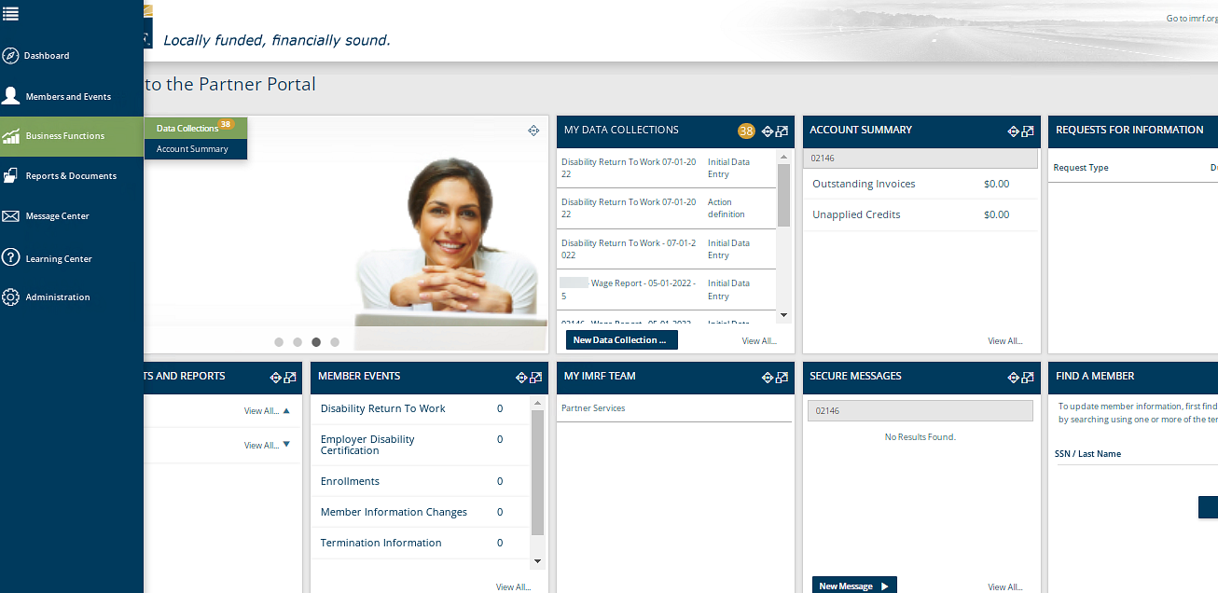
Create a Data Collection
To begin the process of entering an Employer Disability Certification, a new Data Collection must be started.
Notes:
Start the Data Collection by clicking the Business Functions icon on the left-hand toolbar and click Data Collections, that will take you to a screen displaying all Data Collections previously created. Or on the Dashboard under the widget “My Data Collections”, click New Data Collection to go directly to Step 1.

Slide 5
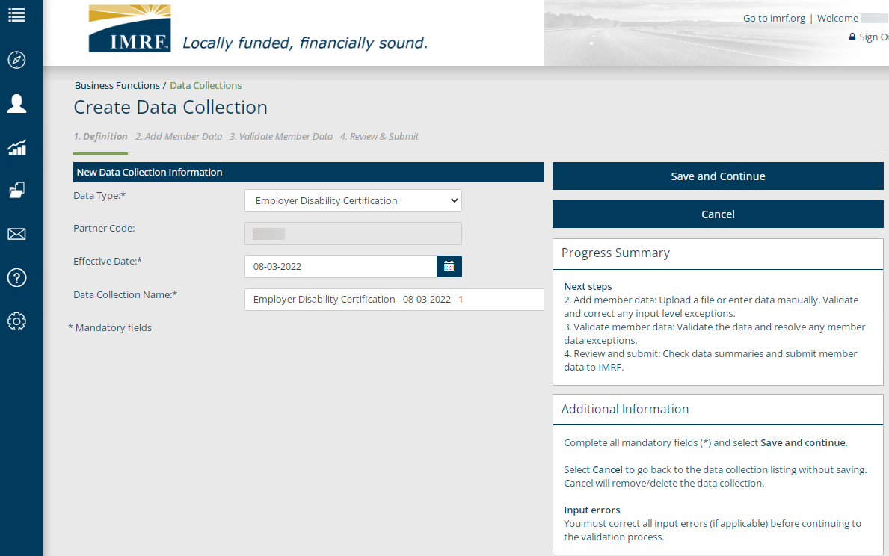
Data Collection Step 1. Definition
Enter Data Collection Information and click Save and Continue.
Notes:
We are now at Step 1. To create the data collection, select “Employer Disability Certification” from the Data Type drop down list. Enter remaining fields, then click Save and Continue.

Slide 6
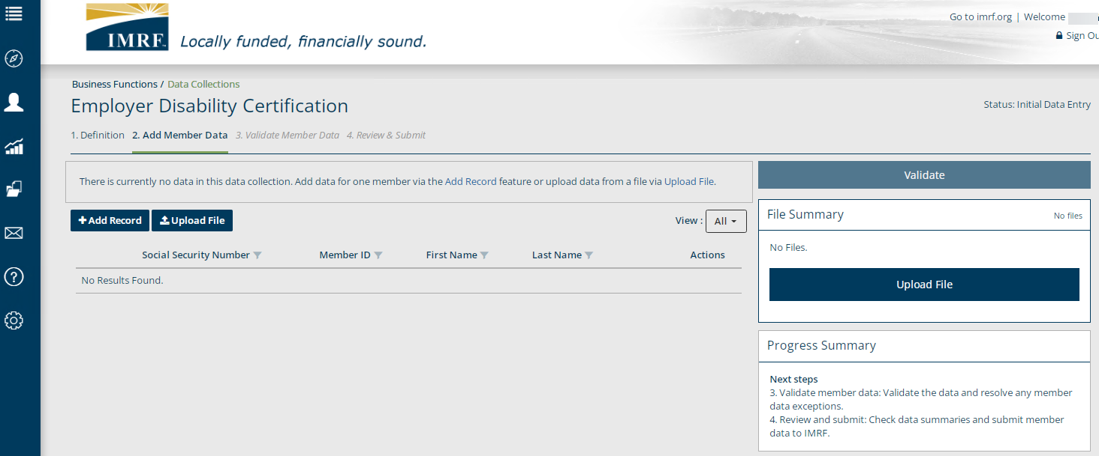
Data Collection Step 2. Add Member Data
Click Add Record to enter the member data.
Notes:
We are now at step 2- Add Member Data. Click Add Record and you will be directed to a screen to enter the Employer Disability Certification information.

Slide 7
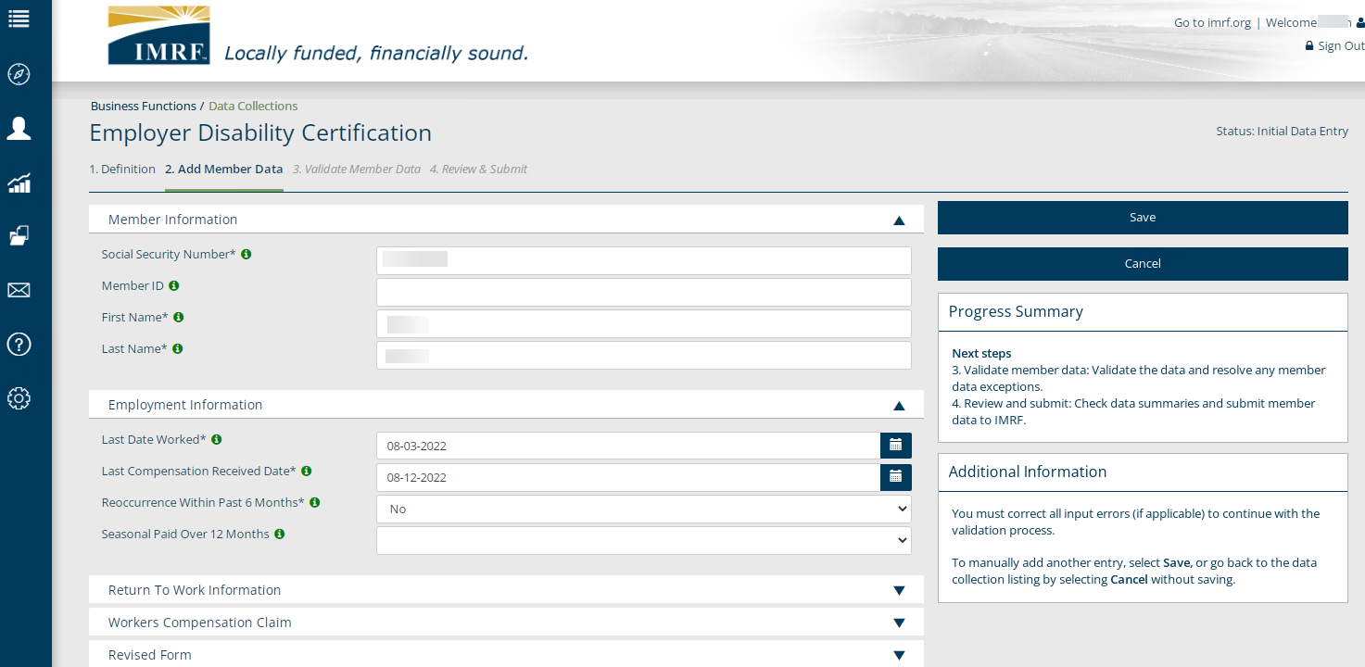
Data Collection Step 2. Add Member Data
Enter the member data information and click Save.
Notes:
Enter the member data information. If you are correcting information previously submitted to IMRF, select “yes” under the revised form section. Click Save. After you click Save and you have more than one member to report, click Add Record and repeat the process until all members are entered.

Slide 8
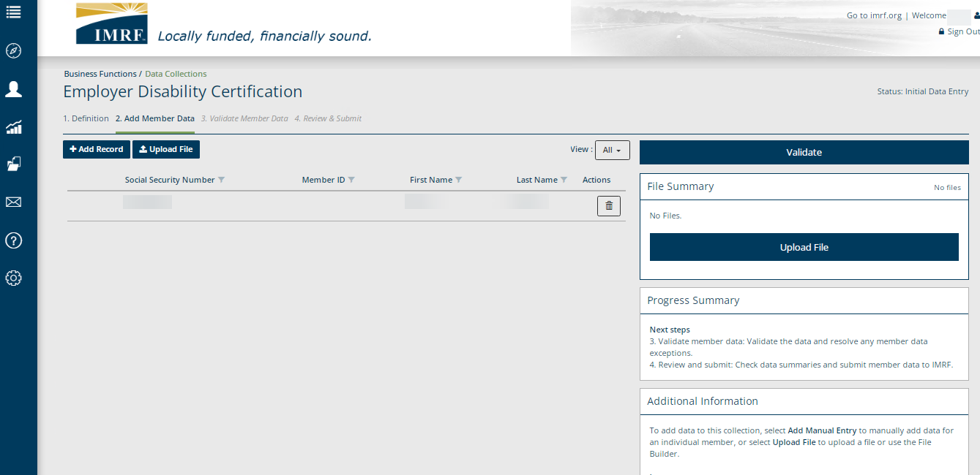
Data Collection Step 2. Add Member Data
With member data entered, click Validate.
All members entered will display on screen.
Notes:
Once you have all member data entered and saved, they will be displayed. Click Validate and this step will validate the information entered against formatting and business requirements to show any errors or warnings, if applicable. By doing this it will bring us to Step 3. Validate Member Data.

Slide 9
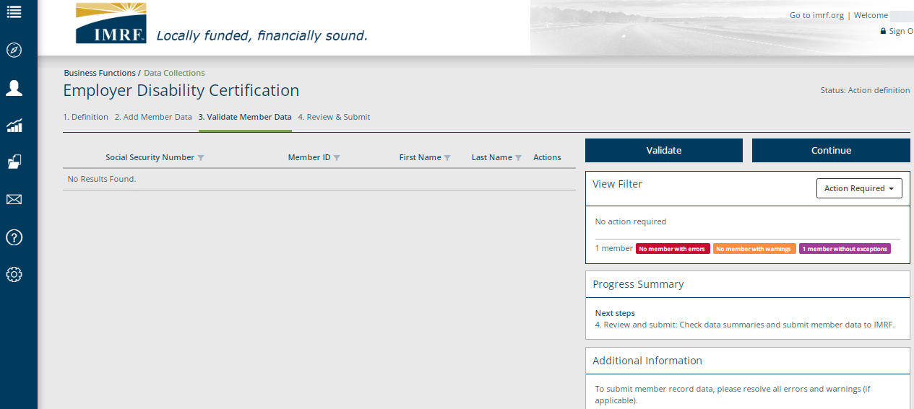
Data Collection Step 3. Validate Member Data
Once errors or warnings are resolved or if you had no issues, you would see, No Results Found. Click Continue to Step 4. Review and Submit.
Any errors or warnings will show here to resolve before you can continue.
Notes:
After validating the file, make sure there are no errors or warnings requiring action to continue. You’ll find them on the right-hand side of the screen. If no errors, then click Continue.

Slide 10
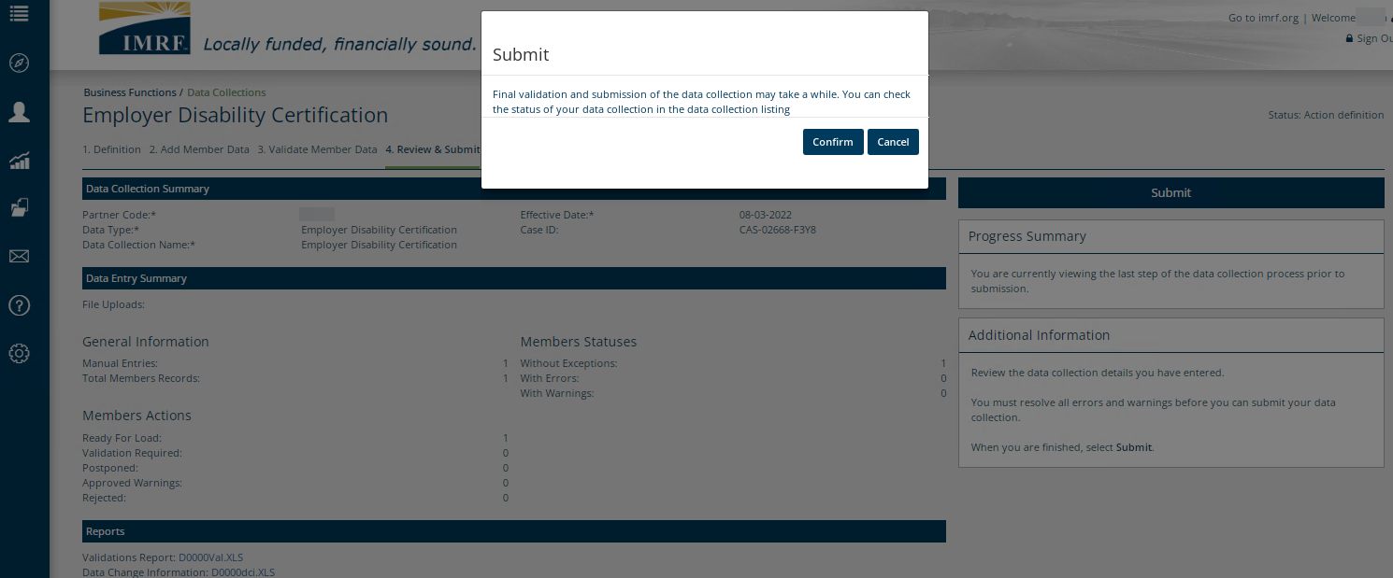
Data Collection Step 4: Review and Submit
Review the data collection details you have entered. Click Submit and you will get a pop up to confirm.
Notes:
After validation, you will be able to submit the data collection to IMRF. You will receive a pop-up box asking for confirmation. After confirming the submission, you may move on to uploading a copy of the member’s job description. It is not required that the job description is uploaded right after submitting the data collection. However, doing so would complete the action required by the employer when certifying a member’s disability.

Slide 11
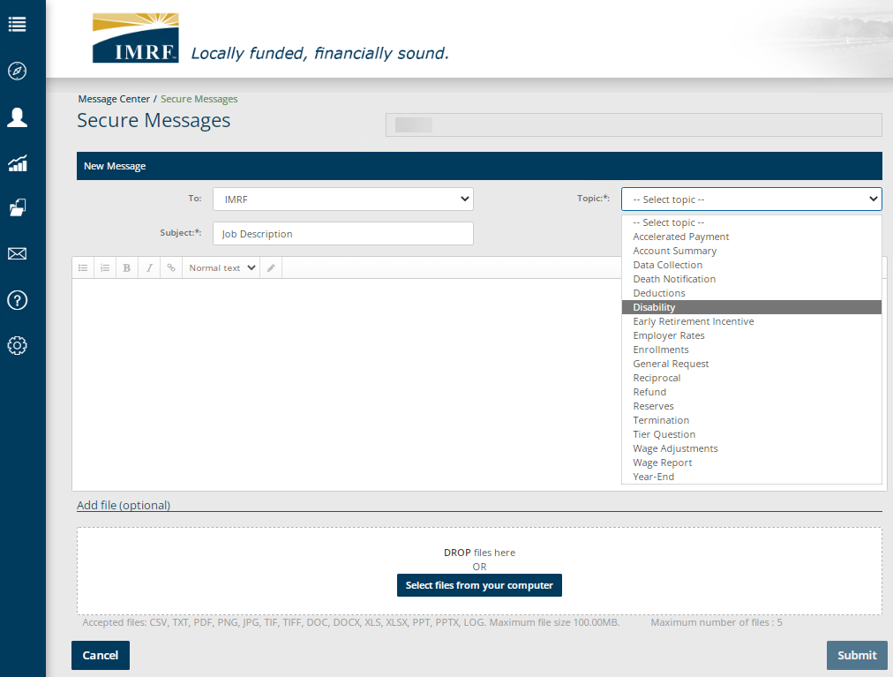
Upload the job description with a Secure Message
Click envelope icon on the left toolbar to open a Secure Message
Select “Disability” as topic
Provide the member’s name and member ID number
Attach copy of the job description with the member’s name and member ID number written on it
Click Submit to send the Secure Message
Hello,
Please see the attached job description for (member name) (Member ID).
With the robust drop-down list, you’ll find that communicating through Secure Message is an efficient means of not only sending IMRF documents but also submitting questions on a variety of topics to our Employer Services Contact Center!
Notes:
To send IMRF the job description, upload via secure message. Select disability as the topic and complete the subject field. Attach a copy of the document and provide the members identifying information. When complete, click Submit completing the Employer disability Certification process.

Slide 12

Thank you for your time!
Any other questions?
Send questions through Secure Messaging
Or
Employer Contact Center:
1-800-728-7971
Notes:
Thank you for viewing. If you still have questions, please reach out to IMRF via Secure Message. You may also reach us by phone at 800-728-7971. Thanks again.

