Slide 1
Employer Access: Password Reset

Slide 2
Agenda
Employer Access Password Reset
Steps to Initiate Password Reset
Recovery Method Options
Set up New Password
Notes:
In this video, we will touch on:
Steps to Initiate Password Reset
Recovery Method Options
Set up New Password

Slide 3
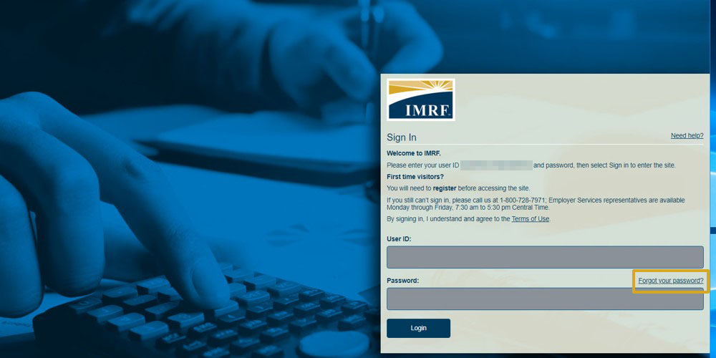
If you can’t sign in because of a forgotten password, click Forgot your password to reset.
Notes:
In the event of a forgotten password, select Forgot your password from the login screen.

Slide 4
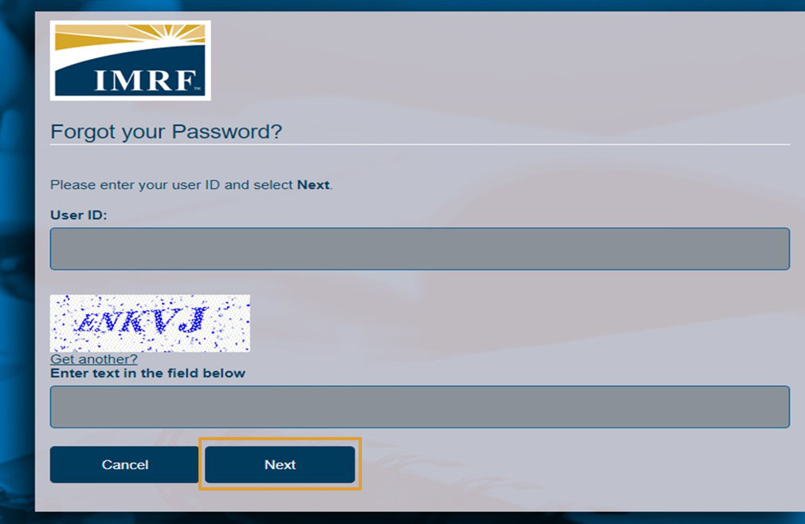
Enter your User ID and Captcha. Click Next.
Notes:
After selecting Forgot your password on the login page, you will need to enter your User ID. Confirm you are not a robot by answering the CAPTCHA. Then click Next.

Slide 5
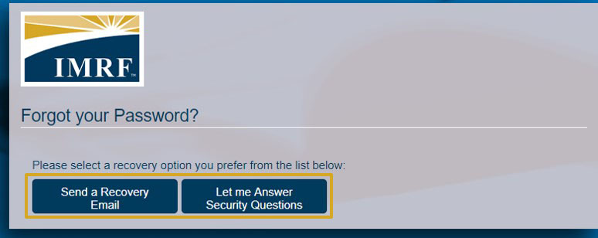
Select a password reset method.
Notes:
Select the recovery option you prefer to use to help reset your password. Have a recovery email sent or answer security questions.

Slide 6
Recovery method – Email
Click the link to reset.
Notes:
If you chose email as your recovery method, you will get an email with a link to reset your password. The link will expire after 24 hours.

Slide 7
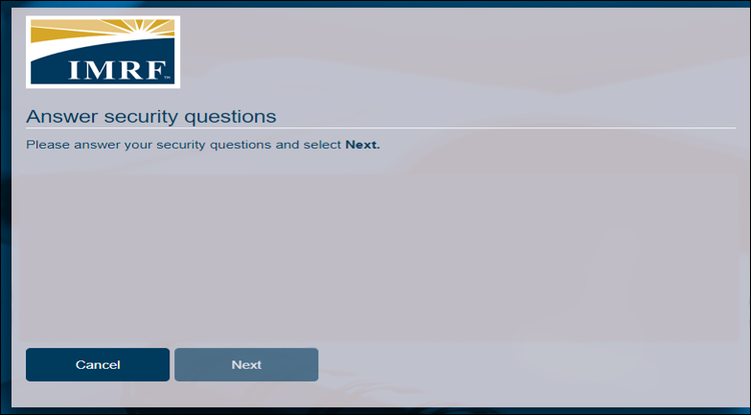
Recovery method – Security Questions
Answer questions and click Next.
The system will provide you with security questions to choose from.
Notes:
If you chose security questions as your recovery method, answer the questions and click Next. You will then be prompted to setup a new password.

Slide 8
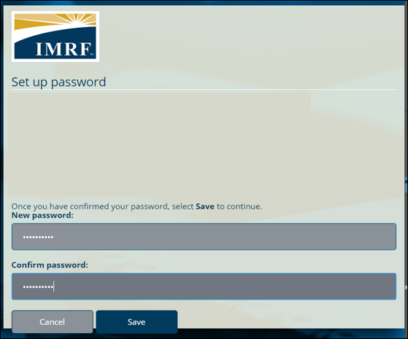
Set up and confirm the new password and click Save. When successful, click Back to sign in.
The system will provide you specific password requirements.
The system will provide you specific password requirements.
Notes:
Set up your new password following the guidelines provided. Once you have successfully changed your password click Back to sign in to return to the login page and sign into your account.

Slide 9
Thank you for your time!
Any other questions?
Send questions via Secure Messaging
Or
Employer Contact Center:
1-800-728-7971
Notes:
Thank you for viewing. If you still have questions, please reach out to IMRF via Secure Message. You may also reach us by phone at 800-728-7971. Thanks again.

