Slide 1
Access Management: Removing Team Member

Slide 2
Agenda
Access Management
Removing Team Member
Navigating Access Management
Locating Team Member
Removing Team Member

Slide 3
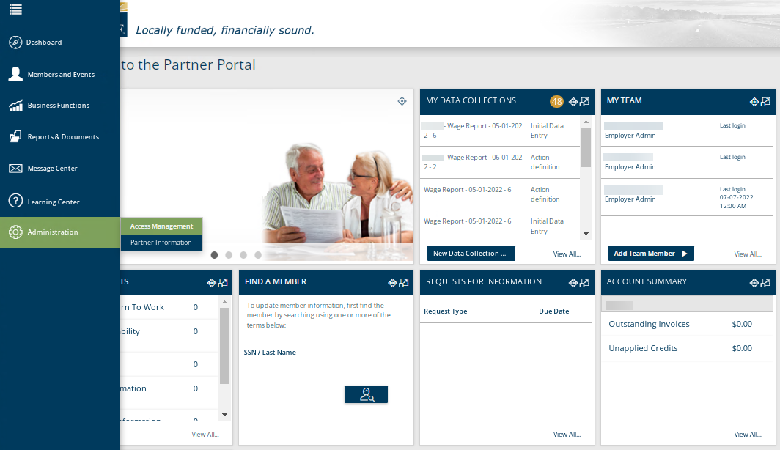
Employer Access – Access Management
The Access Management functionality is located on the Left-Hand Tool Bar under Administration. This functionality is also available from the Dashboard under the widget “My Team”.
Notes:
The Access Management functionality is located on the Left-Hand Tool Bar under Administration. This functionality is also available from the Dashboard under the widget “My Team”. If you use the Left-Hand Tool Bar or click View All in the widget, it will take you to a screen that lists all Team Members currently.

Slide 4
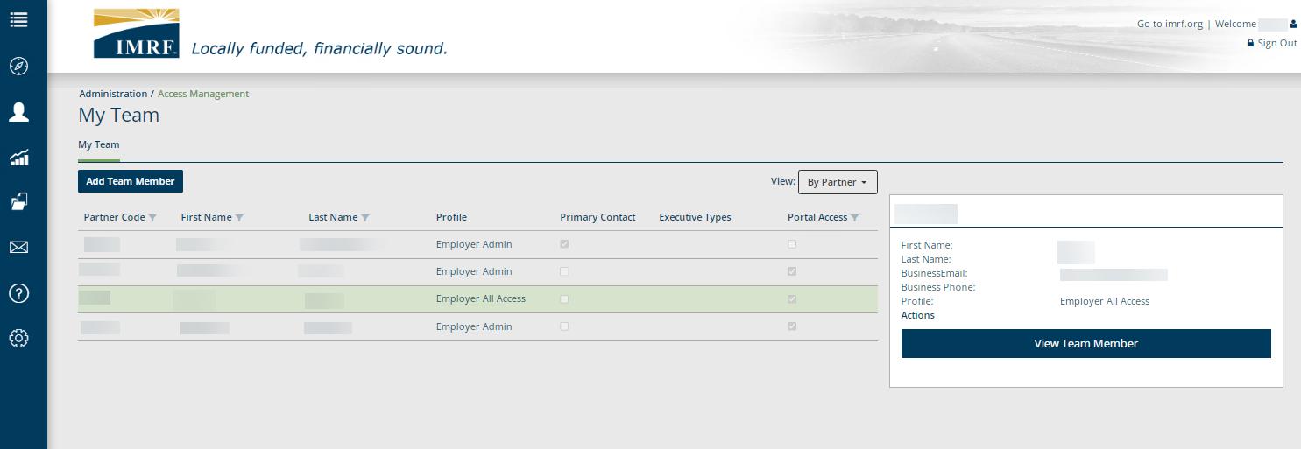
Employer Access – Access Management
Click the row with the Team Member to be removed and click, View Team Member.
Notes:
On the My Team landing page it will display the current Team Members. Click on the row of the member that needs to be removed. To the right click View Team Member.

Slide 5
Employer Access – Access Management
Click Remove Access and a pop-up window will appear to confirm, click Yes.
Notes:
The Team Members information is displayed on screen. Select Remove Access and a pop-up window will appear with a reminder that you are about to remove access to the Portal. Select ‘Yes’. You have now removed the Team Members access.

Slide 6
Thank you for your time!
Any other questions?
Send questions via Secure Messaging
Or
Employer Contact Center:
1-800-728-7971
Notes:
Thank you for viewing. If you still have questions, please reach out to IMRF via Secure Message. You may also reach us by phone at 800-728-7971. Thanks again.

