Slide 2
Agenda
Financial update
Planning for the future
General rate-making principles
Annual documentation
Closing remarks

Slide 3
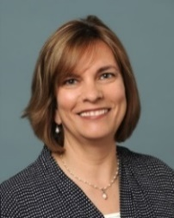
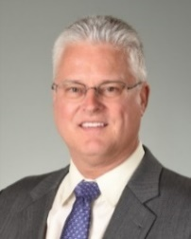
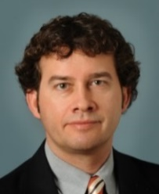
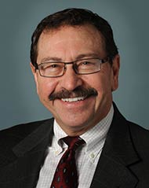
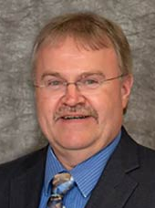
Our Board of Trustees
4 ELECTED BY EMPLOYERS
1 ELECTED BY RETIRED MEMBERS
V
Sue Stanish
Director of Finance
Naperville Park District
Tom Kuehne
Finance Director/Treasurer
Village of Arlington Heights
David Miller
Executive Director
North Shore Water Reclamation District
Gwen Henry
Treasurer
DuPage County
Louis Kosiba
Retired Executive Director IMRF
One Employer Trustee position (Tom Kuehne’s seat) will be up for election in 2022. If you want to run for Trustee, the candidate packet will be available on June 30, 2022, on www.IMRF.org
3 ELECTED BY MEMBERS
P
President
S
P
S
V
Vice President
Tracie Mitchell Communications Specialist
Central IL Regional
Dispatch Center
Natalie Copper School-age Child Care Site-coordinator
Dawes School in Evanston
Peter Stefan Finance Director/Treasurer
Village of Lake in the Hills
S
Secretary

Slide 4
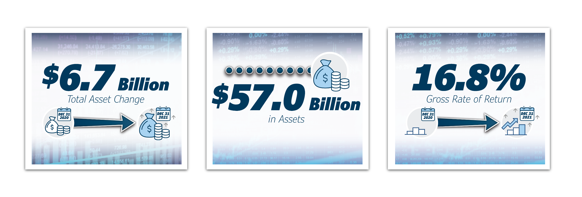
2021 financial results
All figures are as of 12/31/2021

Slide 5
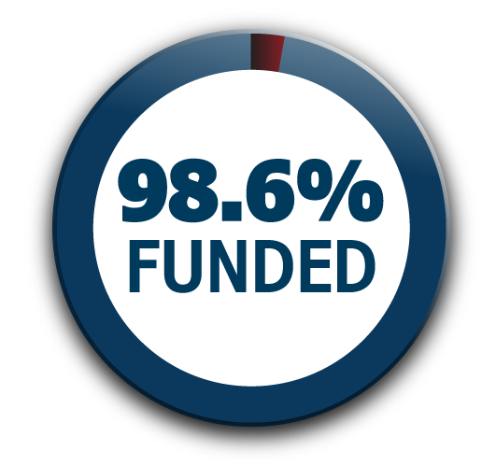
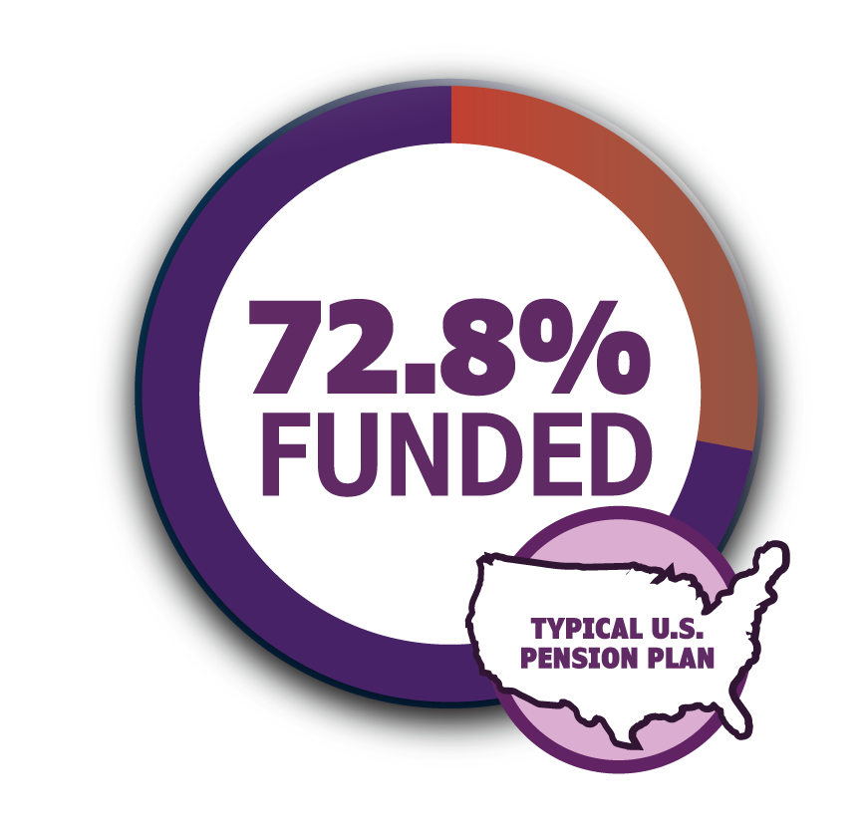
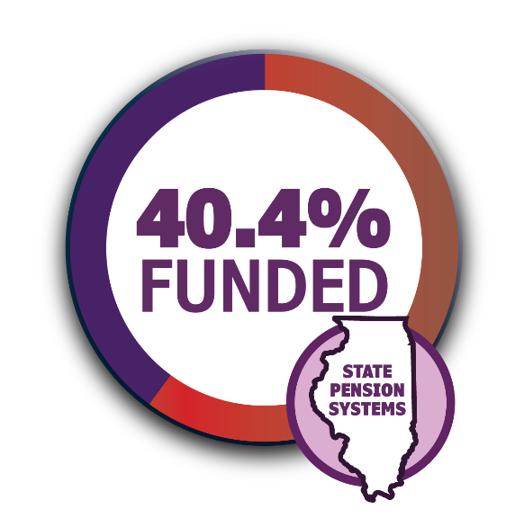
Actuarial funded status
as of 12/31/2021
Average funded status
www.nasra.org/publicfundsurvey
Average funded status
“Illinois State Retirement Systems Financial Condition as of June 30, 2020” - COGFA

Slide 6
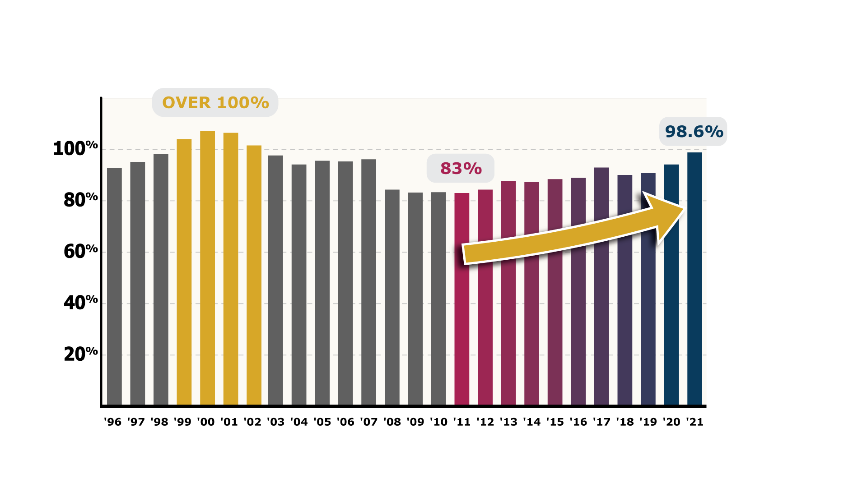
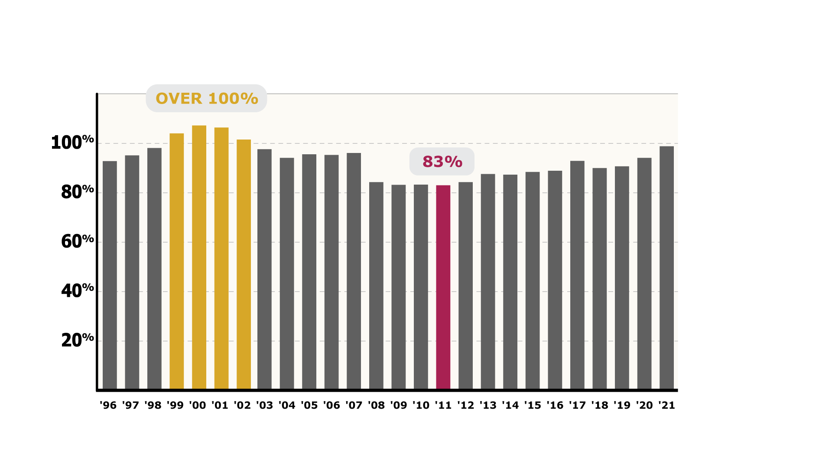
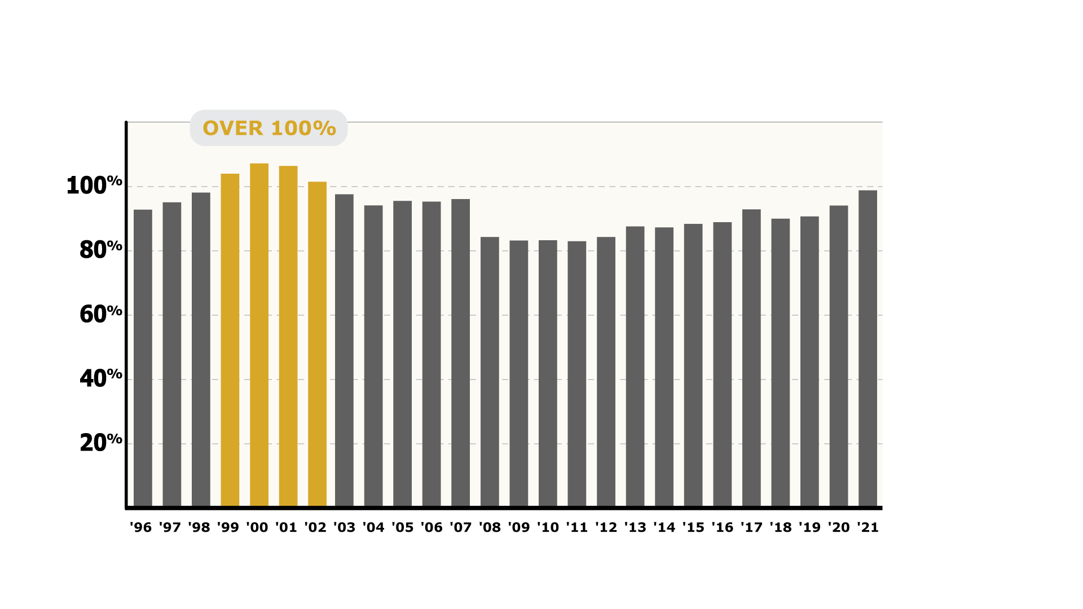
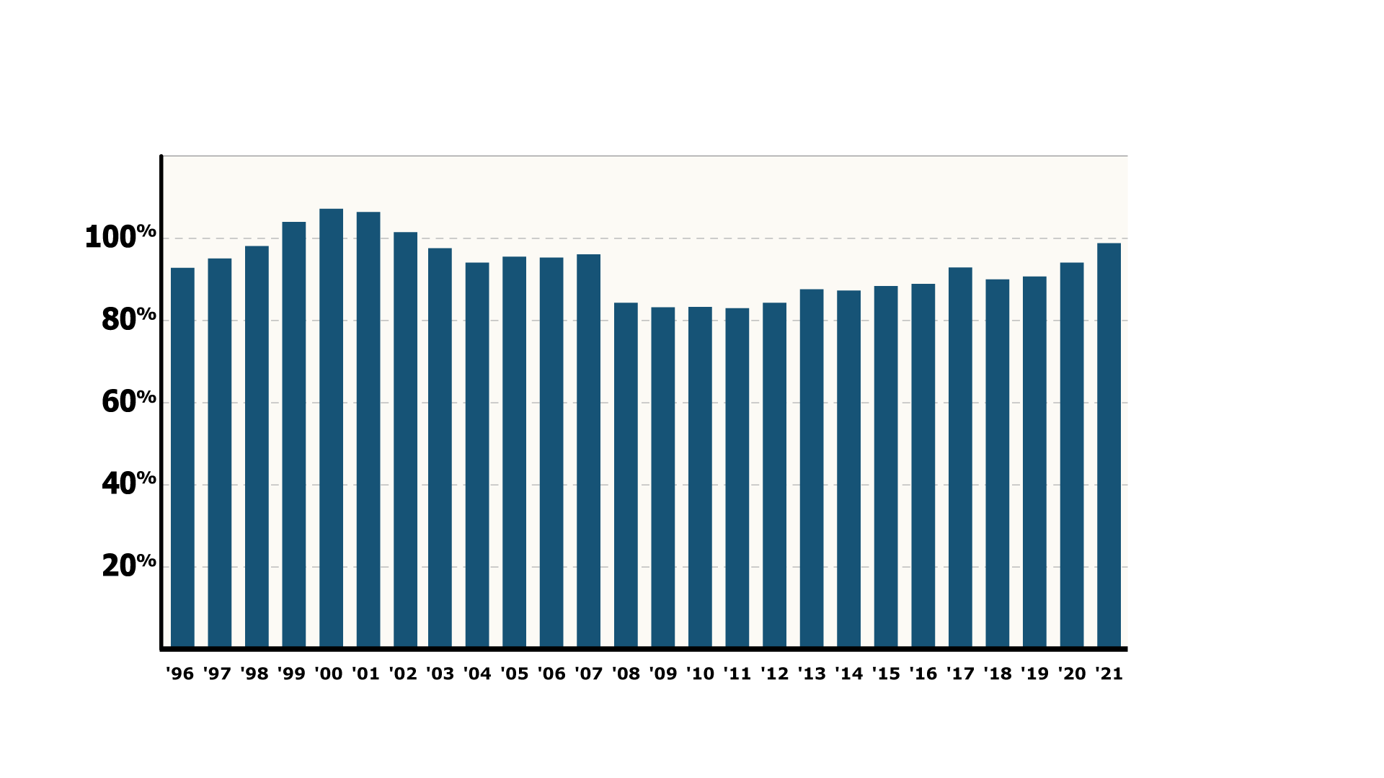
Actuarial funded status since 1996

Slide 7
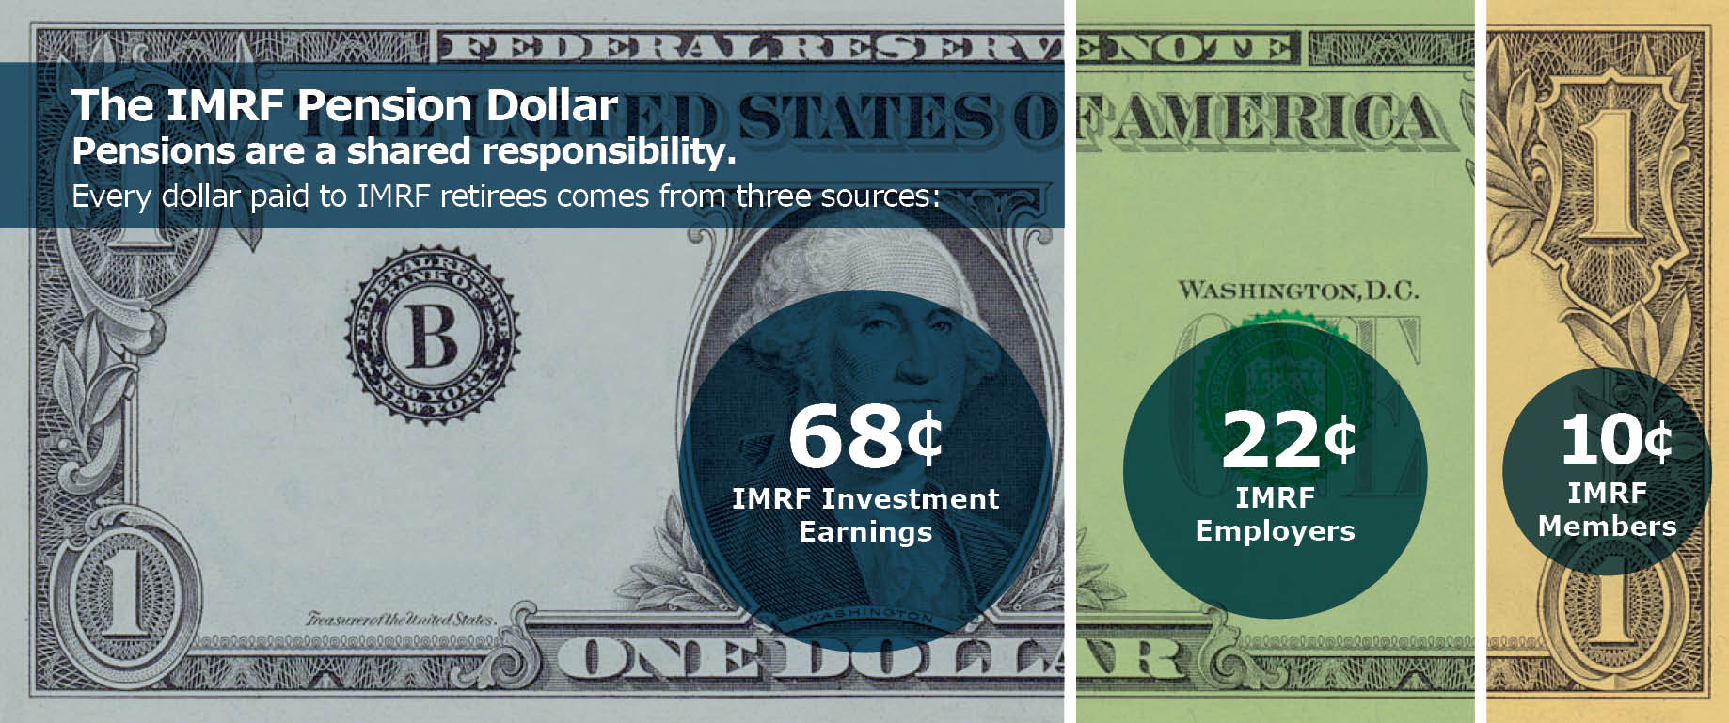
IMRF Pension Dollar

Slide 8
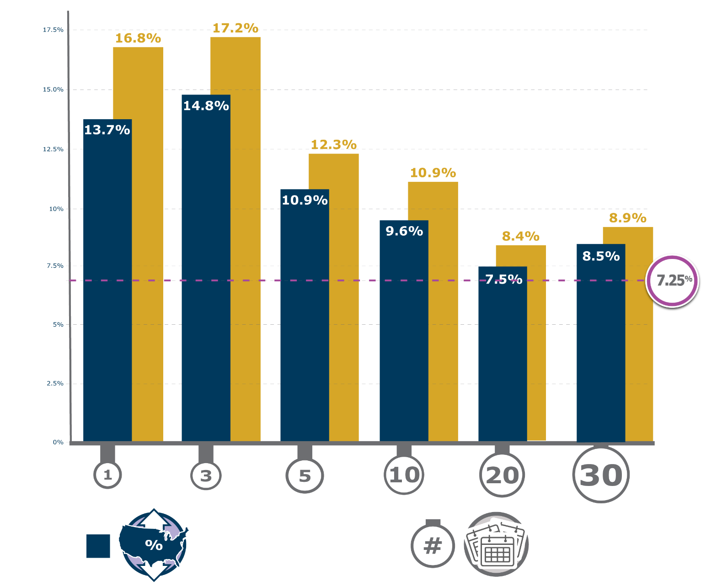
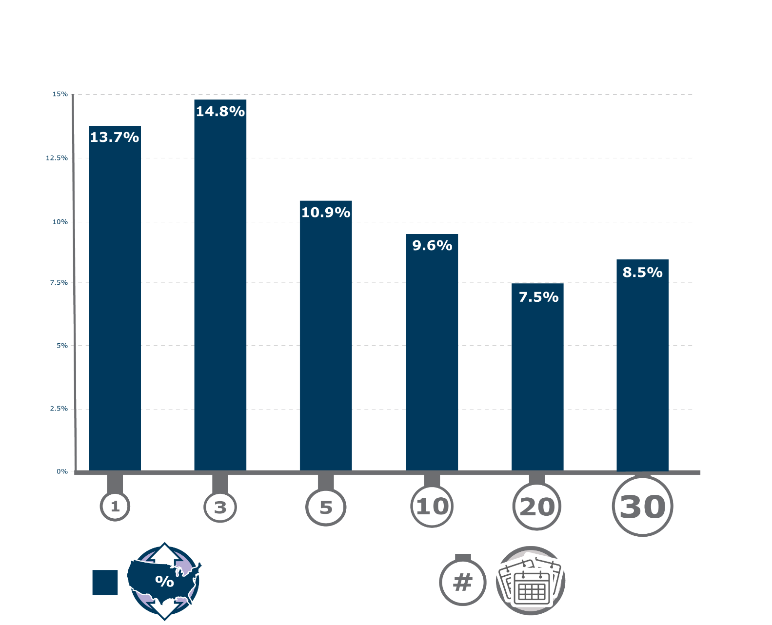
Investment returns of NASRA public pensions
NASRA
National Association of State Retirement Administrators
IMRF’s
ASSUMED RATE OF RETURN
Investment Returns
Nationwide Median
Investment Returns
Years Ended 12/31/2021
www.nasra.org

Slide 9
IMRF gross returns by asset class Periods ended December 31, 2021
Asset class | 1 Year | 3 Years | 5 Years | 10 Years
Domestic Equity | 24.89% | 25.36% | 17.27% | 16.06%
International Equity | 9.78% | 15.54% | 11.12% | 9.13%
Fixed Income | -0.44% | 5.55% | 4.22% | 3.88%
Real Estate | 21.95% | 11.74% | 10.72% | 11.17%
Alternatives Investments | 46.46% | 21.67% | 18.82% | 13.49%
Private Equity | 54.15% | 25.42% | 22.61% | 16.16%
Agriculture | 2.69% | 0.42% | -0.63% | 7.51%
Timberland | -2.72% | 0.89% | 0.71% | 2.11%
Unlisted Infrastructure | 11.68% | 12.38% | NA | NA
Cash | 2.44% | 2.86% | 2.52% | 1.40%
More details are available at imrf.org

Slide 10
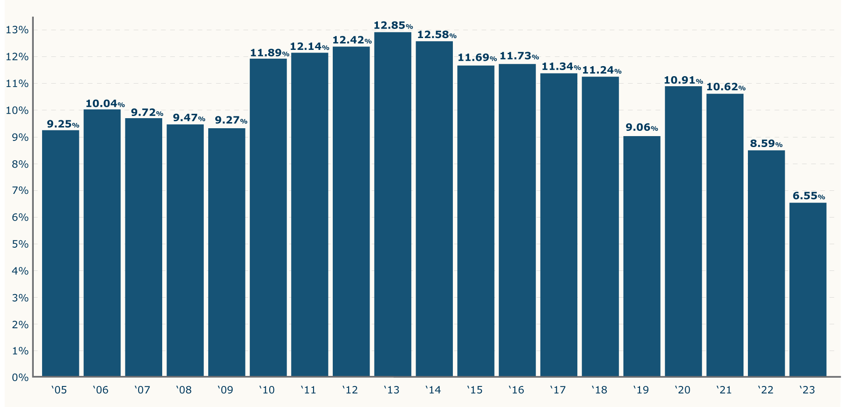
Average Regular Plan employer contribution rates

Slide 11
Planning for the future
IMRF’s asset total since 2019
Volatility in the markets
Our assumed rate of return

Slide 12
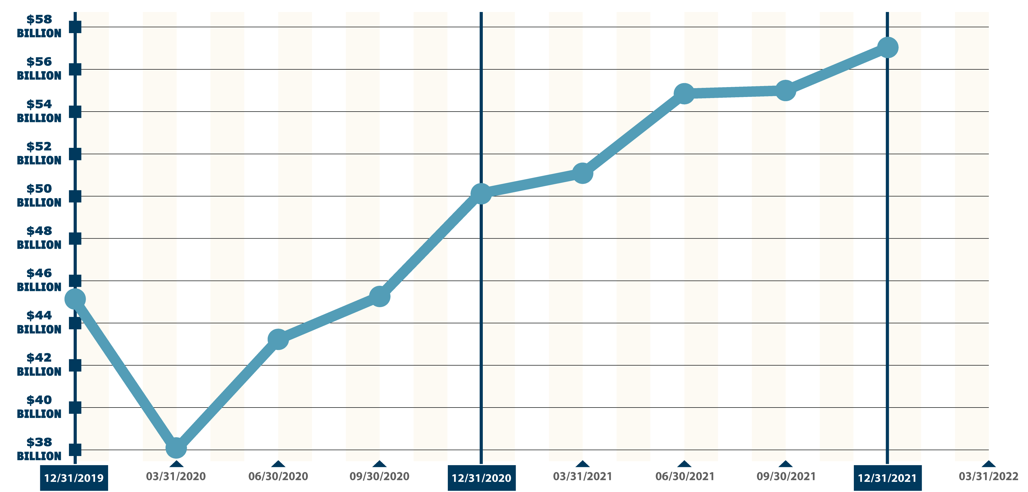
IMRF’s assets 2019 to present
$57.0 Billion
12/31/2021
$50.3 Billion
12/31/2020
$53.9 Billion
03/31/2022
$38.2 Billion
03/31/2020

Slide 13
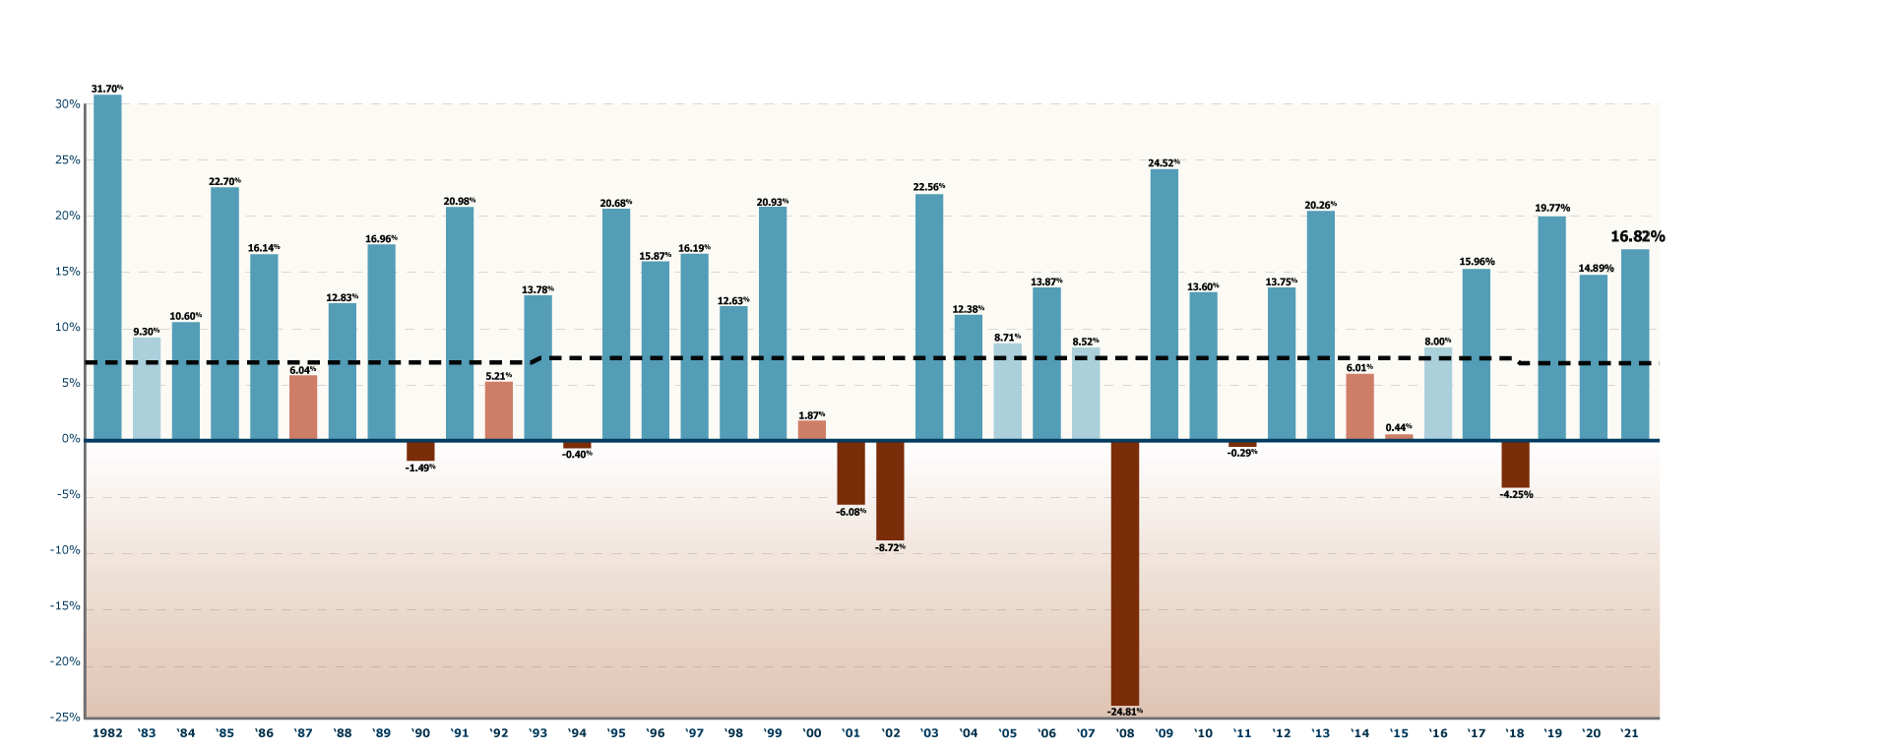
Investment returns: strong but volatile
GROSS RETURNS

Slide 14
Investment return expectations looking forward
 | Wilshire | GRS CMAM 2020 Survey | Horizon Survey
10-year forecast | 5.75% | 5.85% | 6.49%
20-year forecast | 6.85% | 6.71% | 7.16%
Based on inflation assumption of 1.80% for Wilshire and 2.25% for Surveys

Slide 15
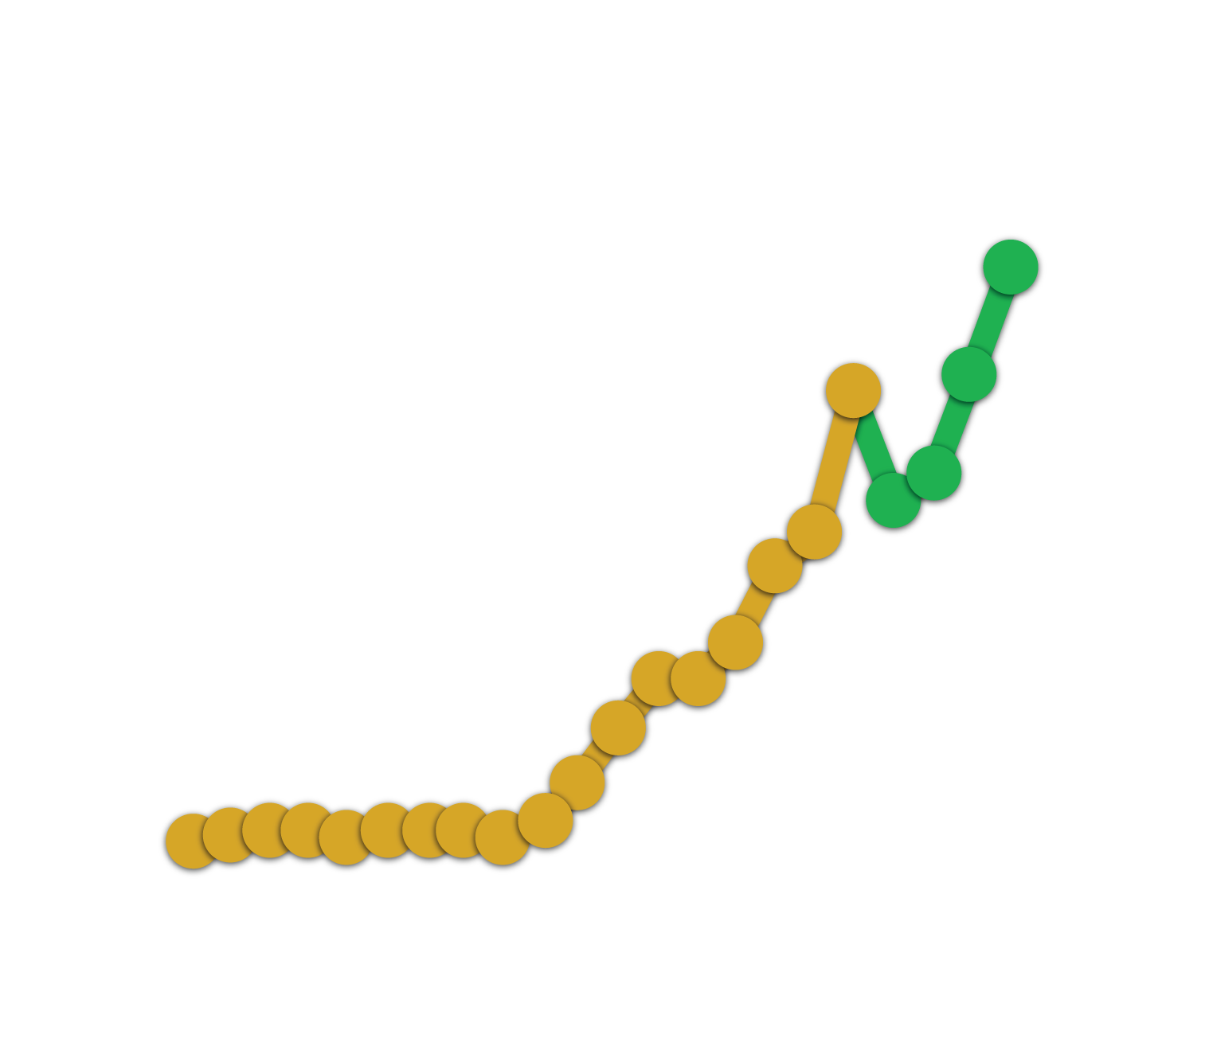
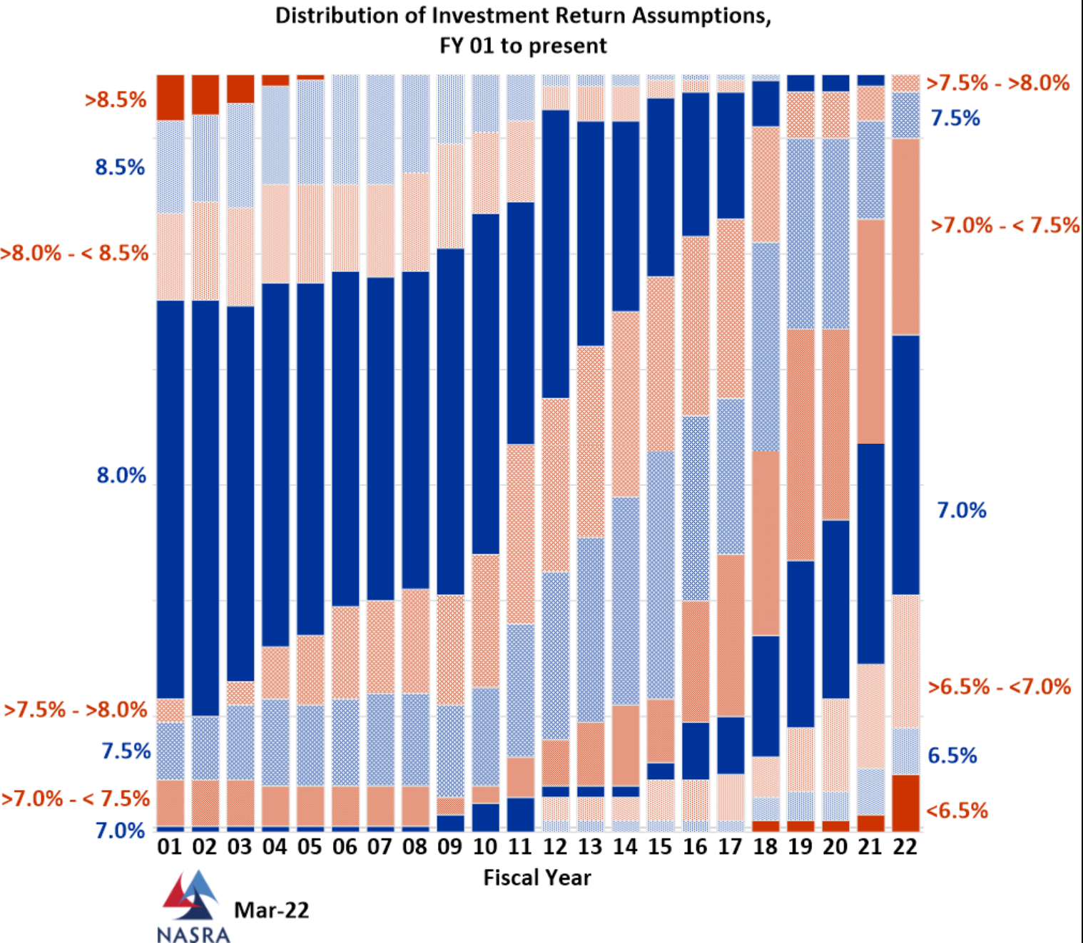
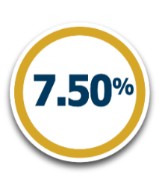
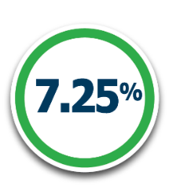
Assumed rate of return for all NASRA funds
Distribution of Investment Return Assumptions, FY 01 to present
NASRA
2022 AVERAGE ASSUMED RATE OF RETURN
NASRA
National Association of State Retirement Administrators
6.99%
PRIOR ASSUMED RATE OF RETURN
CURRENT ASSUMED RATE OF RETURN

Slide 16
Assumed rate of return for all NASRA funds
Distribution of Investment Return Assumptions, FY 01 to present
NASRA
2022 AVERAGE ASSUMED RATE OF RETURN
NASRA
National Association of State Retirement Administrators
6.99%
PRIOR ASSUMED RATE OF RETURN
CURRENT ASSUMED RATE OF RETURN

Slide 17
General rate-making principles
Reserve accounts
How your rates are calculated
Understanding demographic impacts on rates
Actuarial assumptions

Slide 18
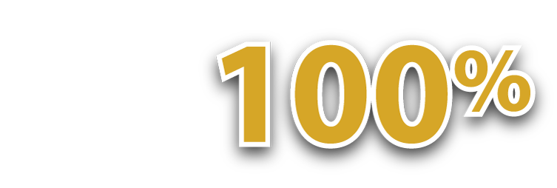
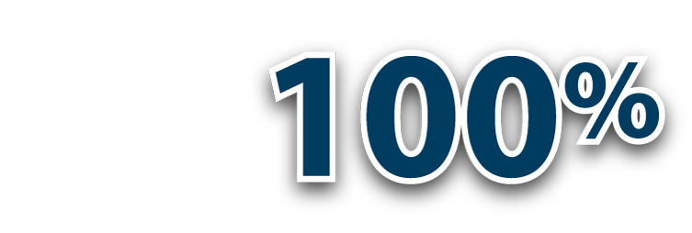
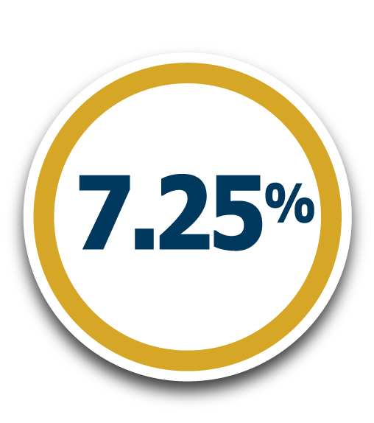
Reserve accounts and funded status
Employer Reserve serves as a “Balancing Account.”
FUNDED STATUS
FUNDED STATUS
FUNDED STATUS
MEMBER
RESERVE
EMPLOYER
RESERVE
ANNUITANT
RESERVE
Member Reserve and Annuitant Reserve accounts must be kept at 100% funded status. IMRF credits these accounts 7.25% yearly.

Slide 19
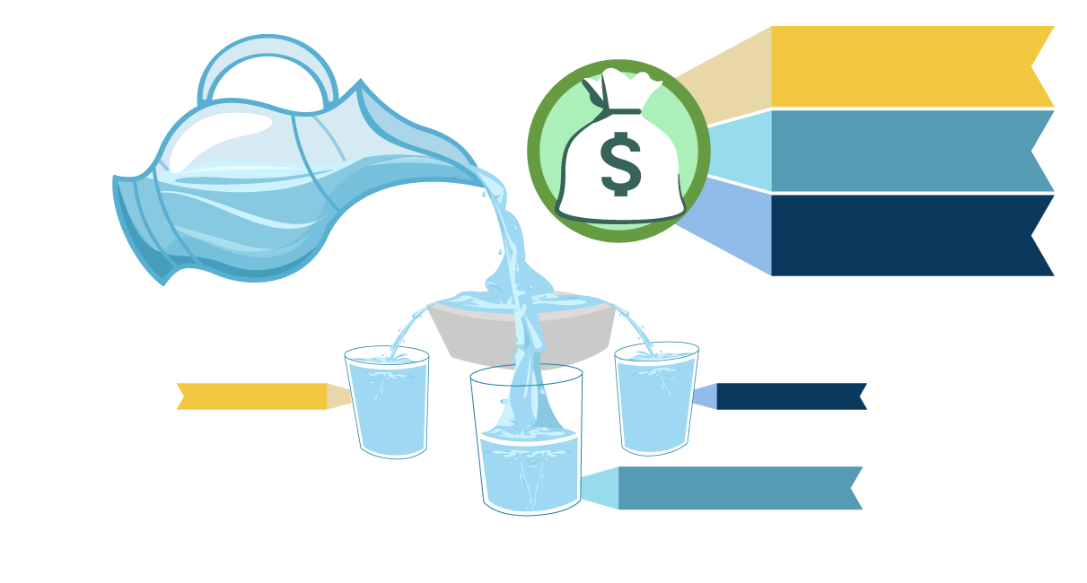
Investment gain distribution in 2021
Member Reserve
$0.491 Billion
Employer Reserve $6.033 Billion
Annuitant Reserve
$1.972 Billion
Figures do not include member and employer contributions or transfers to Annuitant Reserves.
Member
Annuitant
Employer

Slide 20
As an agent multiple employer plan, each employer has a separate reserve account
Your employer pays for the retirement benefits of only its employees.
How your employer reserve account works.
Credited with contributions made by your employer.
Credited investment gain or loss.
Debited retirement costs of your employees.
Your employer’s finances have no relationship to the pension assets and liabilities of IMRF’s other 3,032 employers.
EACH EMPLOYER
HAS ITS OWN
RESERVE ACOUNT

Slide 21
If an employer is less than 100% funded on an actuarial basis as of 12/31/2021
Taxing Bodies
20-year closed amortization period to pay off any unfunded liability
Instrumentalities
10-year reopening period to pay off any unfunded liability
Recalculated every year (unlimited time to achieve 100% funded status)
20
10

Slide 22
If an employer is 100% funded or more on an actuarial basis as of 12/31/2021
A large percentage of employers will be 100% funded or more this year.
Based on 5-year smoothing, 4 of the last 5 years exceeded the 7.25% assumed rate of return.
Funds are held in reserve to offset potential market losses in the future
Unaudited return through 2/28/22 has IMRF at -5.1%

Slide 23
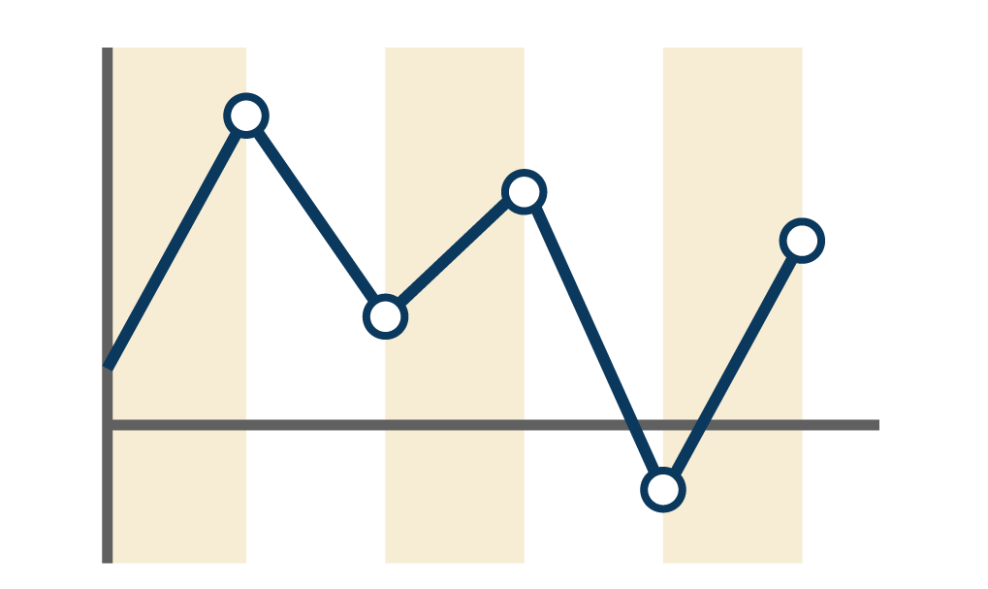
Rate impact from investment results smoothed over a five-year period
This line represents the impact of IMRF’s investment results on employer contributions.
Only 1/5th of investment gain/loss is recognized annually.
There is a two-year lag before investment results impact employer rates.
Year 1
Year 2
Year 3
Year 4
Year 5
Illustration only. Not representative of IMRF’s actual investment experience.

Slide 24
5 parts of the employer rate
Each part is calculated separately and used for specific purposes designated by state law.
Normal Retirement Contributions
Disability Benefit Contributions
Death Benefit Contributions
Supplemental Retirement Contributions (“13th Payment”)
Unfunded Liability Contributions
UNFUNDED
LIABILITY

Slide 25
How is your employer’s rate calculated?
1
2
IMRF provides demographic and financial data as of year-end to IMRF’s actuaries.
Actuaries apply assumptions to the demographic and financial data.
3
4
The actuaries then produce an actuarial valuation for IMRF.
Actuaries rely on the valuation to set contribution rates for each employer.

Slide 26
3 common demographic reasons why your employer rate can increase
The size of your workforce decreases
Deferred membership
Vested members terminate and leave their contributions with IMRF
Employee Retirements

Slide 27
Your specific employer’s rate is designed to achieve a 100% funding level.
100% funding means your employer will have all the funds needed to pay its pension obligations when its employees retire.
If +100% funded
Assets are held in reserve to offset potential market losses in the future.
Your employer is in a strong position to manage future market downturns.

Slide 28
Actuarial assumptions
Used to calculate how much money needs to be set aside to fund future benefits.
IMRF Board sets assumptions
Economic and Demographic
Updated every three years

Slide 29
Demographic assumptions defined
Active members that quit (withdrawal rates)
Disability for active members
Retirement for active members
Merit and longevity pay for active members
Mortality for active members, retirees, and their beneficiaries

Slide 30
Economic assumptions defined
Price inflation = 2.25%
Wage inflation = 2.75%
Payroll growth = 2.50%
Investment return assumption = 7.25%

Slide 31
Non-economic assumptions defined
Mortality rates
Before retirement
After retirement
Disability rates
Rates of retirement
Rates of separation from employment (Refunds)
Marriage probabilities of active members

Slide 32
Actual experience compared to actuarial assumptions
What happens when IMRF’s actual experience does not align with its economic and demographic actuarial assumptions?
Any variance between our assumptions and our actual experience impacts your contribution rates.

Slide 33
Variance in assumptions
Some variances are out of your control as an employer.
Example
IMRF assumes a certain percentage of your workforce will file for disability at some point.
If in reality, a greater percentage of your workforce files for disability over time, this will increase your employer contribution rate in future years.
Some variances are in your control as an employer.
Example
IMRF assumes that your workforce’s wages will grow by 2.75% annually.
If your workforce’s wages grow by 5% annually, this will increase your employer contribution rate in future years.

Slide 34
Annual documentation
There are two main purposes for our documentation
Projects your future costs
Employer Reserve Statement
Rate Notices
Financial reporting
GASB Statements
Schedule of Changes in Fiduciary Net Position
SOC-1 Type 2 Report

Slide 35
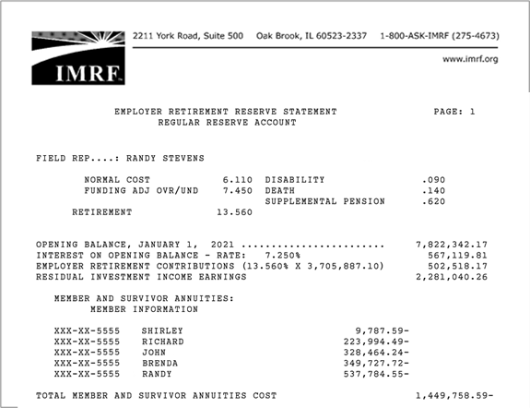
Employer Reserve Statement
Projects your future costs
This statement shows your employer’s funds on deposit as of January 1
Credits
Debits
Adjustments

Slide 36
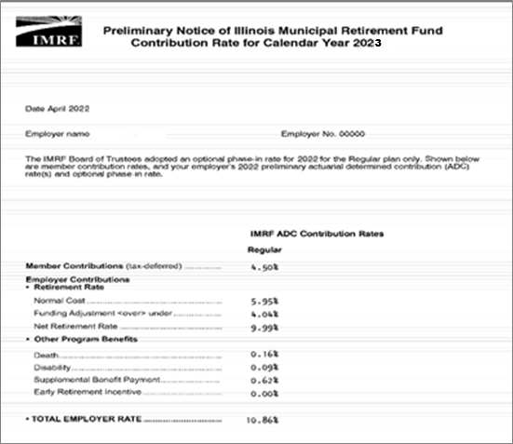
Preliminary & Final Rate Notices
Projects your future costs
These statements show your employer’s rate for the year.
“Preliminary Rate Notice” in April
“Final Rate Notice” in November

Slide 37
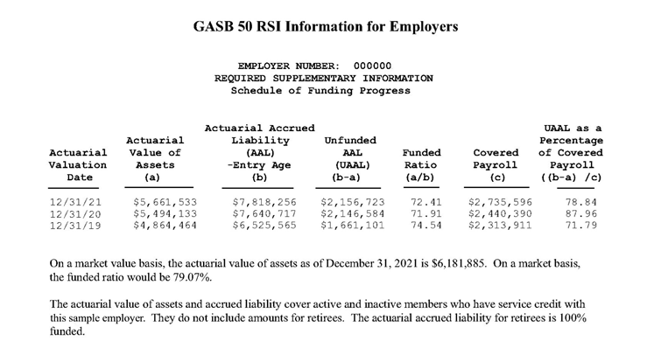
GASB 50 Disclosure Statement
Financial
reporting
This statement shows your funded status
Does not include retirees
Shows status broken out by plan
One report per plan

Slide 38
GASB 68 Disclosure Statement
Financial
reporting
This statement also shows funded status.
Used by employers who do GAAP reporting
This funded status includes retirees
Will be HIGHER for more employers

Slide 39
Is your employer 100% funded?
Find out in the Executive Summary in your GASB 68 Statement.
Financial
reporting
Funding of GASB 68 resulted in a booking of an asset for the first time for 2,980 out of 3,380 plans
Net pension Liability
In this report, a bracketed number represents an asset.
Total Pension Liability/(Asset)
Plan Fiduciary Net Position
Net Pension Liability/(Asset)
$ 102,441,221
112,412,528
$ (9,971,307)
Page 6

Slide 40
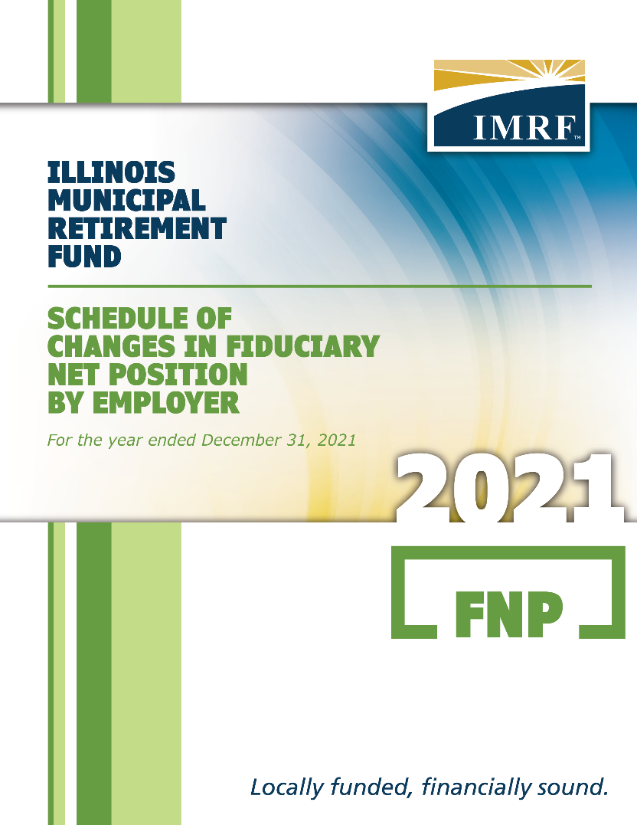
Schedule of Changes in Fiduciary Net Position
Financial
reporting
This statement shows Fiduciary Net Position by employer
Available in May
Needed by employers who GAAP report
Supplements the IMRF ACFR

Slide 41
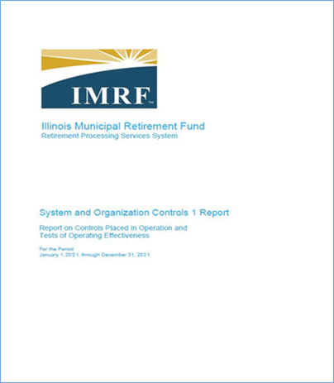
SOC-1 Type 2 Report
Financial
reporting
This statement verifies IMRF’s strict internal controls
Available in March
Relieves your auditors from having to test IMRF data

Slide 42
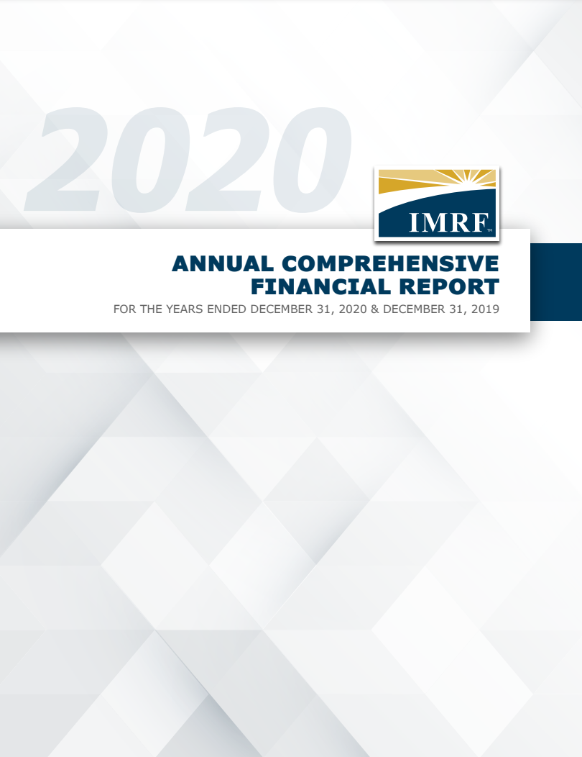
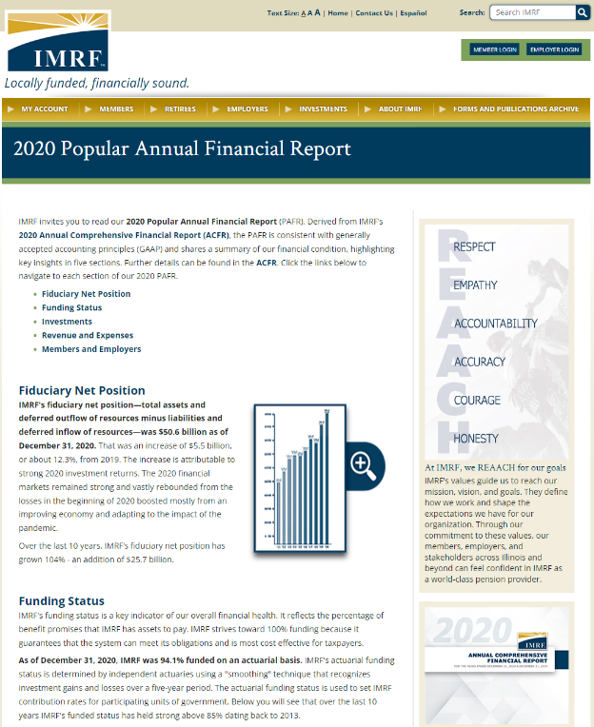
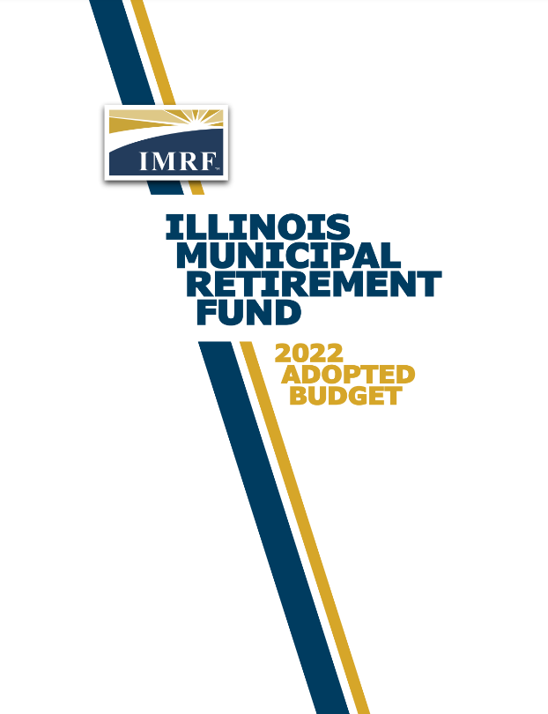
GFOA ”Triple Crown” Award Winner
Annual Comprehensive Financial Report (ACFR)
Popular Annual Financial Report (PAFR)
Budget
Document
IMRF is one of just four public pensions in North America to receive the “Triple Crown” honor.

Slide 43
Closing remarks
IMRF’s financial progress since 1980
Growth in Tier 2 membership
Technology modernization project

Slide 44
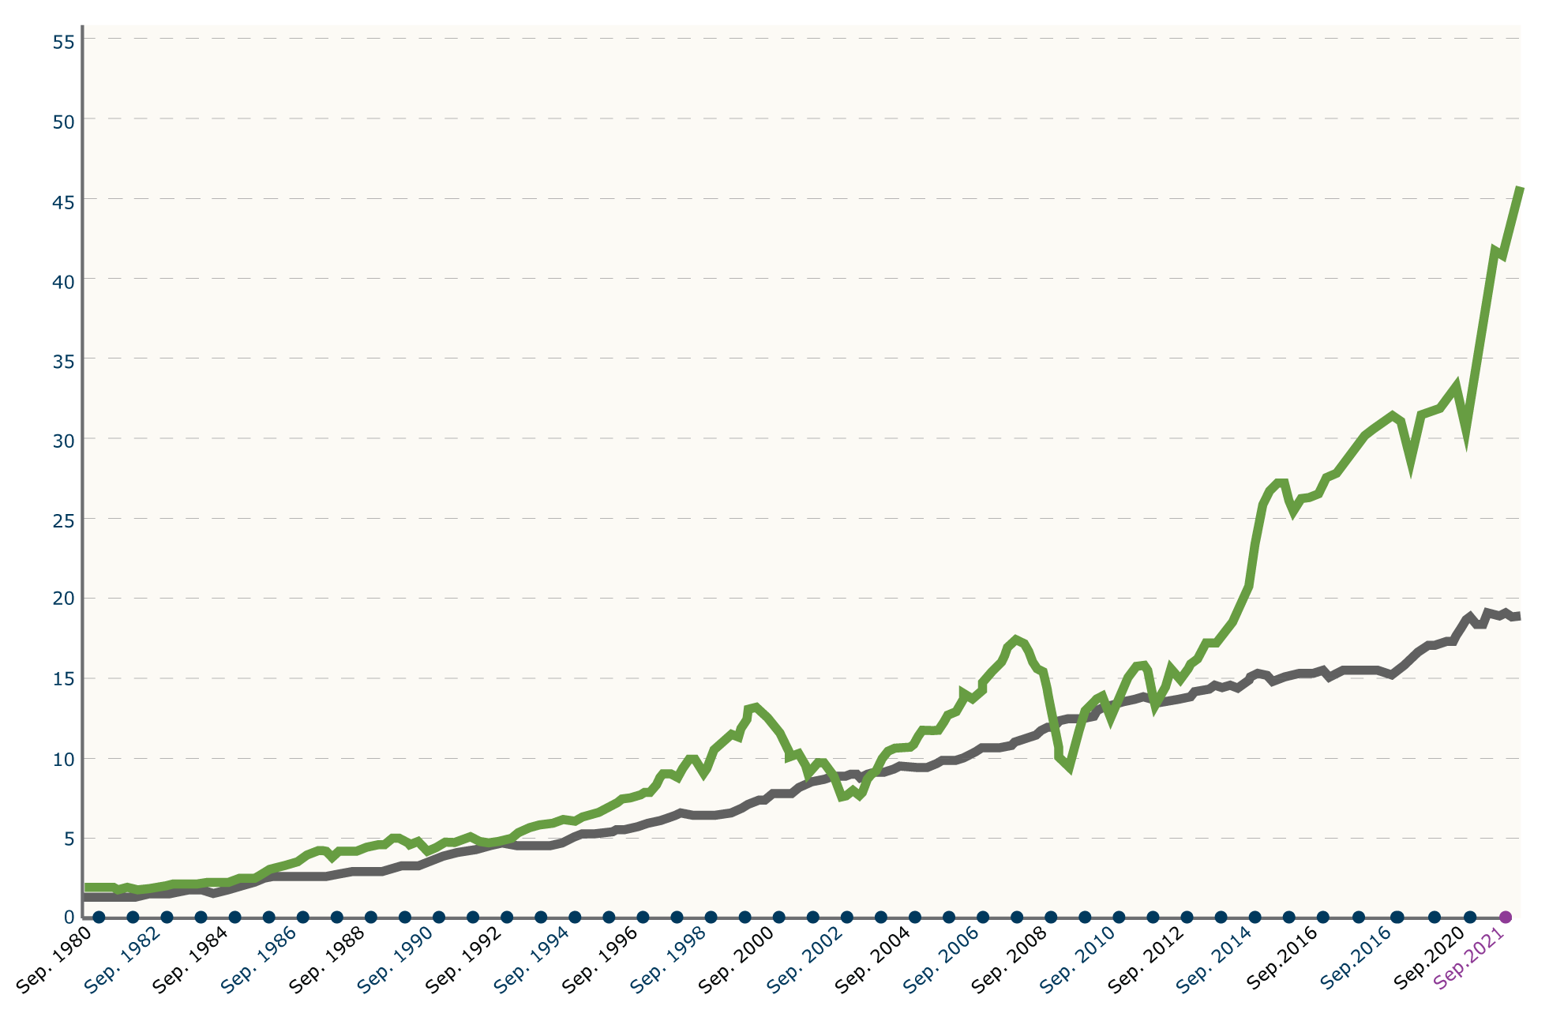
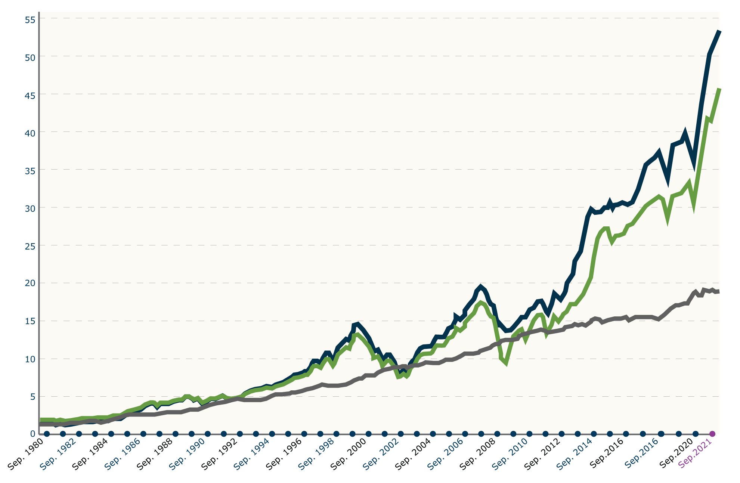
Growth of $1 since 1980
$53.11
IMRF
$46.15
MSCI All Country World Index
Value of $1 Invested on September 30, 1980
$18.90
Bloomberg Barclays U.S. Aggregate Index

Slide 45
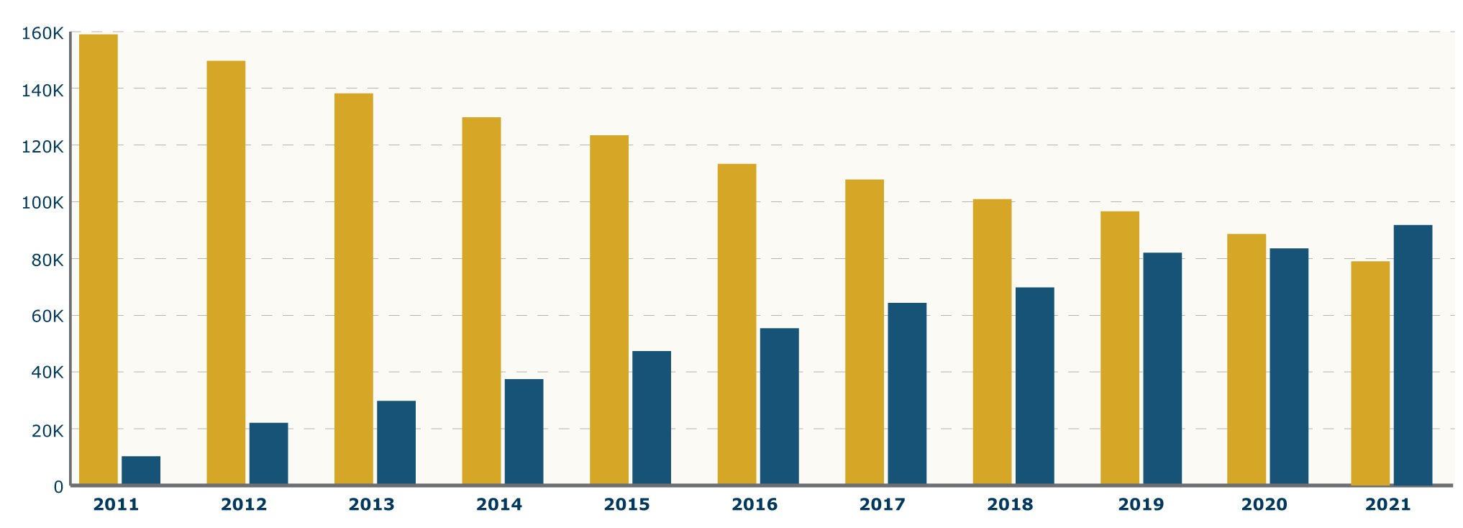
Number of active Regular Plan members

Slide 46
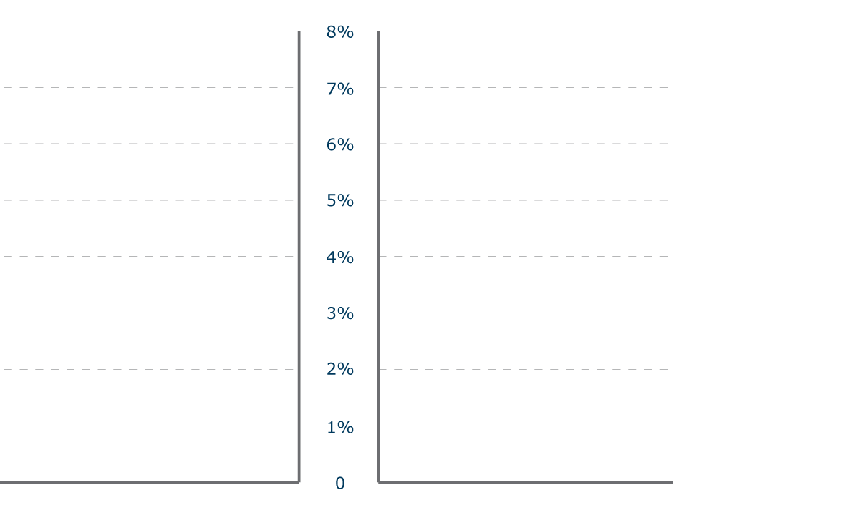
Regular Plan average normal cost
6.24%
New Tier 2 legislation was approved in 2010 to reduce retirement costs for Illinois
All new members start in Tier 2
Tier 2 costs 42% less than Tier 1
3.64%

Slide 47
Technology modernization project
IMRF is modernizing the technologies and processes it uses for pension administration.
The project will improve the way employers and members interact with IMRF.
More transactions will go online, particularly for employers, enabling faster and more modern communication.
IMRF will provide training for employers before rollout of the new systems in Q4 2022.

Slide 48
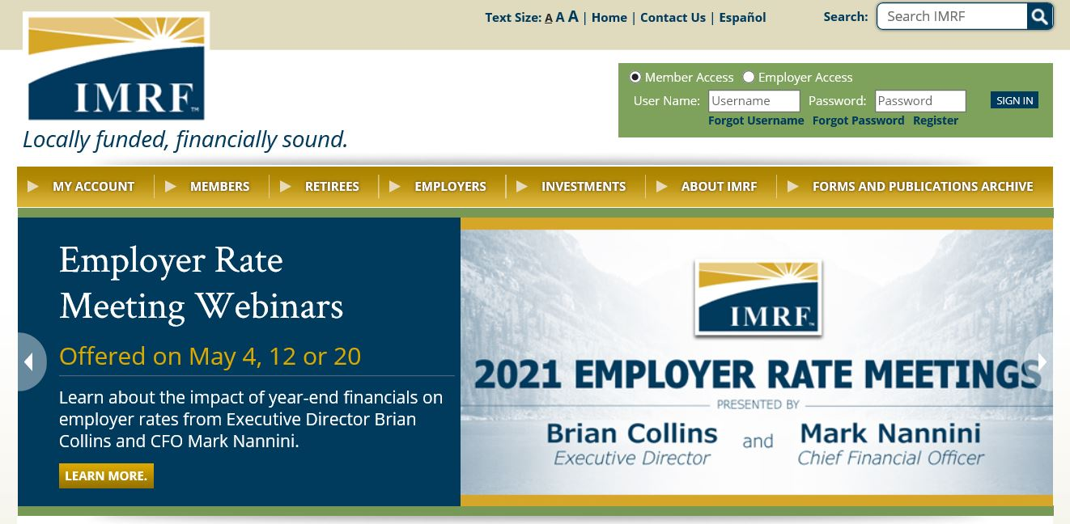
Do you know someone who did not attend today but would benefit from this information?
They can register for the next Rate Meeting at IMRF.org
www.imrf.org

Slide 49
Questions?
Brian Collins
bcollins@imrf.org 630-368-5355
Mark Nannini
mnannini@imrf.org
630-368-5345
www.imrf.org

