Slide 1
Disability Return to Work Data Collection Add Record Manual Entry
Notes:
Disability Return to Work Data Collection

Slide 2
Agenda
Disability Return to Work
Data Collection Overview
Data Collection Creation
Add Member Data
Validation Process
Review and Submit
Notes:
In this webinar, we will touch on: (read list)

Slide 3
Data Collection Overview
What is a Data Collection?
Information is sent in via Employer Access as a Data Collection using a new file format, Comma-separated Value or .CSV.
Filing is Simple, Fast, Easy and Web-Centric replacing 90% of all previous forms.
For smaller employers the Add Record Manual Entry is quick, it prompts the user for information, responds interactively to prevent errors, and creates the new file format that is then submitted to IMRF.
IMRF is asking for the information you supplied to us before and some new information. This allows the employer more control over the entire life cycle of their members from enrollment through retirement.
3
Notes:
What is a Data Collection ?
Information is sent in via employer Access as a Data Collection using a new file format, Comma-separated Value or .CSV.
Filing is Simple, Fast, Easy and Web-Centric replacing 90% of all previous forms. i.e., monthly wage report, wage adjustments, enrollments, terminations, disability, etc.
For smaller employers the Add Record Manual Entry is quick, it prompts the user for information, responds interactively to prevent errors, and creates the new file format that is then submitted to IMRF.
IMRF is asking for the information you supplied to us before and some new information. The new functionality allows the employer more control over the entire life cycle of their members from enrollment through retirement.

Slide 4
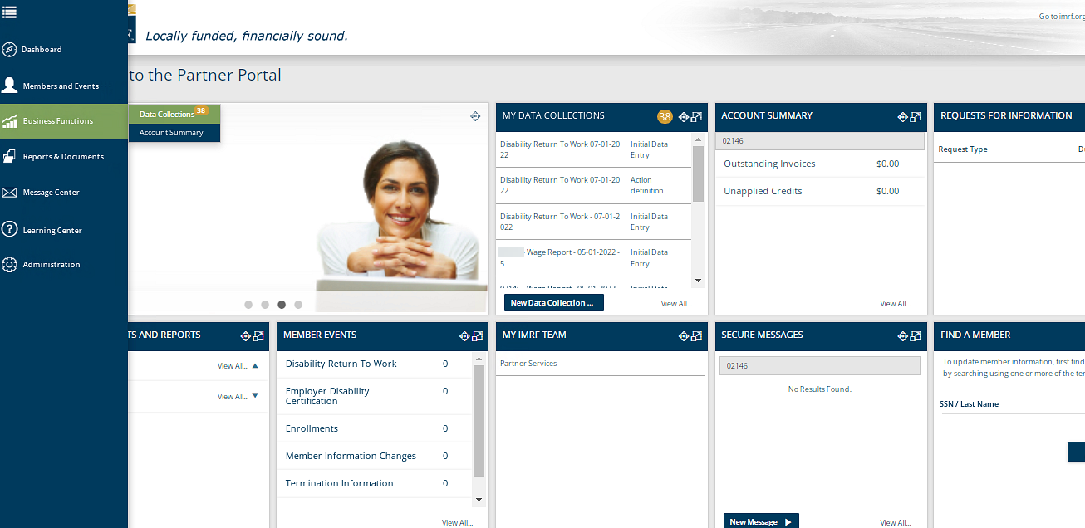
Create a Data Collection
To begin the process of entering Disability Return to Work, a new Data Collection must be started.
Notes:
Start the Data Collection by clicking the Business Functions icon on the left-hand toolbar and click Data Collections, that will take you to a screen displaying all Data Collections previously created or on the Dashboard under the widget “My Data Collections”, click New Data Collection to go directly to Step 1.

Slide 5
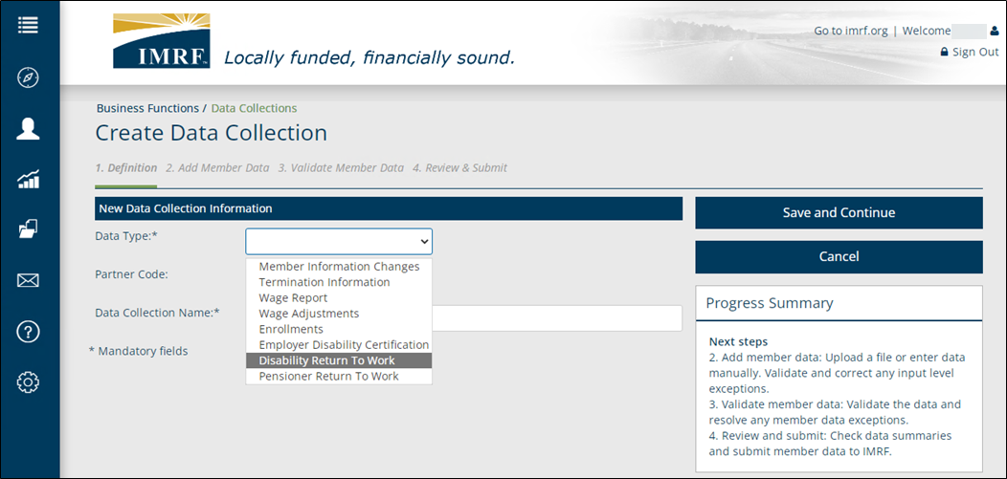
Data Collection Step 1. Definition
Notes:
We are now at Step 1 Definition. To create the data collection, select “Disability Return to Work” from the Data Type drop down list. Enter remaining mandatory dates and name fields, then click Save and Continue.

Slide 6
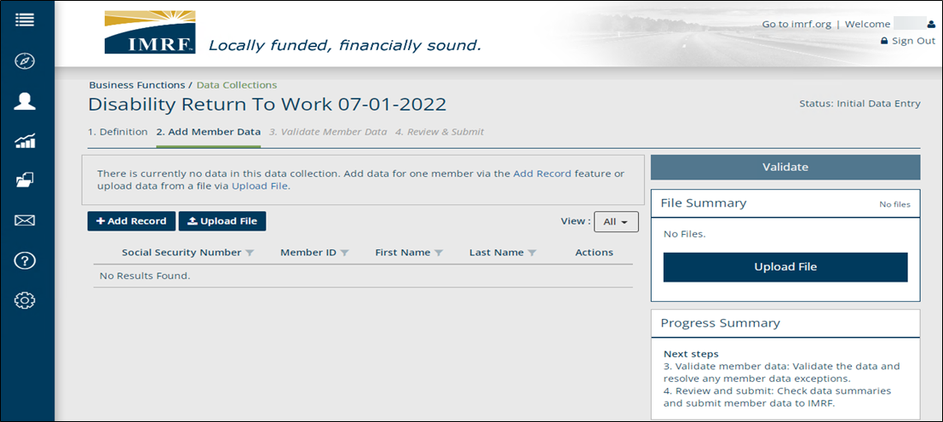
Data Collection Step 1. Definition
Click Add Record to enter the member data.
Notes:
We are now at step 2- Add Member Data. Click Add Record and you will be directed to a screen to enter the Disability Return to Work information.

Slide 7
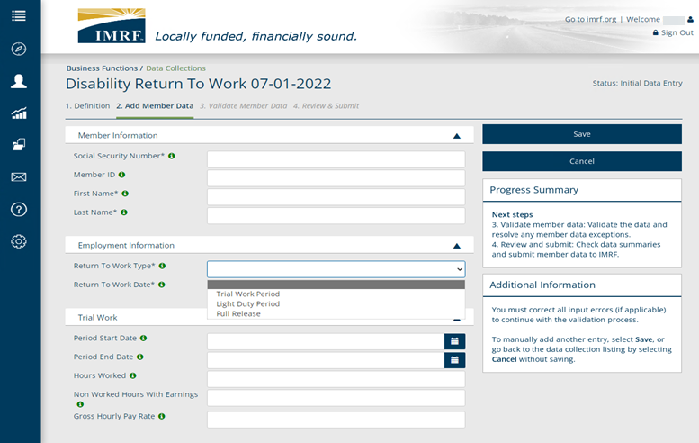
Data Collection Step 2: Add Member Data
Enter the Disability Return to Work information and click Save.
Trial Work Period: member is working a reduced or modified schedule in terms of work hours or days per week.*
Light Duty Period: member is working normal hours but has medical restrictions.
Full Release:
Full release to return to work without restrictions.
* If a Trial Work Period, you must provide hours worked, non-worked hours & member’s gross hourly pay rate.
Notes:
Enter the required information based on the Return to Work Type. There are 3 options to select from (read side box definitions). Then click on “Save”.

Slide 8
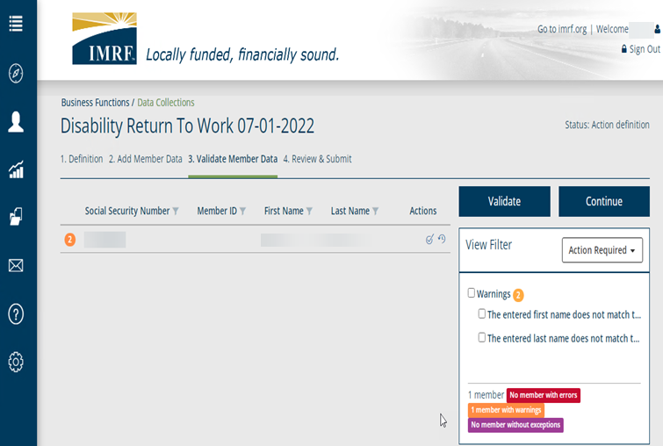
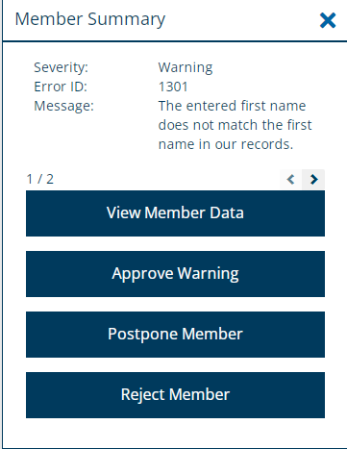
Data Collection Step 3: Validate Member Data
To address a member with errors or warnings, click on the row and a Member Summary box will open.
Click on the applicable option to resolve the warning or error.
If a warning or error message occurs, click on the member’s row of data to resolve the issue
Notes:
To address a member with warnings or errors, click on the row and a Member Summary box will open to the right. Click on the applicable option to resolve the warning or error. View Member Data allows you to make any edits to the original information submitted. For example, fixing a typo. Approve Warning is self-explanatory. Postpone Member allows you to postpone submitting the data collection until you’ve researched the warning or error. Finally, Reject Member will remove the member altogether from the data collection. To close the Member Summary box, click the X in the upper right corner.

Slide 9
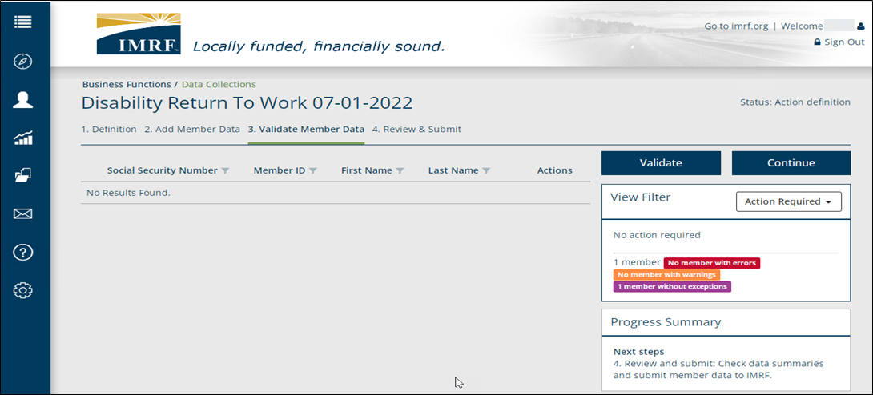
Data Collection Step 3. Validate Member Data
Once errors or warnings are resolved or if you had no issues, you would see, No Results Found. Click Continue to Step 4. Review and Submit.
Notes:
After validating the file, make sure there are no errors. If errors appear, you’ll find them on the right-hand side of the screen. If no errors, then click Continue.

Slide 10
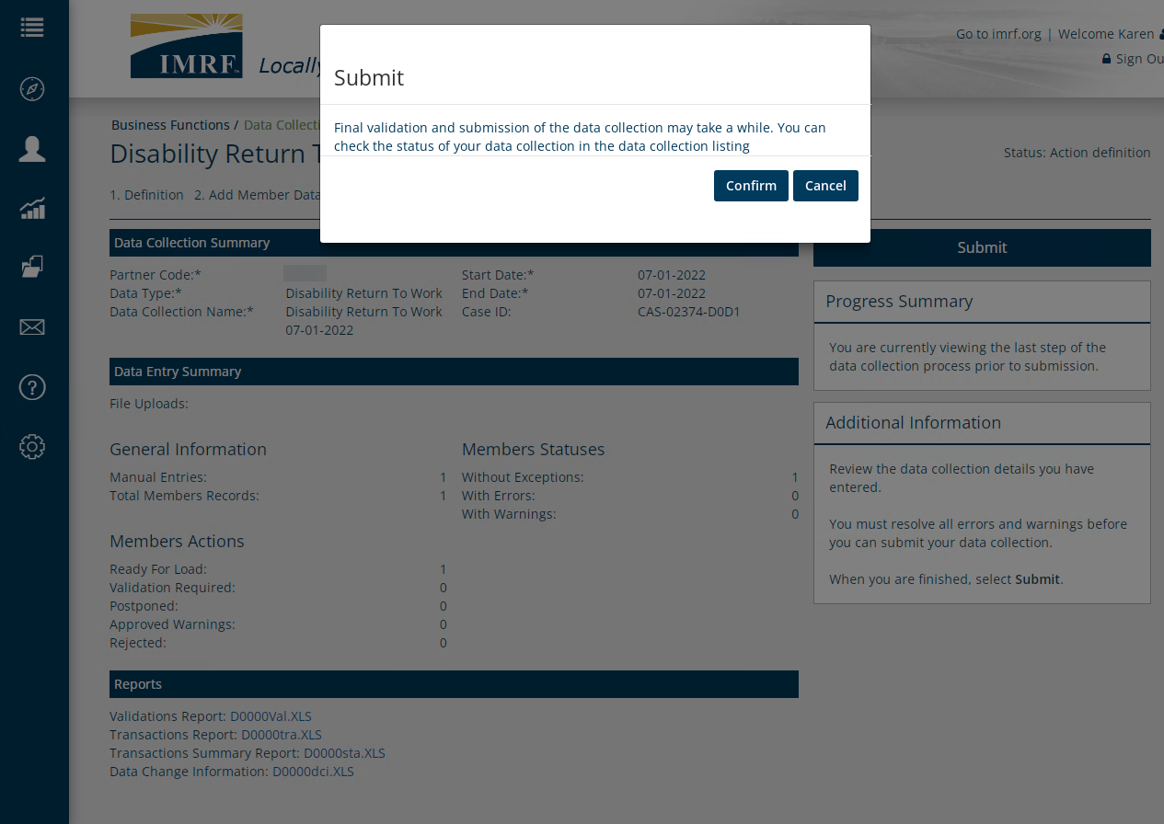
Data Collection Step 4: Review and Submit
Review the listed Data Collection and Data Entry Summary and Reports. Once review is complete, click Submit. A pop-up box will appear to confirm. Click Confirm.
Notes:
After validation process is complete, you will be able to submit the data collection to IMRF. You will receive a pop-up box asking for confirmation. After confirming the submission, you may move on to uploading a copy of the physician’s release. It is not required that the physician’s release is uploaded right after submitting the data collection. However, doing so would complete the action required by the employer when a member returns to work after IMRF disability.

Slide 11
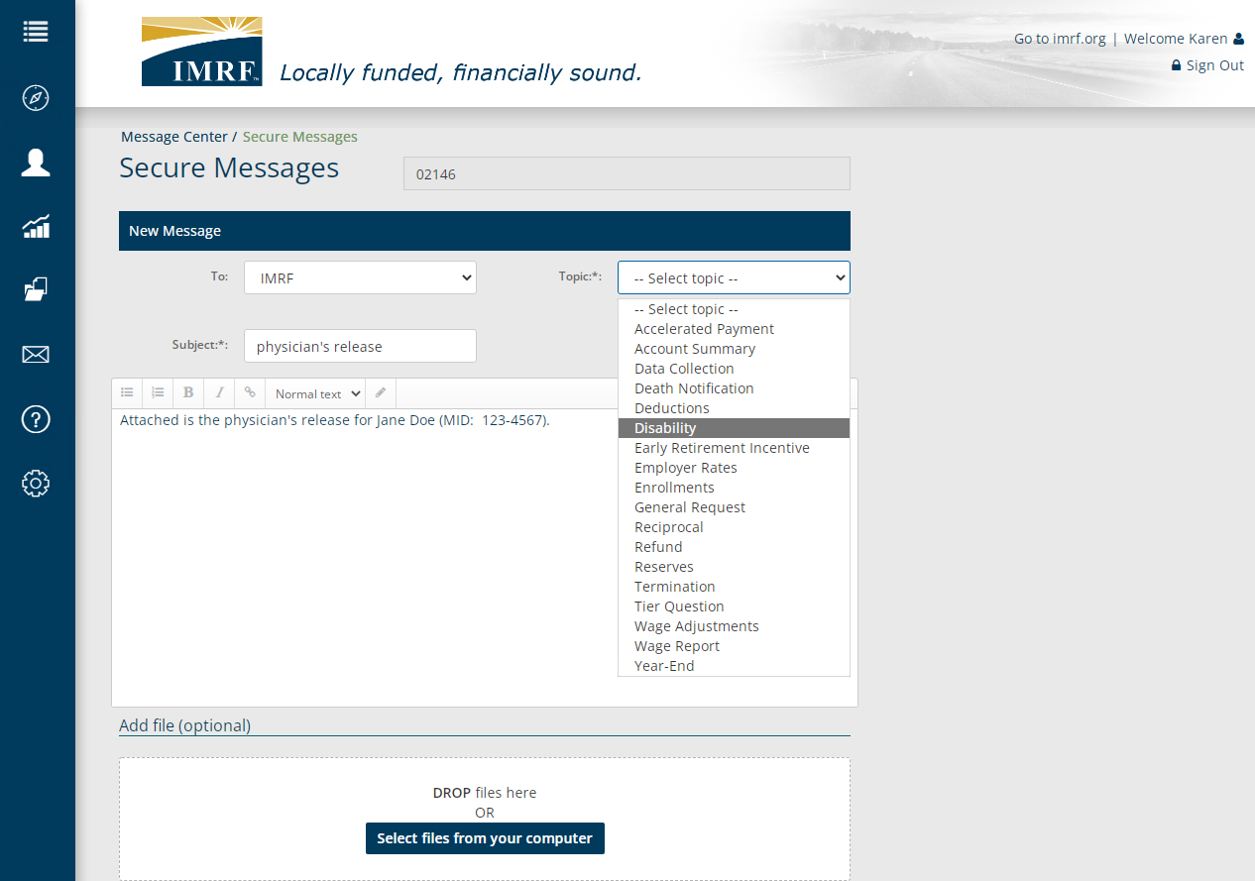
Upload Physician’s Release via Secure Message
Click envelope icon on the left toolbar to open a Secure Message
Select “Disability” as topic
Provide member name and MID
Attach copy of Physician’s Release
Submit
With the robust drop-down list, you’ll find that communicating through Secure Message is an efficient means of not only sending IMRF documents but also submitting questions on a variety of topics to our Employer Services Contact Center!
Notes:
To formally close a disability claim, IMRF requests a copy of the physician’s release. Most often, the release is a simple statement from the doctor written on their script notepad and includes a signature. To send IMRF a copy of the physician’s release, please (read text box)

Slide 12
Thank you for your time!
Any other questions?
Send questions via Secure Messaging
Or
Employer Contact Center:
1-800-728-7971
Notes:
Thank you for viewing. If you still have questions, please reach out to IMRF via Secure Message. You may also reach us by phone at 800-728-7971. Thanks again.

