Slide 1
Access Management: Resend Registration Email

Slide 2
Agenda
Access Management
Resend Registration Email
Navigating Access Management
Locating Team Member
Resend Registration Email

Slide 3
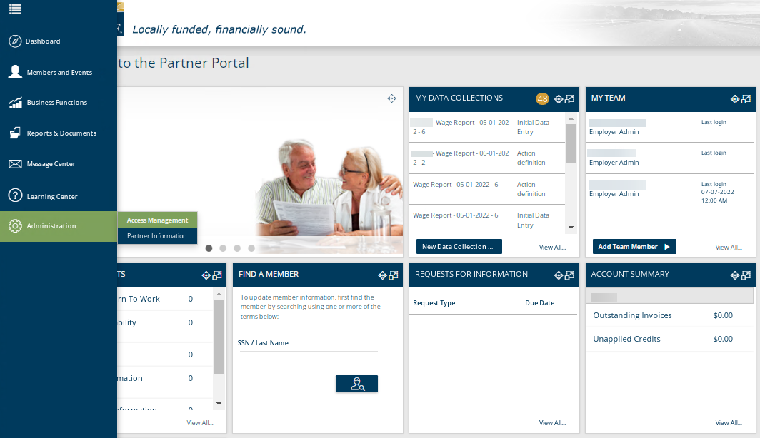
Employer Access – Access Management
The Access Management functionality is located on the Left-Hand Tool Bar under Administration. This functionality is also available from the Dashboard under the widget “My Team”.
Notes:
The Access Management functionality is located on the Left-Hand Tool Bar under Administration. This functionality is also available from the Dashboard under the widget “My Team”. If you use the Left-Hand Tool Bar or click View All in the widget, it will take you to a screen that lists all Team Members currently.

Slide 4
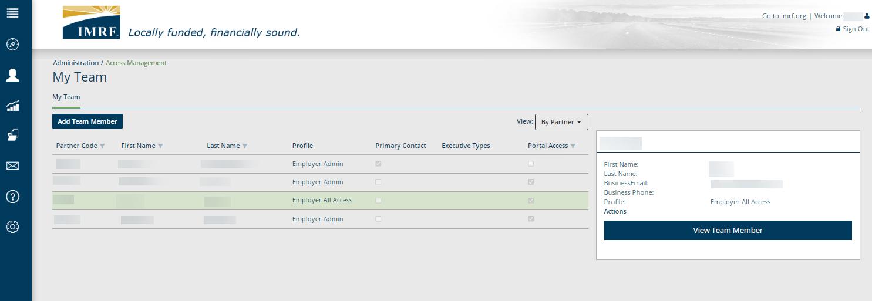
Employer Access – Access Management
Click the row with the Team Member that needs the registration email and click, View Team Member.
Notes:
On the My Team landing page it will display the current Team Members. Click on the row of the member that needs the registration email. To the right click View Team Member.

Slide 5
Employer Access – Access Management
Click Resend registration email. A confirmation that the email has been sent will appear at the top of the screen.
Notes:
The Team Member’s information is displayed on the screen. Select Resend registration email, a confirmation will show at the top of the screen that an email has been sent for the team member to complete the registration process.

Slide 6
Thank you for your time!
Any other questions?
Send questions via Secure Messaging
Or
Employer Contact Center:
1-800-728-7971
Notes:
Thank you for viewing. If you still have questions, please reach out to IMRF via Secure Message. You may also reach us by phone at 800-728-7971. Thanks again.

