Slide 1
Pensioner Return to Work Data Collection Add Record Manual Entry

Slide 2
Agenda
Pensioner Return to Work
Data Collection Overview
Data Collection Creation
Add Member Data
Validation Process
Review and Submit

Slide 3
Data Collection Overview
What is a Data Collection?
Information is sent in via Employer Access as a Data Collection using a new file format, Comma-separated Value or .CSV.
Filing is Simple, Fast, Easy and Web-Centric replacing 90% of all previous forms.
For smaller employers the Add Record Manual Entry is quick, it prompts the user for information, responds interactively to prevent errors, and creates the new file format that is then submitted to IMRF.
IMRF is asking for the information you supplied to us before and some new information. This allows the employer more control over the entire life cycle of their members from enrollment through retirement.
3
Notes:
What is a Data Collection ?
Information is sent in via employer Access as a Data Collection using a new file format, Comma-separated Value or .CSV.
Filing is Simple, Fast, Easy and Web-Centric replacing 90% of all previous forms. i.e., monthly wage report, wage adjustments, enrollments, terminations, disability, etc.
For smaller employers the Add Record Manual Entry is quick, it prompts the user for information, responds interactively to prevent errors, and creates the new file format that is then submitted to IMRF.
IMRF is asking for the information you supplied to us before and some new information. The new functionality allows the employer more control over the entire life cycle of their members from enrollment through retirement.

Slide 4
Pensioner Return to Work Overview
Things that will stay the same… | Things that are new…
Return to Work rules | Employers to report on a monthly basis the hours a pensioner worked
Separation of Service Rules
Notes:
The Return to Work rules and Separation of Service Rules will remain the same. What is new is now employers are to report on a monthly basis the hours a pensioner worked.

Slide 5
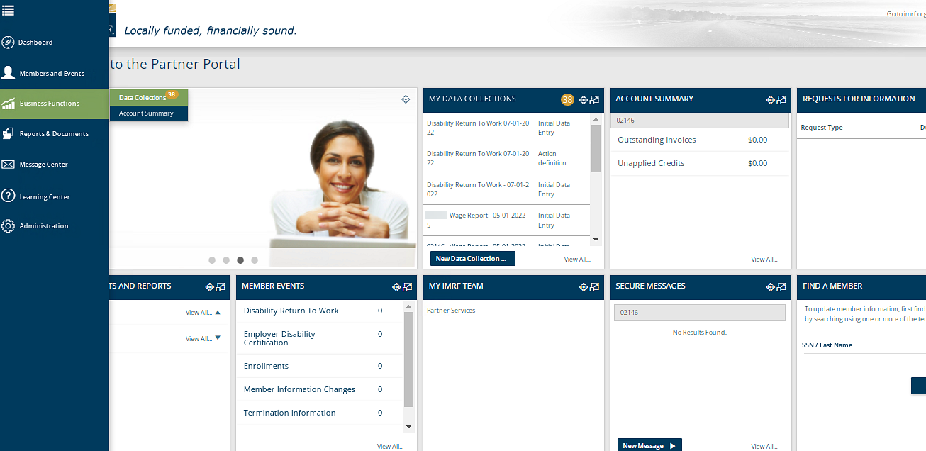
Create a Data Collection
To begin the process of entering a Pensioner Return to Work, a new Data Collection must be started.
Notes:
To process a Pensioner Return to Work, we need to create a Data Collection. Start the Data Collection by clicking the Business Functions icon on the left-hand toolbar and click Data Collections, that will take you to a screen displaying all Data Collections previously created or on the Dashboard under the widget “My Data Collections”, click New Data Collection to go directly to Step 1.

Slide 6
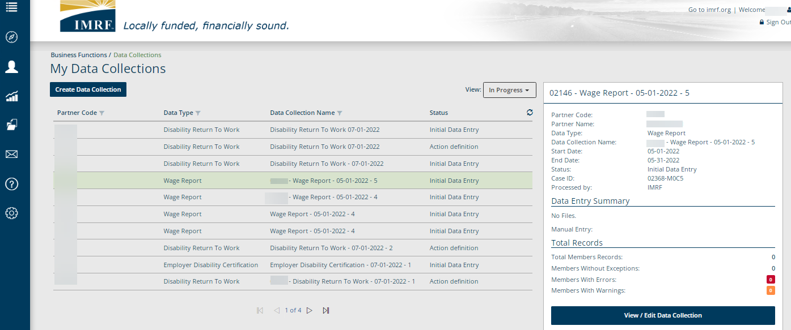
Click on Create Data Collection to proceed.
Data Collections previously created will be listed below with their status.
Click on row to highlight. View/edit already created Data Collections
Notes:
Click on Create Data Collection to begin the Pensioner Return to Work process. This screen also lists data collections that have previously been created. You can see the status by clicking on the drop-down menu next to view and it will show- In Progress, Completed or All. To View/Edit a data collection already created click on the row you want and to the right a brief summary window will open, click view/edit Data Collection.

Slide 7
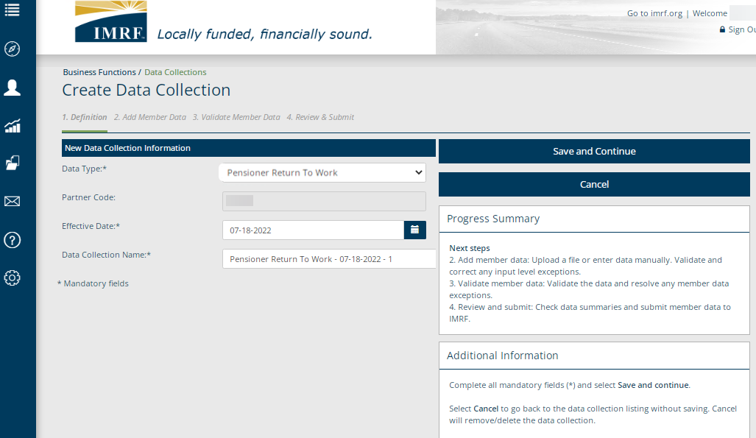
Data Collection Step 1. Definition
Select Pensioner Return to Work as the Data Type from the drop-down menu and complete all mandatory fields. Click Save and Continue to move to the next step in the process.
Notes:
We are now at Step 1 Definition. You will need to select Pensioner Return to Work as the Data Type from the drop-down menu. Enter Partner code, also known as, employer number, enter the effective date and the Data Collection Name, which will be prepopulated for your convenience.
Click Save and Continue to bring you to step 2. Add Member Data.

Slide 8
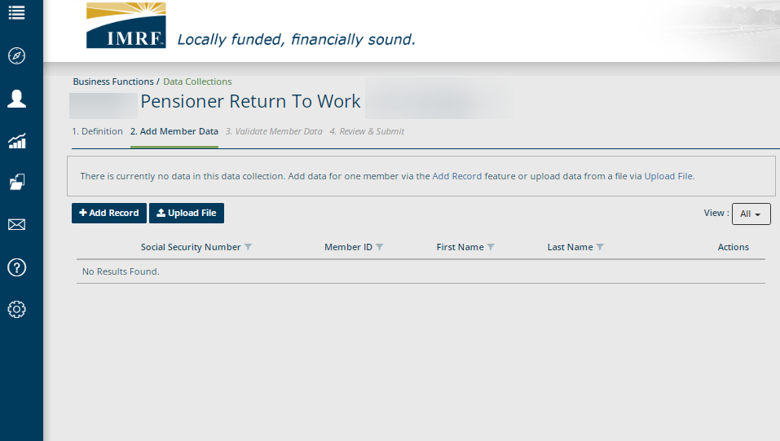
Data Collection Step 2: Add Member Data
Click Add Record to enter the member data.
Notes:
We are now at step 2- Add Member Data. Click Add Record and you will be directed to a screen to enter the Pensioner Return to Work information.

Slide 9
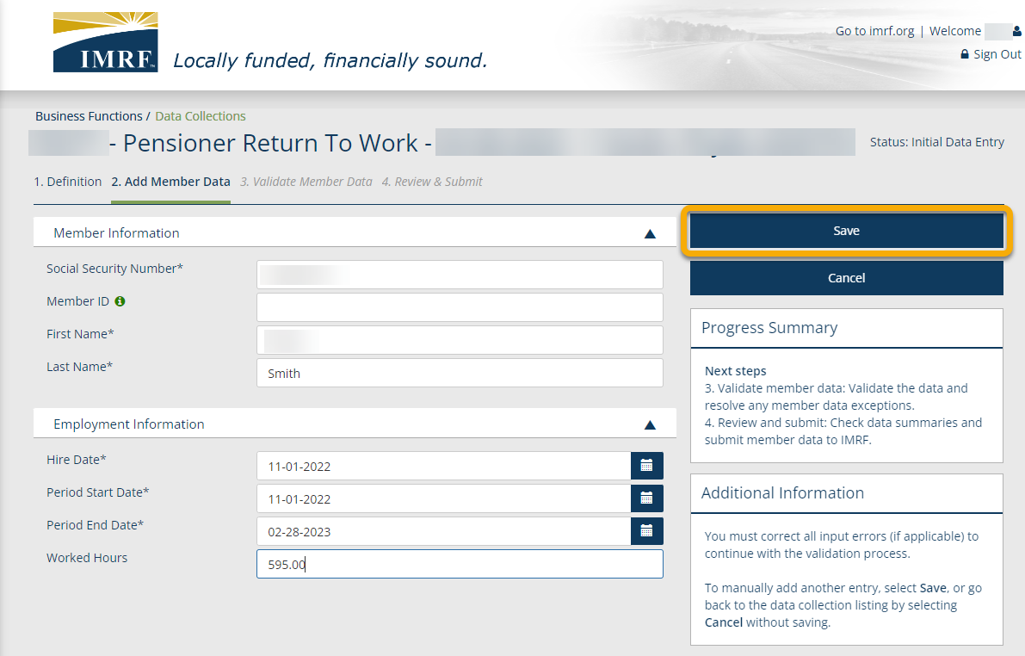
Data Collection Step 2: Add Member Data
Enter the Pensioner Return to Work information and click Save.
If you have multiple Pensioner Return to Work entries, after you click Save, select Add Record and repeat steps until all are entered.
Notes:
Enter the pensioners information and click Save. For worked hours make sure to use a decimal value for example 599.00.
If you have multiple Pensioner Return to Work entries to complete, after you click Save, select Add Record and repeat steps until all are entered.

Slide 10
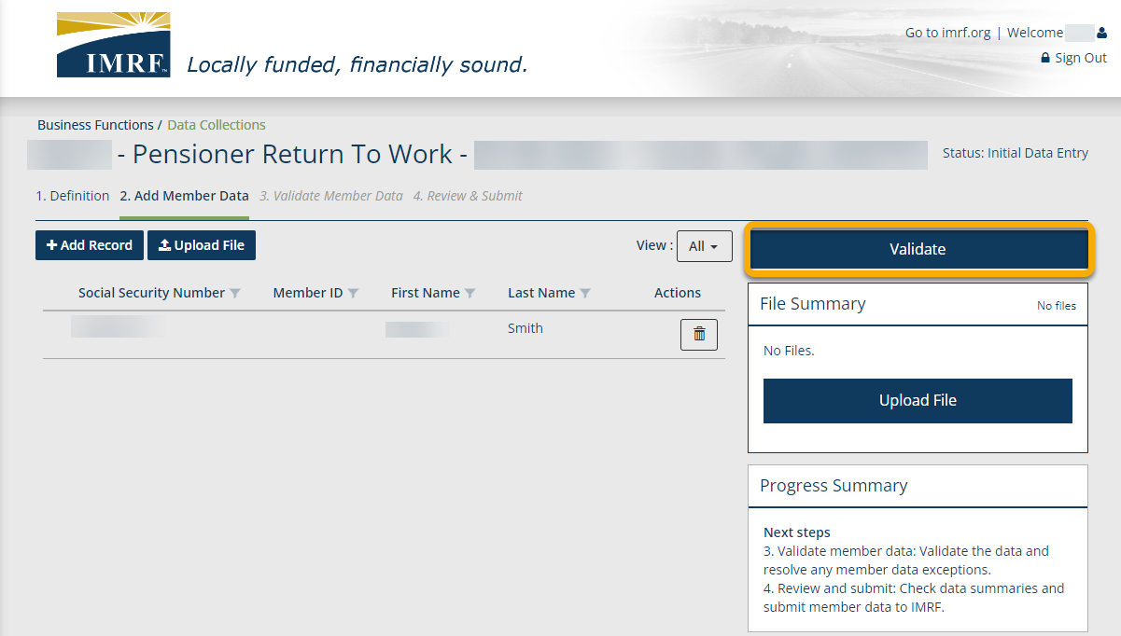
Data Collection Step 2: Add Member Data
Once you have all Pensioner Return to Work data entered, they will display on the screen. Make sure that the view is set to All to see them listed. Click Validate and this step will validate the information entered against formatting and business requirements to show any errors or warnings, if applicable.
All new members entered will display here.
Notes:
Once you have all Pensioner Return to Work data entered and saved, they will be displayed. Make sure that the view is set to All to see them listed. Click Validate and this step will validate the information entered against formatting and business requirements to show any errors or warnings, if applicable. By doing this it will bring us to Step 3. Validate Member Data.

Slide 11
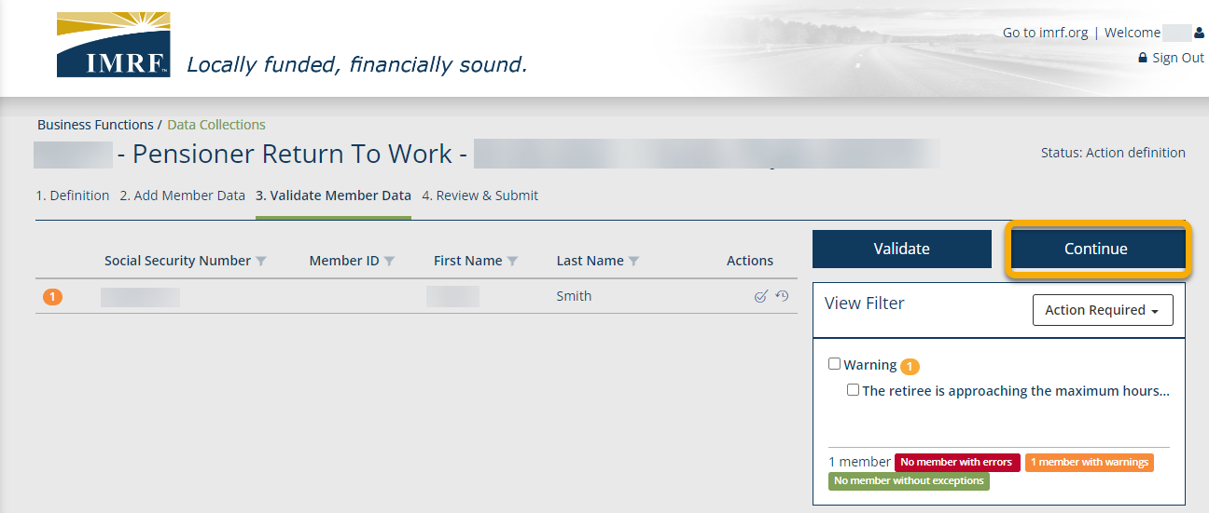
Data Collection Step 3. Validate Member Data
Resolve any errors or warnings that appear, if applicable. Once resolved or if you had no issues, you would see, No Results Found. Click Continue to Step 4. Review and Submit.
Notes:
Click on any errors or warnings to respond to them, if applicable. Once all have been resolved or no issues you will see, No Results Found, click Continue to Step 4. Review and Submit.

Slide 12
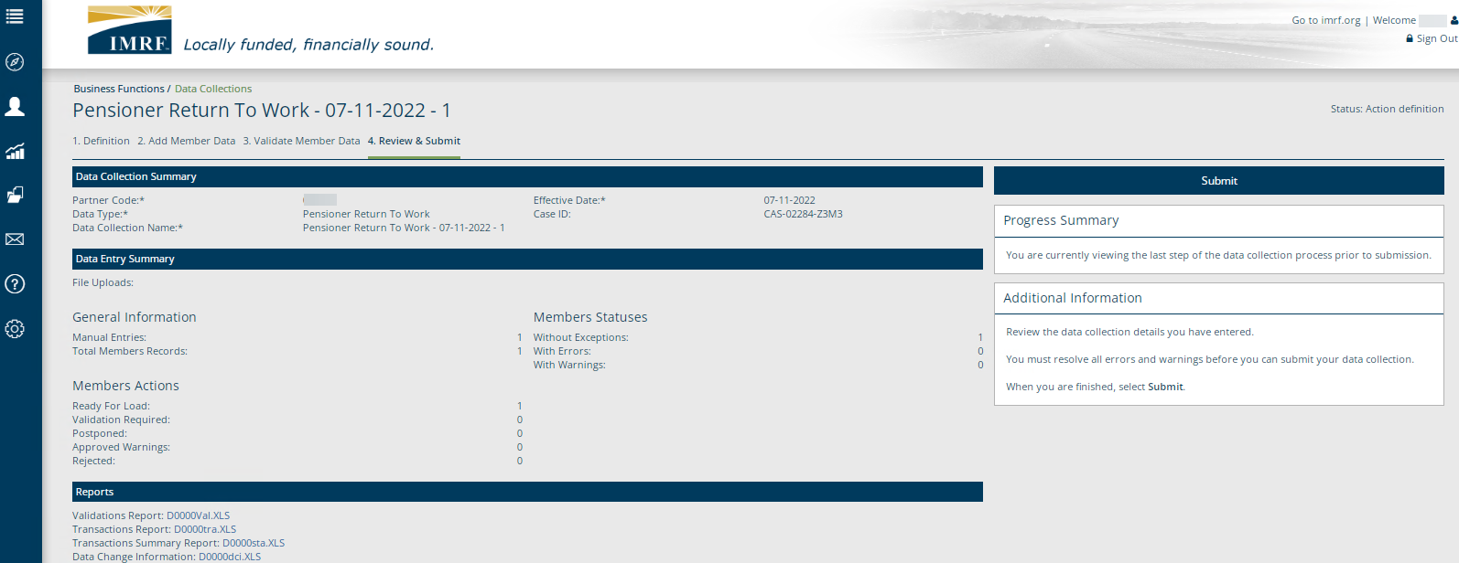
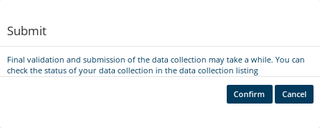
Data Collection Step 4: Review and Submit
Review the listed Data Collection and Data Entry Summary and Reports. Once review is complete, click Submit. A pop-up box will appear to confirm. Click Confirm and that will complete your Pensioner Return to Work Data Collection.
Notes:
We have reached the final step in the pensioner Return to Work Data Collection process, Step 4. Review and Submit. When you have reviewed the summaries and reports, click Submit, you will get a pop-up box to confirm. Click confirm and that will complete the process.

Slide 13
Thank you for your time!
Any other questions?
Send questions via Secure Messaging
Or
Employer Contact Center:
1-800-728-7971
Notes:
Thank you for viewing. If you still have questions, please reach out to IMRF via Secure Message. You may also reach us by phone at 800-728-7971. Thanks again.

