Slide 1
Employer Access: Register Employer Admin Login

Slide 2
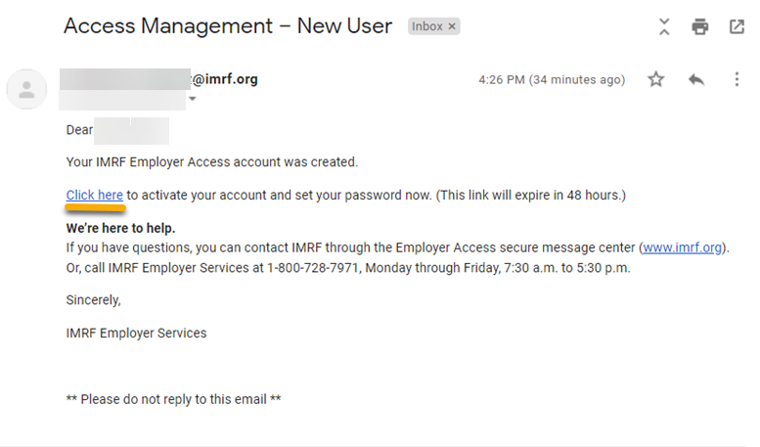
Click on Click here to begin the account registration process.
Notes:
For Employer Admins to activate the Employer Access account, you will receive an email with a secure link, click on Click Here in the email to be directed to the IMRF login page to register.

Slide 3
Sign in with your User ID the temporary password.
User ID is your business email address.
Notes:
The link brings you to the IMRF Portal Log in screen to use your business email as the User ID and the temporary password to Log In.

Slide 4
Set up a unique password.
Notes:
You will be asked to set up a unique password.
Password must include between 10 and 30 characters, 1 upper case letter, 1 lower case character, 1 number and 1 special character.

Slide 5
5
Choose security questions to answer in the event you forget your password.
Notes:
After you have selected a Password, you will then be asked to set up 3 security questions from a list. You can click on the modify drop down arrow to show the options of questions. Click Next when complete.
The system uses these questions and answers if you forget your password and need to reset.
You only need to select questions and answers upon initial login.

Slide 6
Confirm security questions and click Save.
Notes:
To confirm your security questions, click the Save button.

Slide 7
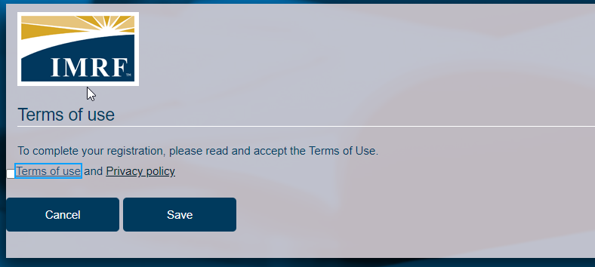
7
Read and accept the Terms of Use, click Save.
Click Continue to have access to the portal.
Notes:
To complete the registration process, please read and accept the Terms of Use. Click Save. Once that is done you will see the terms of use accepted successfully. Click Continue to have access to the portal.

Slide 8
Thank you for your time!
Any other questions?
Send questions via Secure Messaging
Or
Employer Contact Center:
1-800-728-7971
Notes:
Thank you for viewing. If you still have questions, please reach out to IMRF via Secure Message. You may also reach us by phone at 800-728-7971. Thanks again.

