Slide 1
Employer Access: How To Change Security Questions

Slide 2
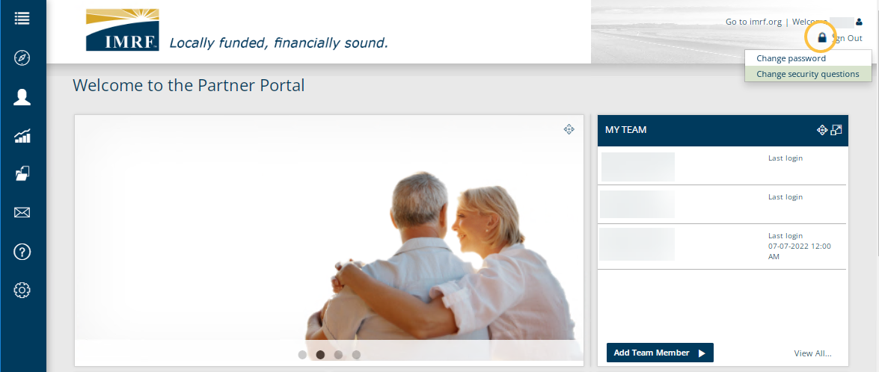
To change your security questions, click the Lock Icon and select change security questions.
Notes:
To change Security questions, from the dashboard in the upper right corner, click on the Lock Icon and select ‘Change Security Questions’.

Slide 3
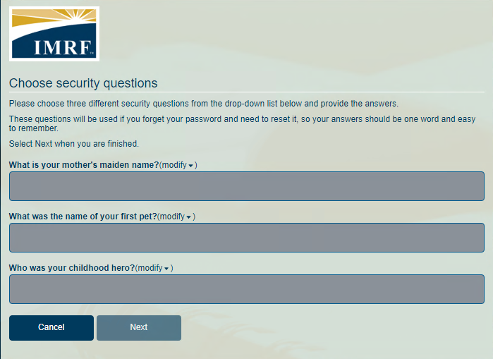
Choose Security Questions from the drop-down list and provide answers. Click Next.
Notes:
Next to each question select Modify to choose the security question, then provide an answer for each one. Click ‘Next’

Slide 4
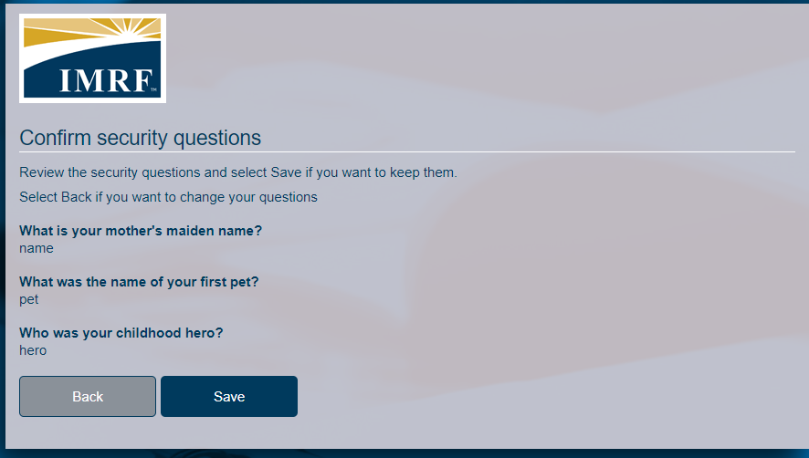
Confirm security questions
Review security questions and answers.
Click Save to keep them.
Click Back to change them.
Notes:
Confirm your security questions and answers. To keep them, click Save. If you would like to change your questions, click back and select again.

Slide 5
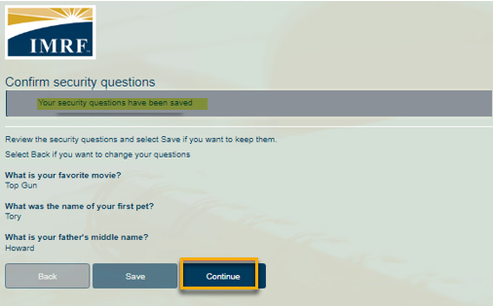
Confirmation that your security questions have been saved will appear at the top. Click Continue to go to the dashboard.
Notes:
Confirmation that your security questions have been saved will appear at the top. Click Continue to go back to the dashboard.

Slide 6
Thank you for your time!
Any other questions?
Send questions via Secure Messaging
Or
Employer Contact Center:
1-800-728-7971
Notes:
Thank you for viewing. If you still have questions, please reach out to IMRF via Secure Message. You may also reach us by phone at 800-728-7971. Thanks again.

